Slide 1
A Rare Case of Primary Cardiac Lymphoma and The Role of Early Surgical Debulking: a Case Report
September 2018
EHJ-CR-D-18-00163R2

Slide 2
Introduction
Primary cardiac lymphoma (PCL) : rare extra-nodal lymphoma involving only the heart and/or the pericardium.¹
More common among immunocompromised patients with male predominance.^{2,3}
Its non-specific cardiac manifestations often delay diagnosis, resulting in poor prognosis.^{2,3}

Slide 3
Case Presentation
History and Examination Findings
Patient was a 73-year-old male.
Chief complaint: worsening dyspnoea on exertion for 2 months.
      1 month ago: Patient lost weight (10 kg).
      1 week ago: Patient had 2 episodes of syncope.
Drug history: aspirin, metformin, bisoprolol, candesartan, and atorvastatin.

Slide 4
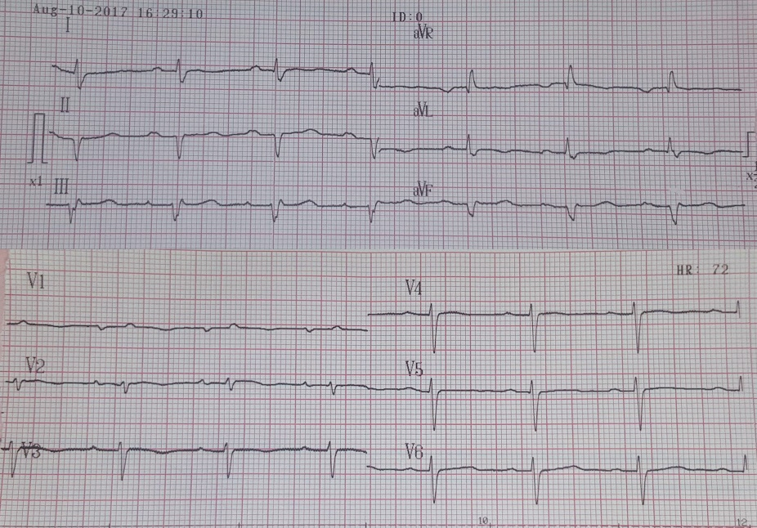
Case Presentation
Investigations
Laboratory results
      Anaemia with Hb of 11.7 g/dL (13.0-16.0).
      Leukocytosis with leukocyte of 10.210x10³/μlitre (5-10).
12 lead ECG (Fig. 1)
      LAD
      low QRS voltage in V1 and V2
      1st grade AV block
      P mitrale
Figure 1. Preoperative ECG showing LAD, low QRS voltage in V1 and V2, 1st grade AV block, and P mitrale

Slide 5
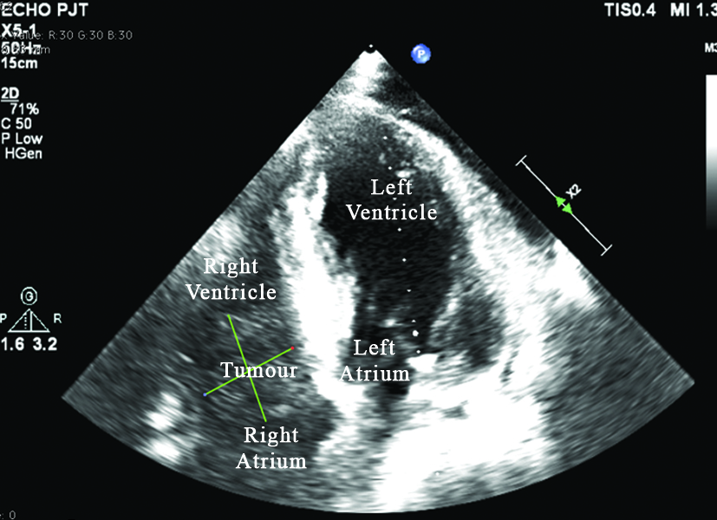
Case Presentation
Investigations
Chest radiograph
      Cardiomegaly
      Elongated and calcified aorta
TTE (Fig.2)
      Sessile intracardiac tumour from RA to RV, traversing TV
      Mild MR, AR, AS
      Large pericardial effusion (21.6 mm)
      Preserved EF (59.1%)
Figure 2. Echocardiography showing tumour extending from RA to RV through the TV.

Slide 6
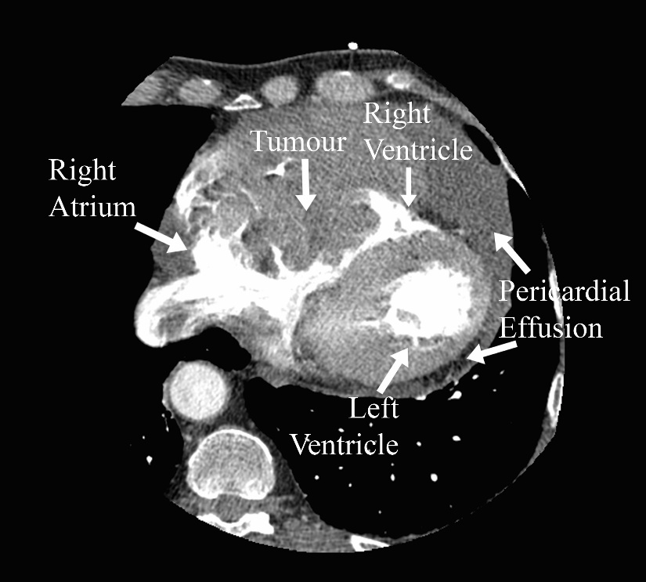
Case Presentation
Investigations
Multi-slice CT Coronary Angiogram (Fig. 3)
      Calcified plaque in LAD, RCA, LMS, LCX.
      7.2x10.2 cm intramural tumour RA-RV with tissue density and few necrotic areas, affecting TV and RCA.
      Multiple lymphadenopathy on stations 4L, 5, and 6.
      25 mm pericardial effusion.
Figure 3. MSCT showing a tumour at right atrioventricular region.

Slide 7
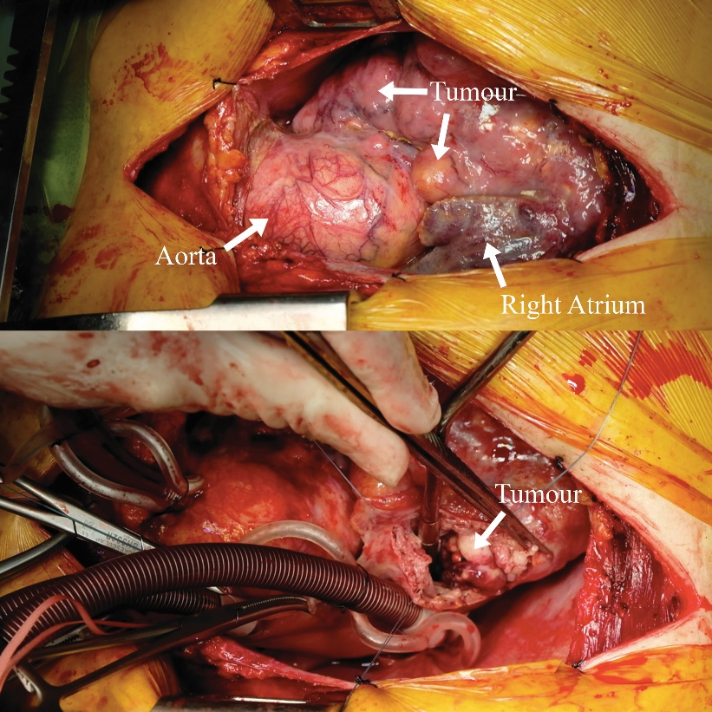
Case Presentation
Management
Surgical debulking and biopsy was done.
Tumour appeared globular, yellowish white in colour, with unclear border, and did not bleed easily (Fig. 4).
Debulking was performed until the TV became visible.
The annulus appeared dilated and the chordae were ruptured
Valve repair with anterior-septal commisuroplasty and De Vega’s procedure was done.
Figure 4. Intraoperative pictures of the tumour

Slide 8
Case Presentation
Management
Cytological examination of the resected specimen demonstrated diffuse large B-cell lymphoma (DLBCL).
According to the Ann Arbor staging of non-Hodgkin lymphomas, the patient was classified as stage IV-B DLBCL.
No dyspnoea was reported postoperatively.
Patient was referred to internal medicine department for chemotherapy but refused further treatment and chose palliative home care instead.
He died 44 days after surgery.

Slide 9
Discussion
PCL is more commonly found among immunocompromised patients with male predominance and usually affects the right chambers of the heart.^{2,3}
      These characteristics correspond with our patient's.
Due to tumour’s size and extension, surgical debulking was done.
      Debulking has shown to improve haemodynamics and prevent sudden death due to arrhythmia or tumour emboli.⁴

Slide 10
Discussion
  After surgery, patient's symptoms were improved and diagnosis of DLBCL was confirmed.
  Chemotherapy with main regimen of CHOP with or without radiotherapy could improve PCL patients’ prognosis.^{2,3,5}
  Meanwhile, total surgical resection is difficult and is not proven to increase survival.^{2,3,5}
      Therefore, we referred our patient to internal medicine department.

Slide 11
Learning Points
Early diagnosis is crucial in PCL cases as its non-specific symptoms often lead to delayed diagnosis and poor prognosis.
Early surgical debulking should be considered to improve symptoms, prevent sudden death, and confirm diagnosis in PCL cases with concerning tumour size and symptoms due to cardiac obstruction.

Slide 12
References
Travis WD, Marx A, Brambilla E, Nicholson A, Burke A. WHO classification of tumours of the lung, pleura, thymus and heart. Lyon: IARC; 2015. p. 340–1.
Miguel CE, Bestetti RB. Primary cardiac lymphoma. Int J Cardiol. 2011;149:358-63.
Petrich A, Cho SI, Billett H. Primary cardiac lymphoma an analysis of presentation, treatment, and outcome patterns. Cancer. 2011.117:581-9.
Habertheuer A, Ehrlich M, Wiedemann D, Mora B, Rath C, Kocher A. A rare case of primary cardiac B cell lymphoma. J Cardiothoracic Surg. 2014;9:14.
Yanase Y, Yamauchi A, Uehara M, Tachibana K, Muraki S, Takagi N, et al. Surgical resection of primary cardiac lymphoma presenting as a huge mass: report of two cases. Gen Thorac Cardiovasc Surg. 2012;60:494-7.

