Slide 1
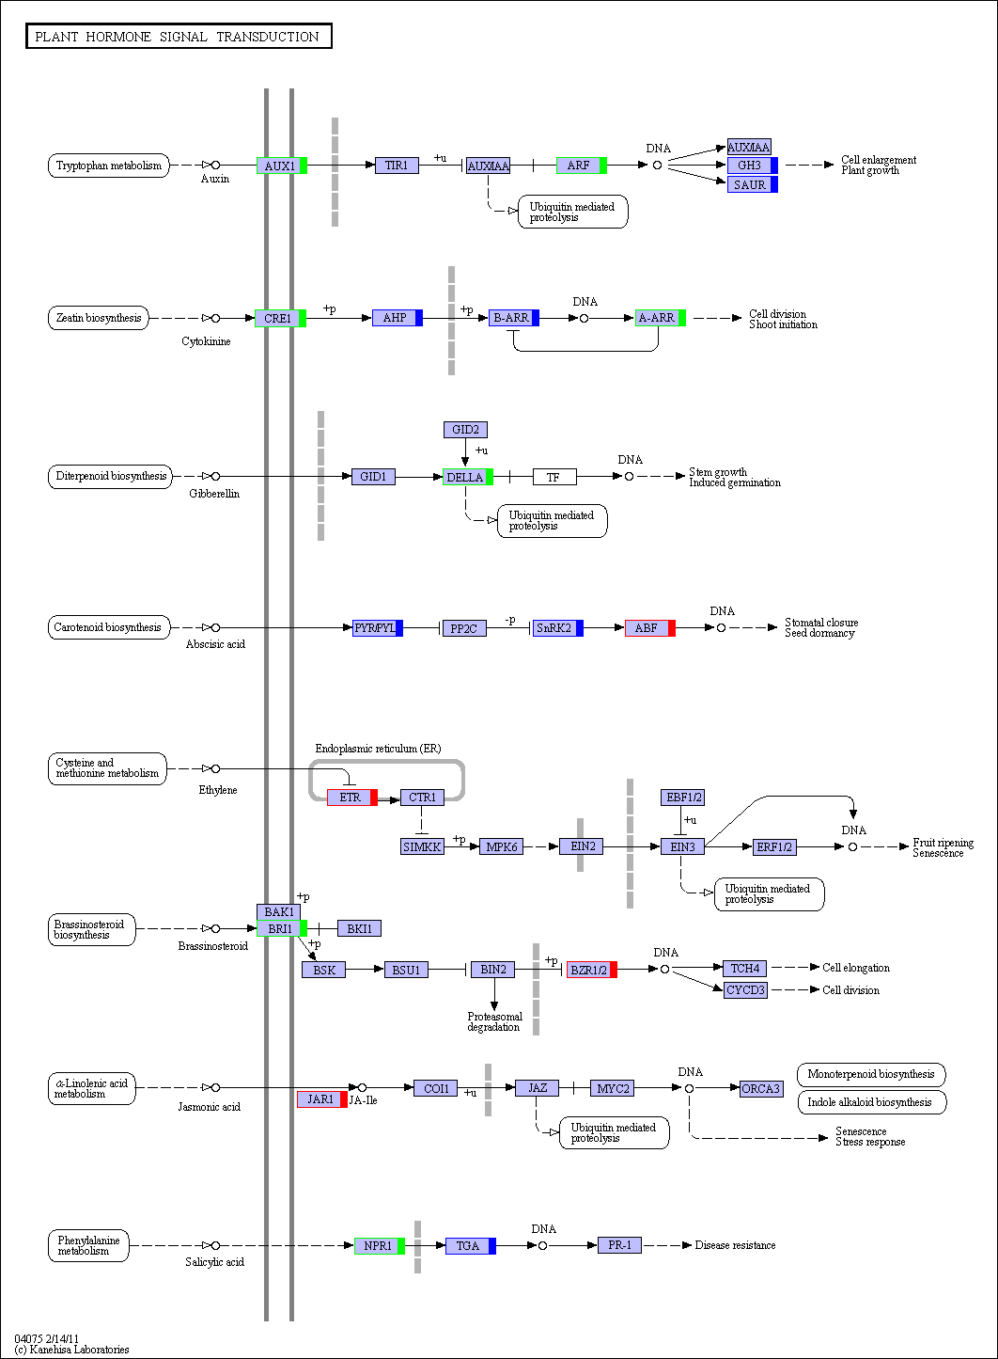
S1 Fig. KEGG pathway analysis identified the plant hormone signal transduction (ko04075) for DEGs between 5 DAP and 14DAP. Red, green and blue indicate genes expression increase, decrease and mixed change at 14 DAP, respectively.

