Slide 1
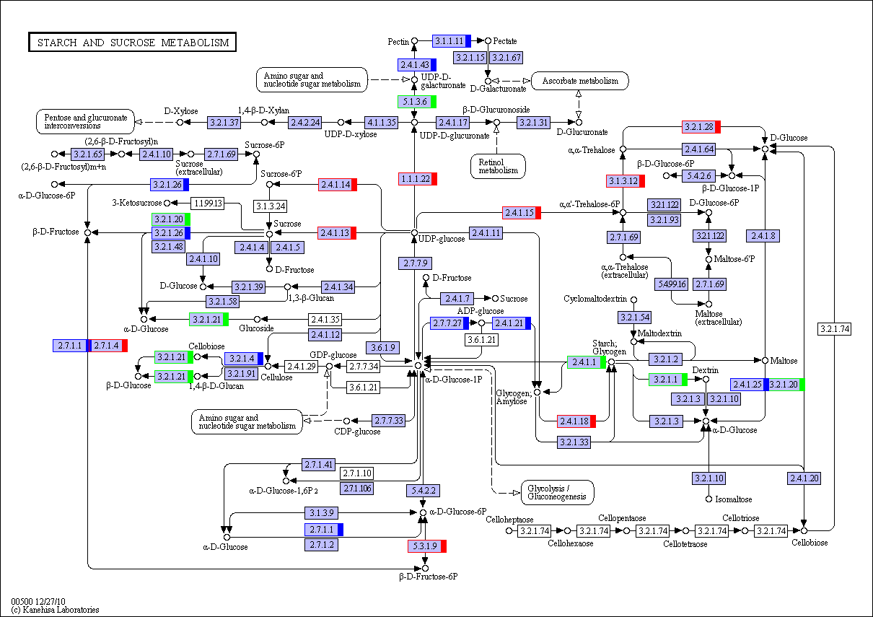
S2 Fig. KEGG pathway analysis identified starch and sucrose metabolism (ko00500) for DEGs between 5 DAP and 14DAP. Red, green and blue indicate genes expression increase, decrease and mixed change at 14 DAP, respectively.

