Slide 1
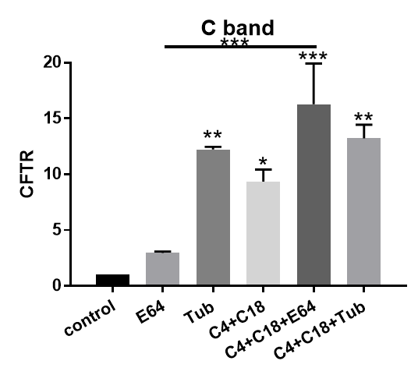
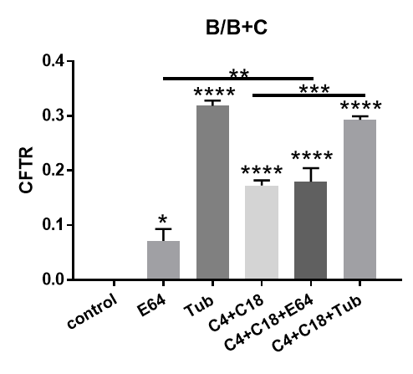
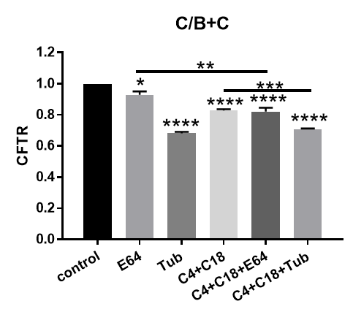
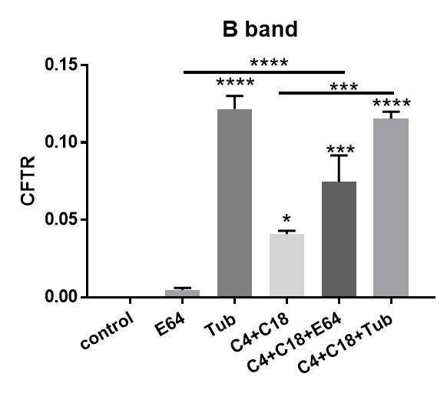
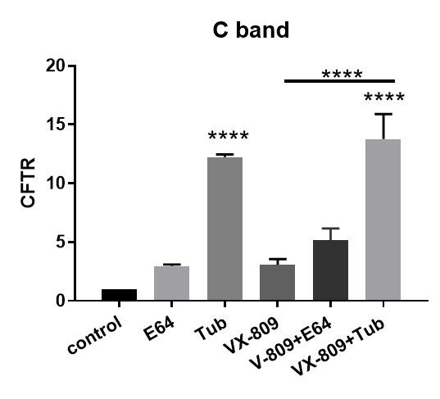
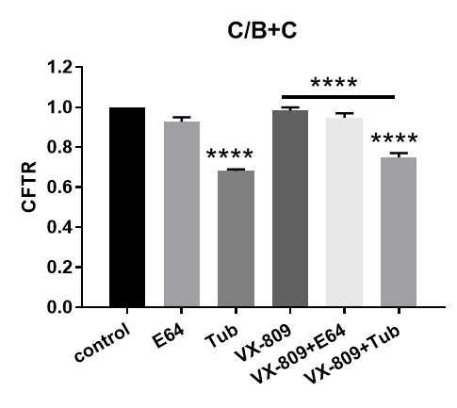
Expression of CFTR in CFBE 41o⁻ WT CFTR cells
(A)
WT CFTR
Control
E64
Tuba
C4+C18
C4+C18
+E64
C4+C18
+Tuba
VX809
VX809
+E64
VX809
+Tuba
C Band
B Band
150
GAPDH(36)
38
(B)
(D)
(F)
(H)
(C)
(E)
(G)
(I)
Supplemental Figure 1

Slide 2
Supplemental Figure 1: The degradation of WT-CFTR. (S1A) Western blot of CFBE41o- cells stably expressing wt-CFTR (lane 1). Note that wt-CFTR protein is present most as the C band. E64 treatment alone (lane 2) has small effect on wt-CFTR steady-state protein levels, suggesting that the lysosome plays a small role in the degradation of wt-CFTR. Tubacin treatment alone (lane 3) increases wt-CFTR steady-state protein levels. Note that the combination of correctors C4+C18 increases band B and C of wt-CFTR (lane 4) and shows considerable synergy when combined with E64 (lane 5), Interesting tubacin in combination with the correctors C3+C4 increases the steady state levels of wt-CFTR compared to the corrector combination treatment alone (lane 6). VX-809 treatment in contrast has a smaller effect on wt-CFTR compared to the corrector combination C4+C18 when applied alone (lane 7) but does show an increase in combination with E64 (lane 8) or tubacin (lane 9). Summary data are normalized to the absence of treatment (S1C-I). (S1B&C) depict the B and (S1D&E) the C band summary data respectively. Data are also represented as the ratio of B/B+C (S1F&G) or C/B+C (S1H&I). Note that treatment with combination of correctors C4+C18 alone or together with E64 or tubacin increases both B and C band expression and lower the ratio of the C relative to the total B+C bands indicating that an increase in B band preferentially over the C band. In contrast there was an increase in the amount of B band relative to the total of B+C bands.

Slide 3
Expression of LC3 in CFBE 41o⁻ WT CFTR cells
WT CFTR
C4+C18
+E64
C4+C18
+Tuba
VX809
+E64
VX809
+Tuba
Control
E64
Tuba
C4+C18
VX809
LC3-I
(A)
LC3-II
GAPDH
(B)
(D)
***
**
****
****
****
****
**
****
****
*
*
(C)
(E)
Supplemental Figure 2

Slide 4
Supplemental Figure 2: Autophagy and WT-CFTR. (S2A). Western blot of LC3 I&II measured in CFBE41o- cells stably expressing WT-CFTR (Lane1). Note that treatment with E64 (lane2), or tubacin (Lane3) has a significant effect on the ratio of LC3II/I (S2B & D) and on the absolute amount of LC3-II (S2C&E). Treatment with the combination of C4+C18 (lane4) has a significant effect on the LC3II/I ratio (S2B) but not on the absolute amount of LC3II (6C). In contrast, following treatment with the combination of correctors and E64 (lane 5) there is a significant increase in and the LC3II/I ratio (S2B) and the absolute amount of LC3II (S2C). Tubacin treatment has an effect in combination with C4+C18 (lane6). VX-809 has a similar effect compared to the combination of correctors (lane 6-8) (S2C-D). Data are normalized to the absence of treatment Data are expressed as the mean ± SEM of 3 independent experiments. Methods as described for Figure 1.

Slide 5
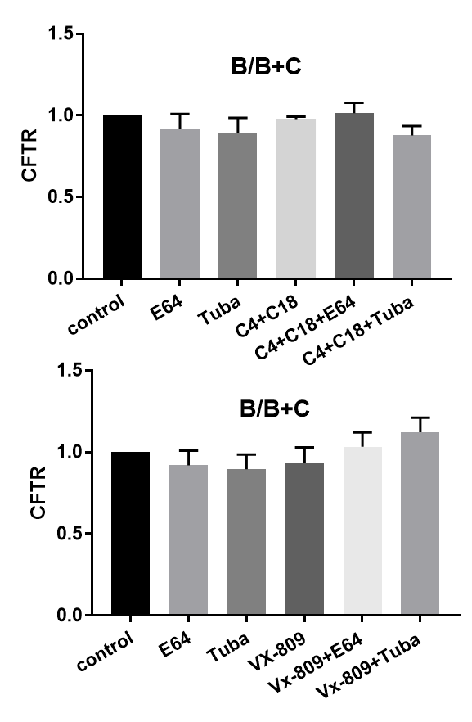
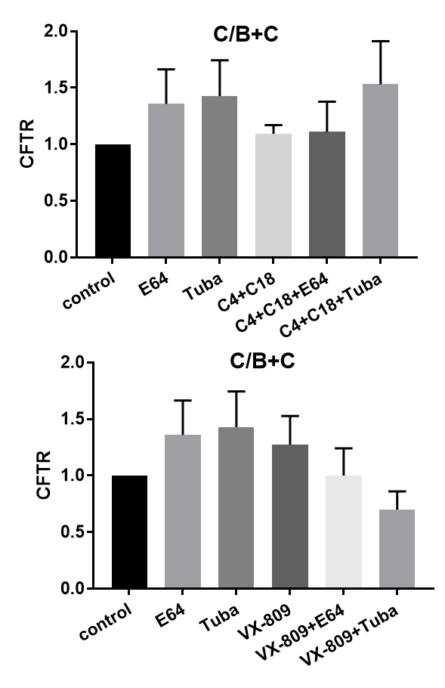
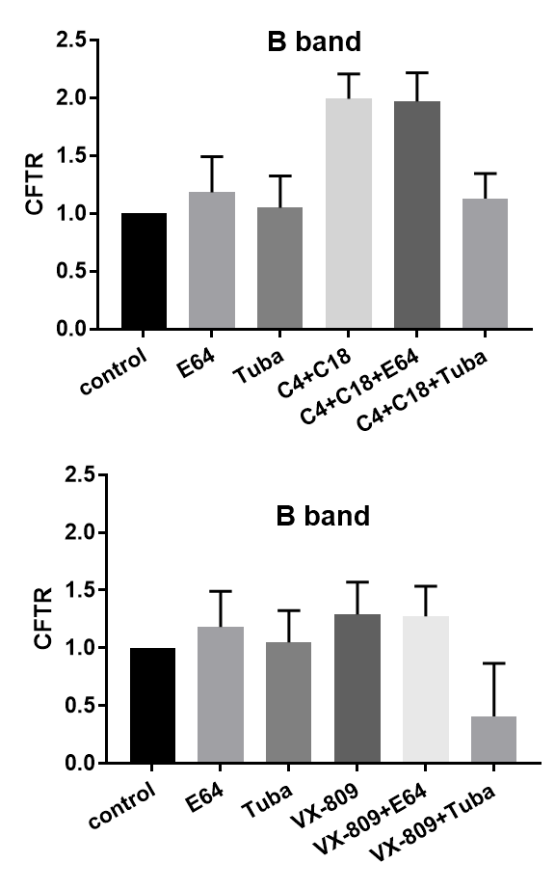
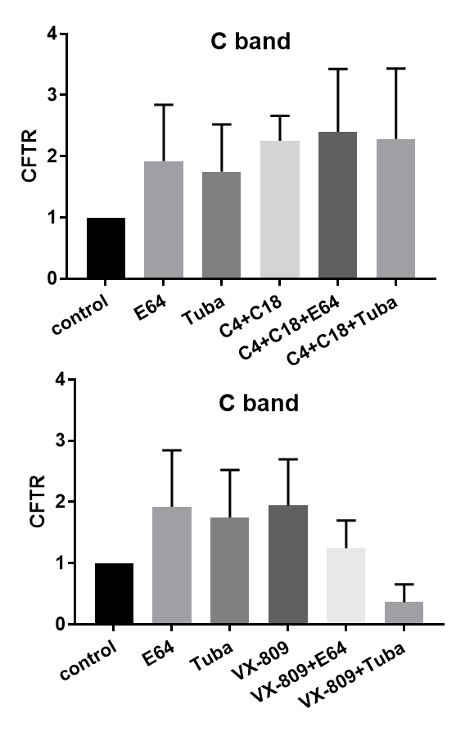
Expression of CFTR in parental CFBE 41o⁻ cells
C4+C18
+E64
C4+C18
+Tuba
VX809
+E64
VX809
+Tuba
(A)
CFBE 41o⁻
Control
E64
Tuba
C4+C18
VX809
CFTR
150
GAPDH(36)
38
(B)
(D)
(F)
(H)
(E)
(G)
(I)
(C)
Supplemental Figure 3

Slide 6
Supplemental Figure 3: Parental CFBE41o- cells. (S3A) Western blot of parental CFBE41o- cells which express an exceedingly small amount of ΔF508-CFTR (lane 1). Note that ΔF508-CFTR protein is present mostly as the B band. Although small changes in B band can be noted amount the groups: E64 treatment alone (lane 2), tubacin treatment alone (lane 3); combination of correctors C4+C18 (lane 4); C4+C18 combined with E64 (lane 5); tubacin in combination with the correctors C3+C4; (lane 6); VX-809 treatment (lane 7) or in combination with E64 (lane 8) or tubacin (lane 9); the effects are not statistically significant most likely because of the small qualities of CFTR are below the level of reliable detectability. Summary data are normalized to the absence of treatment (S3C-I). (S3B&C) depict the B and (S3D&E) the C band summary data respectively. Data are also represented as the ratio of B/B+C (S3F&G) or C/B+C (S3H&I).

Slide 7
Expression of LC3 in parental CFBE 41o- cells
CFBE 41o⁻
Control
E64
Tuba
C4+C18
C4+C18
+E64
C4+C18
+Tuba
VX809
VX809
+E64
VX809
+Tuba
LC3-I
17
(A)
LC3
LC3-II
GAPDH(36)
38
(D)
(B)
**
**
***
****
***
***
*
***
*
**
*
(C)
(E)
Supplemental Figure 4

Slide 8
Supplemental Figure 4: Autophagy and Parental CFBE41o- cells. (S4A). Western blot of LC3 I&II measured in parental CFBE41o- cells (lane 1). Note that treatment with E64, or tubacin (lanes 2-3) has a significant effect on the ratio of LC3II/I (S4B) with much less relative effect on the absolute amount of LC3-II (lanes 1-4) (S4C). In contrast, following treatment with the combination of correctors and E64 (lane 5) there is a significant increase in the LC3II/I ratio (S4C) and absolute amount (S4C) of LC3II. Tubacin treatment has a small effect in combination with C4+C18 (lane 6) (S4B-C). VX-809 has a similar albeit smaller effect compared to the combination of correctors (lane 7-9) (S4D-E). Data are normalized to the absence of treatment. (S4B-C). Data are expressed as the mean ± SEM of 3 independent experiments. Methods as described for Figure 1.

