Slide 1
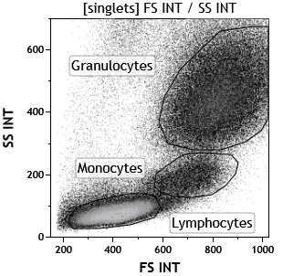
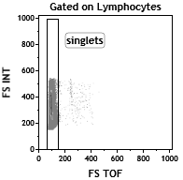
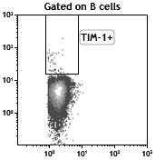
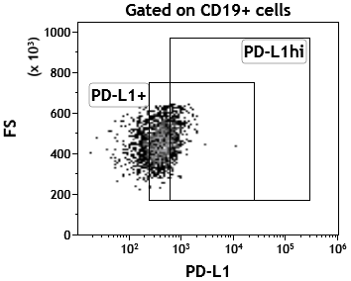
S2 Fig
A
Whole blood Labeling
CD4
CD19
B
Whole blood Labeling: gated on CD19+
(i)
(ii)
(iii)
(iv)
CD24
CD24
TIM-1
FS
CD38
CD27
CD19
PD-L1

