Slide 1
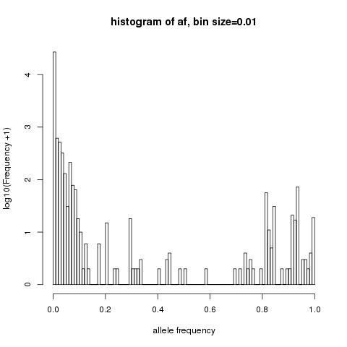
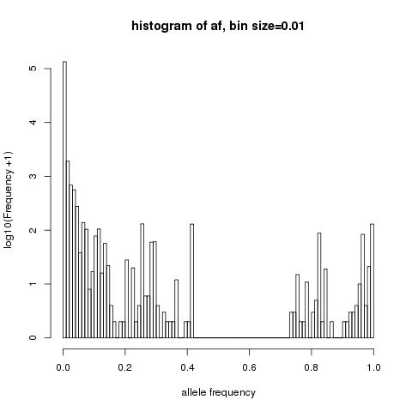
Non-reference variant frequency histogram
Histograms showing log10(frequency+1) of non-reference alleles compared to the H37rv reference for a lineage 2 and b lineage4.
a
b

