Slide 1
Supplemental Figure 1.
kD
6 and 24 h PCNA
70
55
40
35
25
A: Acetaminophen; Veh: DMSO vehicle; FSG: FSG67.
Supplemental Figure 1.
Mice were treated with 300 mg/kg APAP at 0 h followed by either DMSO vehicle (Veh) or 20 mg/kg FSG67 (FSG) at 2, 24, and 48 h. Blood and liver tissue were collected at 6, 24 and 52 h. Immunlot for PCNA at 6 and 24 h. Pooled samples from control (vehicle-only; Ct) mice was included for reference.

Slide 2
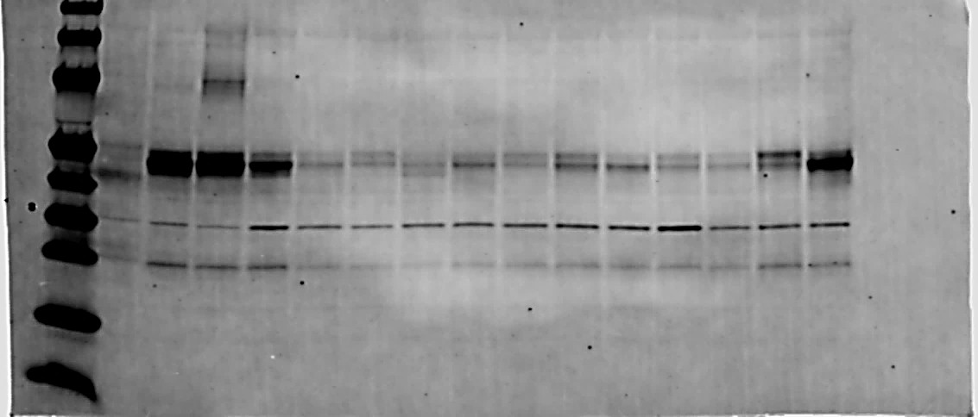
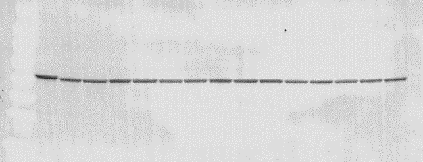
Supplemental Figure 2A.
PCNA and β-actin full blots for Fig. 2.
6 h
24 h
52 h
C
AV
AF
AP+Veh
AP+FSG
AP+Veh
AP+FSG
70
55
40
PCNA (35 kD)
35
25
β-actin
p-GSK3β and GSK3β full blots for Fig. 4
70
55
40
35
25
70
55
40
35
25
A, AP, APAP: Acetaminophen; DMSO: DMSO vehicle; FSG: FSG67.
Supplemental Figure 2A.
Mice were treated with 300 mg/kg APAP at 0 h followed by either DMSO vehicle or 20 mg/kg FSG67 at 2, 24, and 48 h. Blood and liver tissue were collected at 6, 24 and 52 h. Immunoblots for PCNA, p-GSK3β, and total GSK3β.

Slide 3
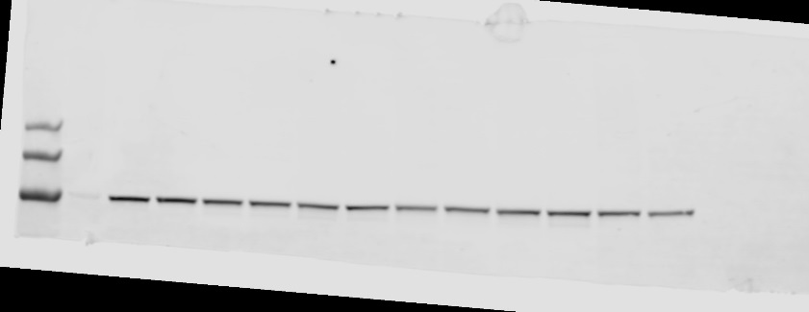
Supplemental Figure 2B Continued.
β-catenin and β-actin full blots for Fig. 5.
C
APAP+DMSO
APAP+FSG67
APAP+DMSO
APAP+FSG67
180
130
100
PCNA (94 kD)
β-actin
Supplemental Figure 2B.
Mice were treated with 300 mg/kg APAP at 0 h followed by either DMSO vehicle or 20 mg/kg FSG67 at 2, 24, and 48 h. Blood and liver tissue were collected at 6, 24 and 52 h. Immunoblots for PCNA and β-actin.

Slide 4
Supplemental Figure 3.
PCNA and β-actin full blots for Fig.6.
APAP+Veh
APAP+FSG67
APAP+FSG67
+GSK3i
70
55
40
35
PCNA (35 kD)
25
β-actin
APAP+Veh
APAP+FSG67
APAP+FSG67
+GSK3i
70
55
40
PCNA (35 kD)
35
25
β-actin
Supplemental Figure 3.
Mice were treated with 300 mg/kg APAP at 0 h followed by either DMSO vehicle or 20 mg/kg FSG67 at 2, 24, and 48 h. Blood and liver tissue were collected at 52 h. Immunoblots for PCNA and β-actin.

