Slide 1
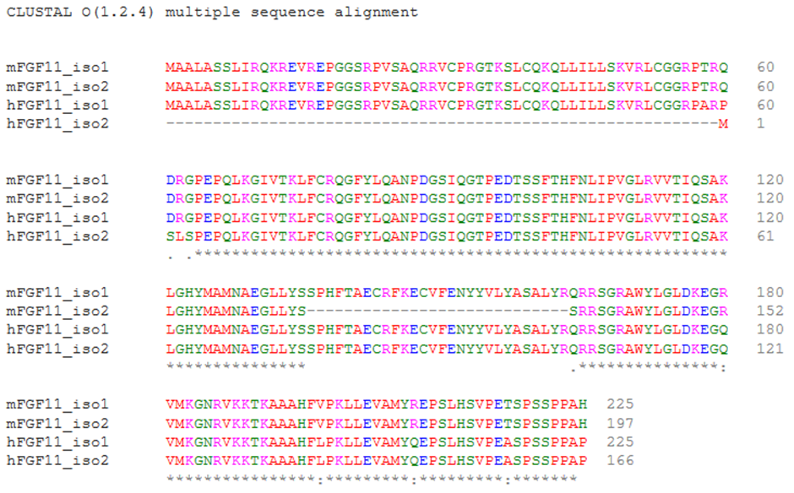
Supplementary Figures
Fig. S1. Multiple amino acid sequence alignment of mouse and human FGF11 isoforms
For comparison, human FGF11 isoform 1 (hFGF11_iso1, NP_004103.1), human FGF11 isoform 2 (hFGF11_iso2, NP_001290389.1), mouse FGF11 isoform 1 (mFGF11_iso1, NP_001349552.1), and mouse FGF11 isoform 2 (mFGF11_iso2, NP_001278033.1) were included in the alignment using Clustal Omega (https://www.ebi.ac.uk/Tools/msa/clustalo/).

