Slide 1
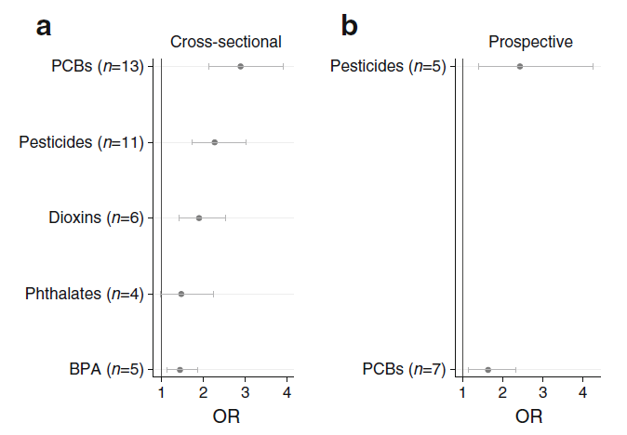
Summary of a meta-analysis of available cross-sectional and prospective studies on the association between environmental contaminants and diabetes published in 2016 by Song et al
PM Lind and L Lind (2018) Diabetologia DOI 10.1007/s00125-018-4621-3
© The Authors 2018. Distributed under the terms of the CC BY 4.0 Attribution License (http://creativecommons.org/licenses/by/4.0/)

