Slide 1
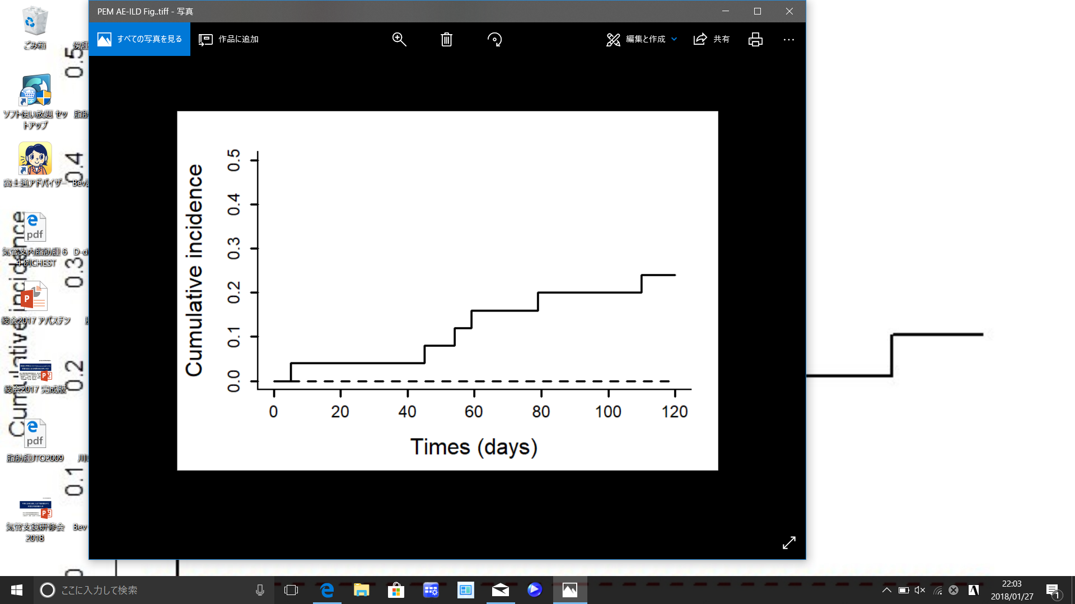
Figure S1
Bev group
Non-Bev group
Gray`s p = 0.044
No. at risk
Bev group
15 15 15 15 15 15
Non-Bev group
25 24 23 21 20 19
Figure S1. Cumulative incidence curves of AE-ILD in only patients who received PEM-containing regimens during first-line chemotherapy. There was a significant difference in occurrence of AE-ILD between the Bev (dotted line) and non-Bev (solid line) groups (p = 0.044, Gray’s test). PEM, pemetrexed. AE-ILD, acute exacerbation of interstitial lung disease.

