Slide 1
Supplementary figure 1
A
B

Slide 2
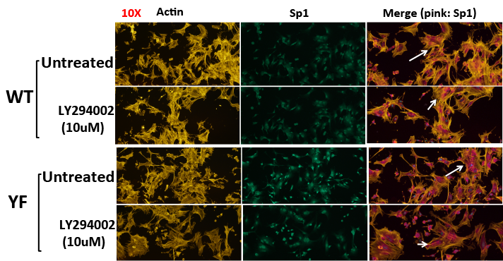
Supplementary figure 2

