Slide 1
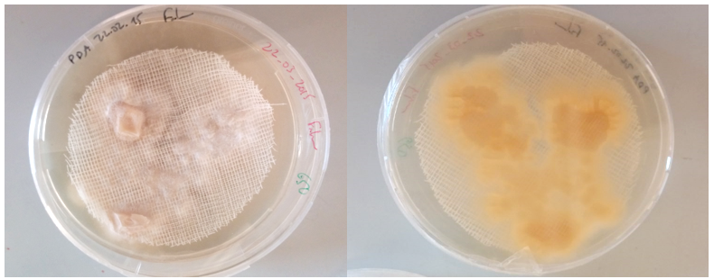
Additional file 1. Culture of Verticillium dahliae in potato dextrose agar medium. The bottom (right) and the top (left) of the Petri dish represent the evolution of the culture after 3-4 weeks.

