Slide 1
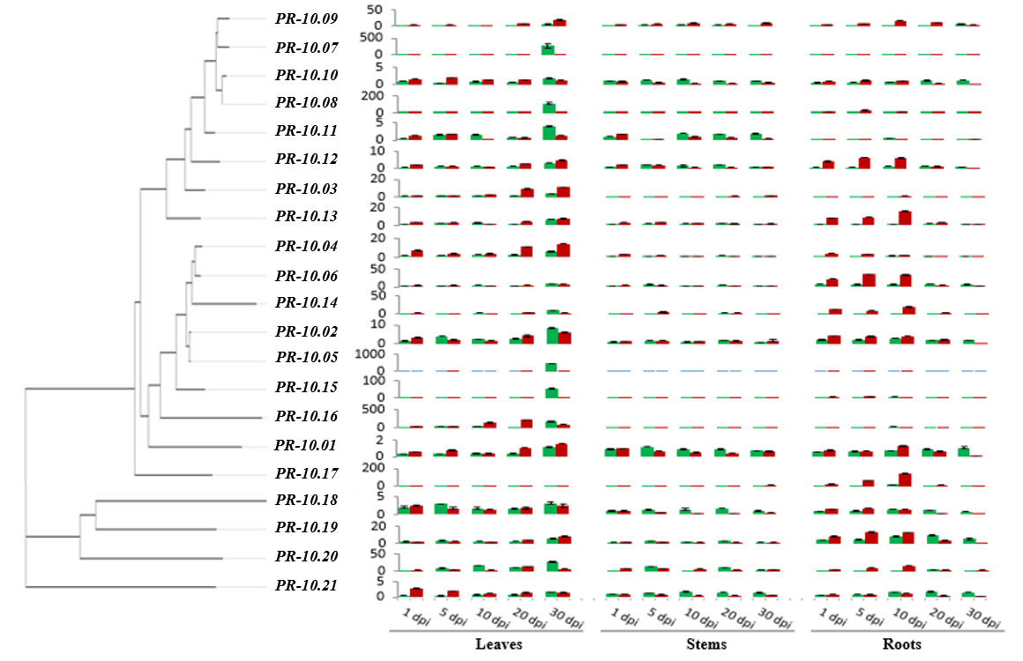
Additional file 4. Phylogenetic tree of PR-10 genes and summary of the expression profile of the 21 PR-10 isoforms in untreated leaves, stems and roots of in vitro cultivated F. × ananassa plants (green bars) and infected tissues with V. dahliae (red bars) at various time points (days) post pathogen inoculation (dpi). qPCR using specific primers for PR-10 genes and the reference gene was used for the expression analysis.

