Slide 1
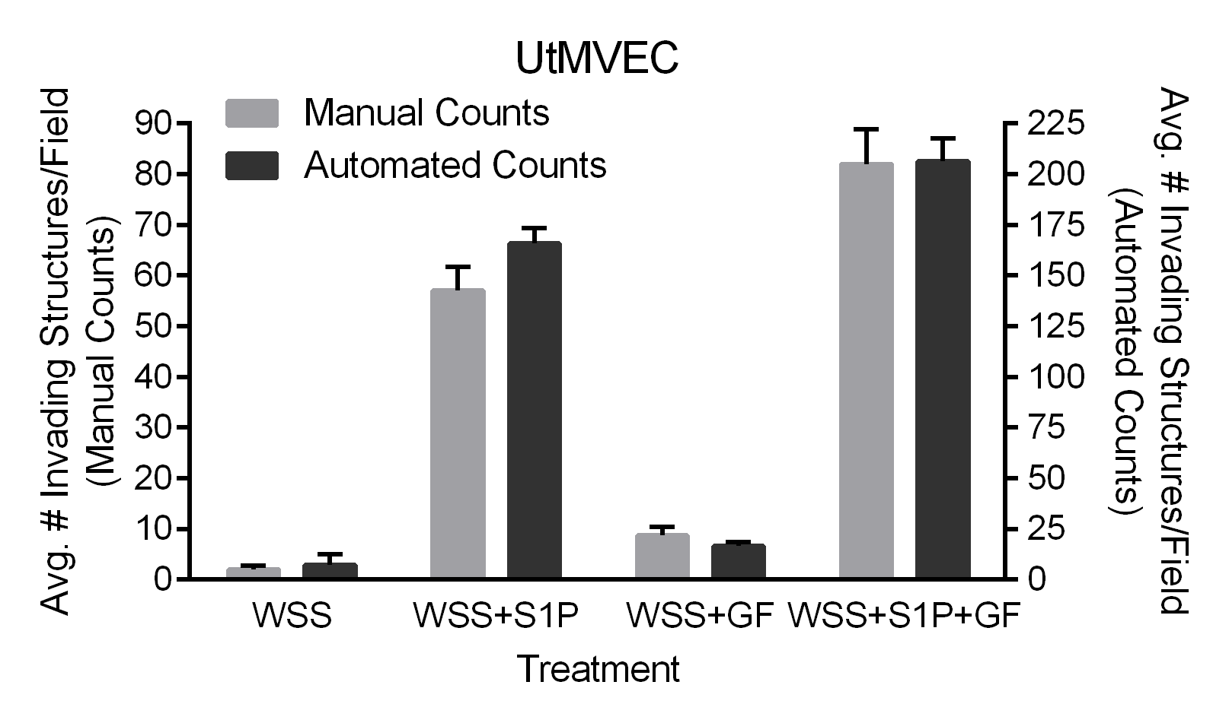
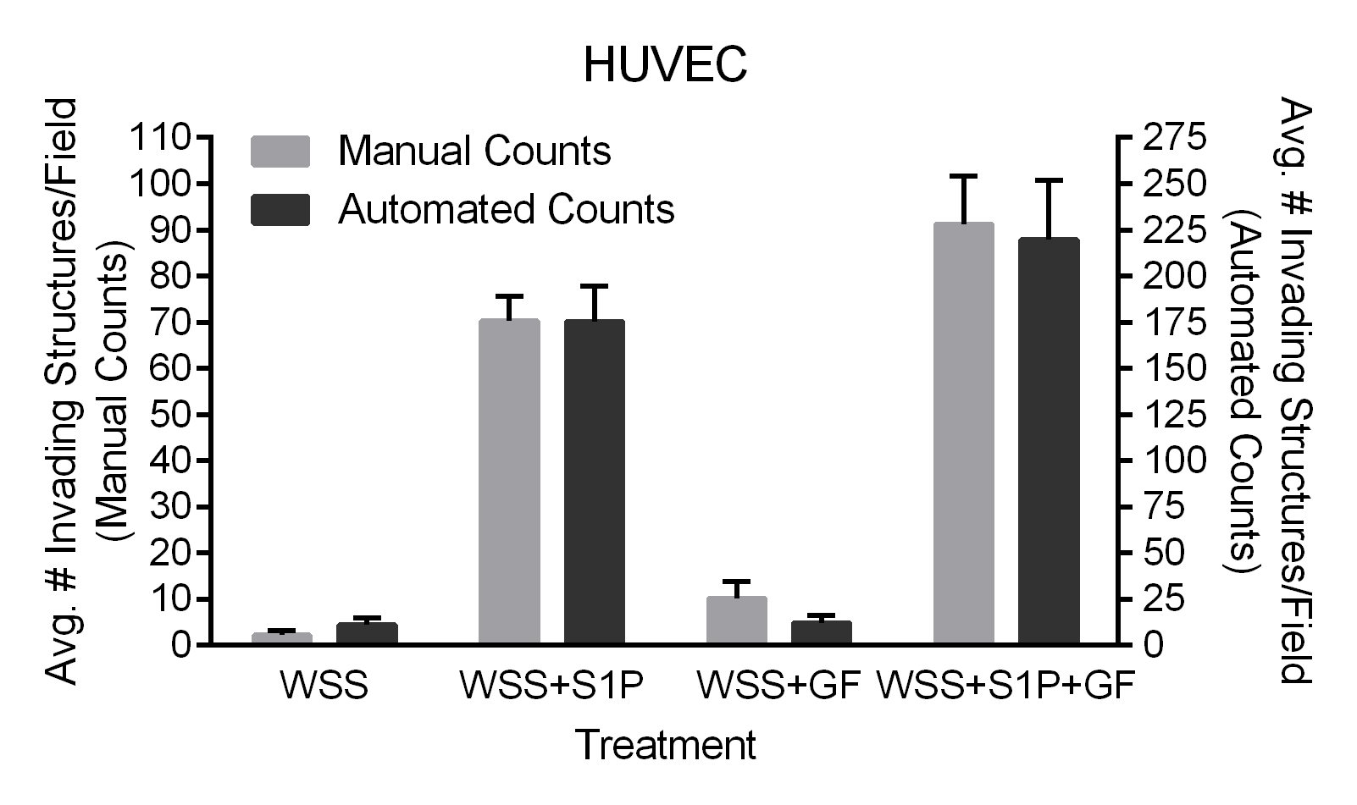
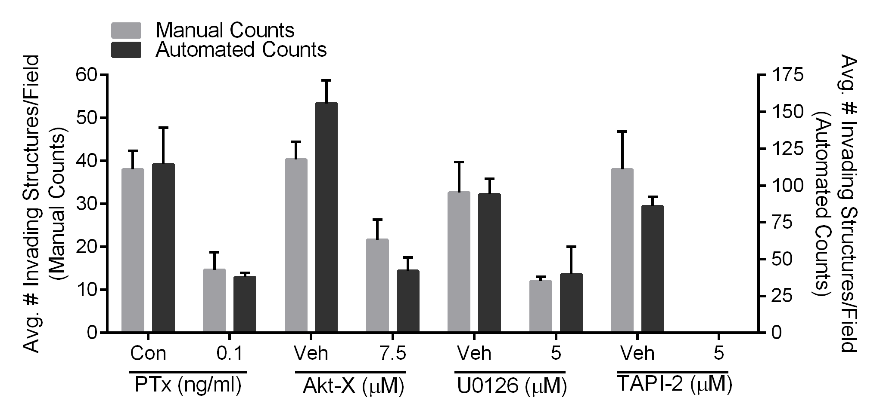
A
B
Supplementary Figure 1
d
C
d
B
B
B
b
b
A
c
A
c
A
a
a
A
C
A
A
a
a
a
a
A
A
b
b
B
B
B
b
b
B

