Slide 1
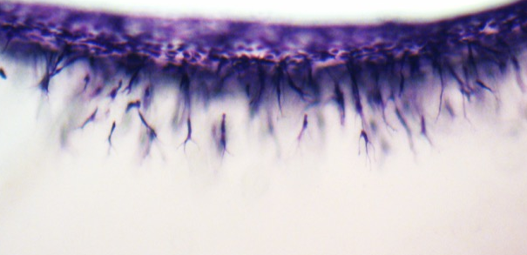
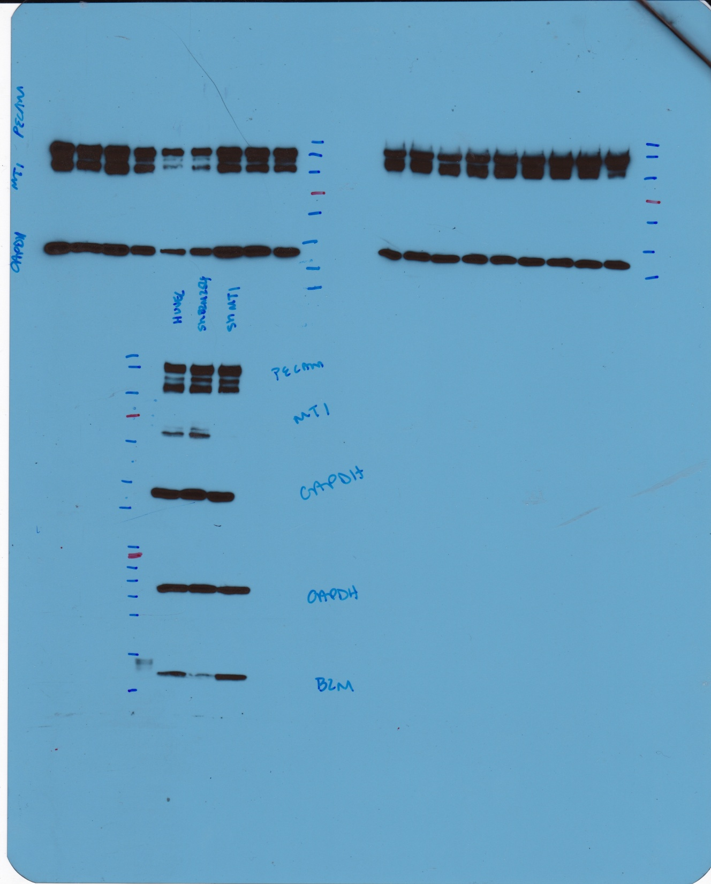
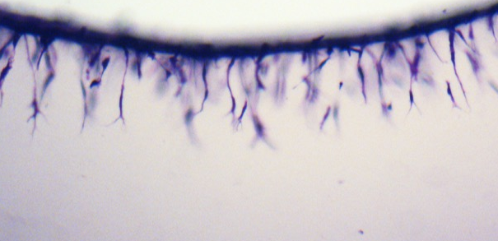
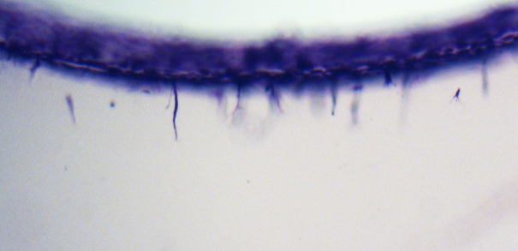
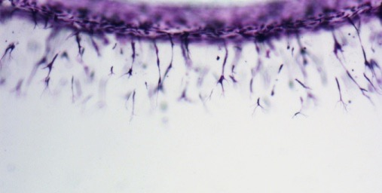
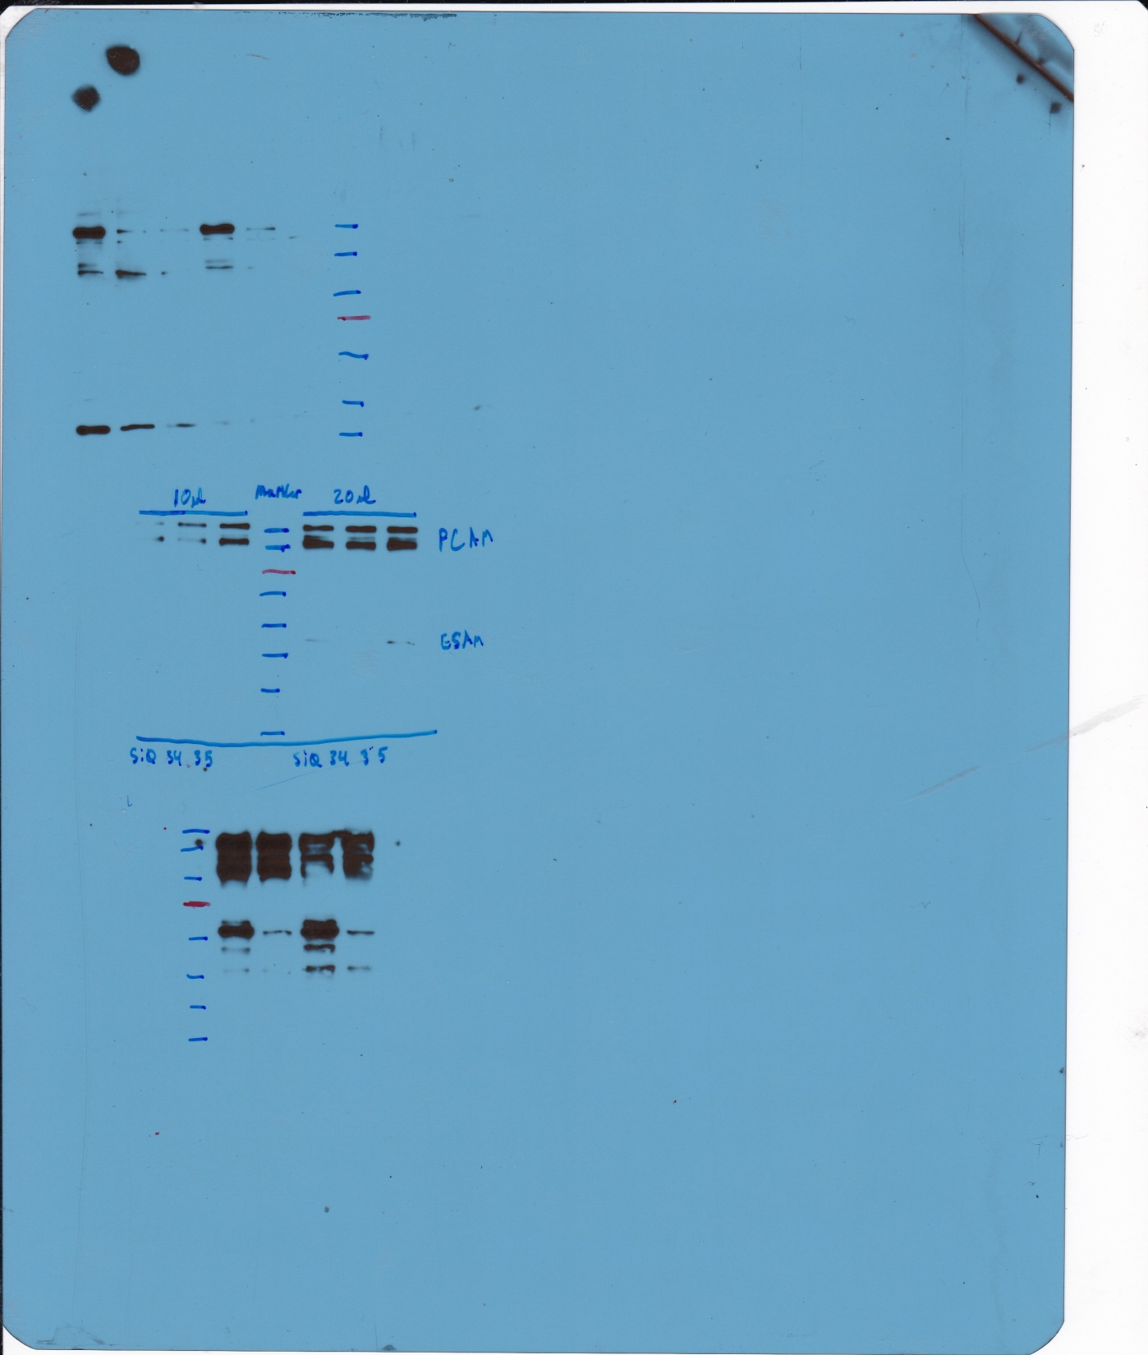
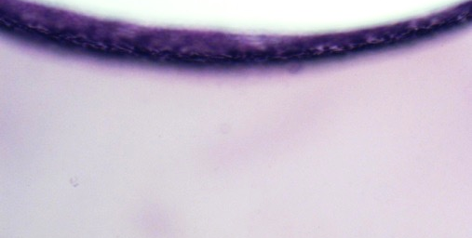
A
B
C
Supplementary Figure 2
Non-transduced
shMT1-MMP
shβ2M
a
MW
(kDa)
Non-transduced
56
MT1-MMP
a
43
GAPDH
43
GAPDH
shβ2M
b
β2M
11
D
siMT1-MMP
siControl
shMT1-MMP
F
MW
(kDa)
E
130
PECAM-1
siControl
56
MT1-MMP
***
siMT1-MMP
Notes:
Scale bar = 200 um

