Slide 1
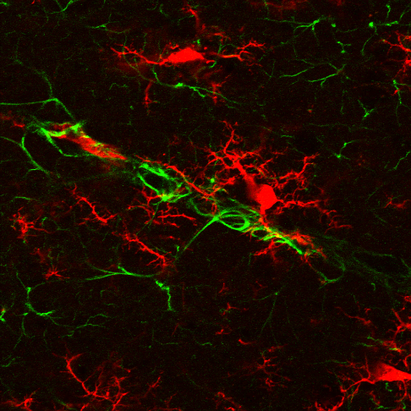
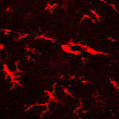
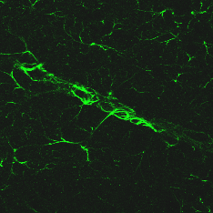
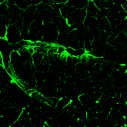
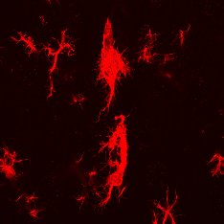
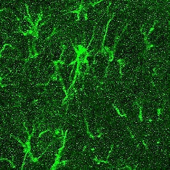
GFAP / Iba-1
Iba-1
GFAP / Iba-1
Iba-1
Control (0W)
DOCA2W
GFAP
GFAP
GFAP / Iba-1
Iba-1
GFAP / Iba-1
Iba-1
DOCA3W
20μm
DOCA4W
GFAP
GFAP
20μm
Figure S1. Morphological changes of astrocyte foot processes making up the small vessel wall in DOCA-salt rats. Shrinkage of astrocyte foot processes was observed in DOCA4W. Scale bars: 50 µm.
20μm
20μm

Slide 2
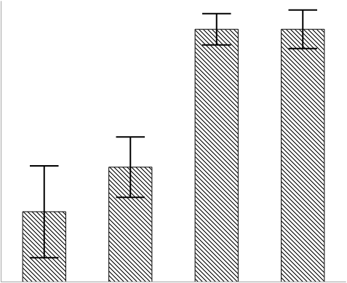
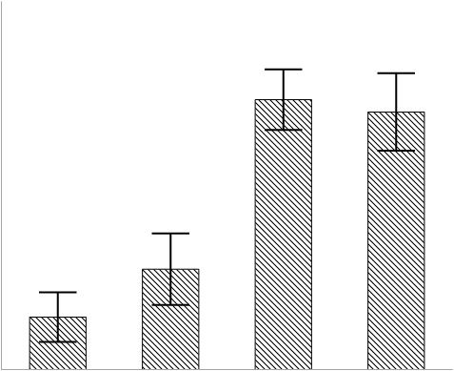
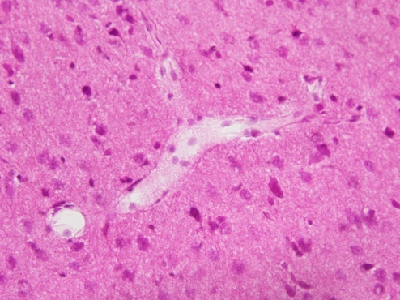
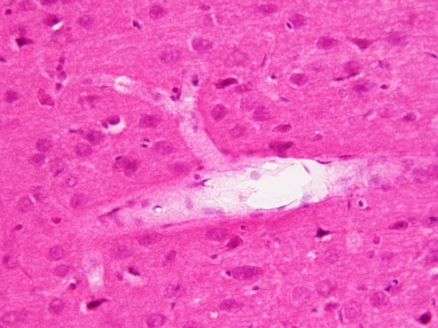
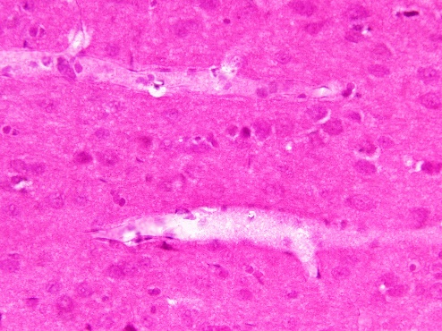
a
b
**
**
**
**
##
##
##
##
100
80
60
40
20
0
100
80
60
40
20
0
Vessel wall thickening (%)
Perivascular space
enlargement (%)
Control
2W
3W
4W
Control
2W
3W
4W
DOCA-salt
DOCA-salt
c
Placebo 2W
Placebo 3W
Placebo 4W
Figure S2. Quantitative analysis of vessel wall thickening (a) and perivascular space enlargement (b) in Figure 1C. Significance is expressed as **P<0.01 relative to the control and ##P<0.01 relative to DOCA2W using the Tukey-Kramer test. (c) Hematoxylin and eosin of brain tissues. Scale bars: 50μm.
Notes:
Supplemental figure 2
On the H-E staining, in the Placebo and DOCA2week, normal vascular structures were observed.
After DOCA 3week, perivascular space enlargement and vessel wall thickening were noted in many vessels.
B.Ratio of vascular remodeling per 10vessels in each rat (total 30 vessels).
C. Ratio of vascular wall thickening per 10vessels in each rat (total 30 vessels).
Scale bar=20μm.

Slide 3
a
CD163 Iba-1
Iba-1
CD163
DOCA4W
b
CD206 Iba-1 DAPI
Iba-1
CD206
DOCA3W
Figure S3. (a) Distribution of perivascular macrophages and microglia in DOCA4W. CD163-positive macrophages were never observed to have infiltrated the amoeboid microglia accumulating in the inflammatory lesion, indicated by the white dotted area. Scale bars: 150 µm. (b) Presence of CD206-positive M2-state microglia (closed white arrowheads) around a site of hemorrhage (white dotted area). The white dotted rectangle in the left column is magnified in the middle and right column. CD206 expression was noted in the microglia cytosol.

Slide 4
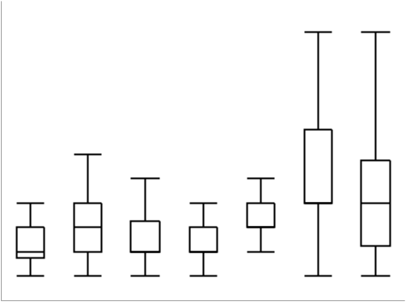
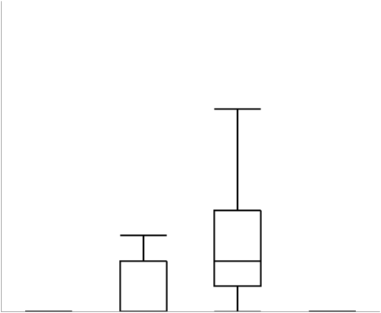


a
*
b
600
**
600
**
††
*
**
#
400
400
the number of
total microglia (/mm2)
the number of Ki-67-positive microglia (/mm2)
200
200
0
2W
3W
4W
2W
3W
4W
0
N.D.
Control
Control
2W
3W
4W
Placebo
DOCA-salt
DOCA-salt
c
d
100
100
50
50
Ki-67- positive microglia
in total microglia (%)
Ki-67- positive
perivascular microglia (%)
0
N.D.
N.D.
N.D.
0
N.D.
N.D.
N.D.
N.D.
Control
2W
3W
4W
Control
2W
3W
4W
Placebo
Placebo
Figure S4. Quantitative analysis of microglia. (a) The time-course changes of the total number of microglia. Significance is expressed as *P<0.05 and **P<0.01 relative to the control using the Dunnett test. (b) The number of Ki-67-positive microglia. Significance is expressed as **P<0.01 relative to the control rats, #P<0.05 relative to DOCA2W, and ††P<0.01 relative to DOCA3W using the Tukey-Kramer test. (c, d) Numbers of Ki-67-positive microglia as a percentage of the total microglia or perivascular microglia in the control and placebo groups.

Slide 5

a
Control (0W)
Placebo 2W
Placebo 3W
Placebo 4W
DOCA 2W
DOCA 3W
DOCA 4W
b
c
Figure S5. Sequential MRI analysis of rat brains. (a) T2-weighted images of brains in the control, the placebo groups, and DOCA groups. (b) The image of the white dotted square (Figure S3A, DOCA3W rat) is magnified. (c) Eosin-positive cells accumulated in the region corresponding to the high-intensity area in the MR image shown by closed arrowheads in Figure S3B. Scale bars: 5 mm (a), 1 mm (b), and 250 µm (c).

