Slide 1
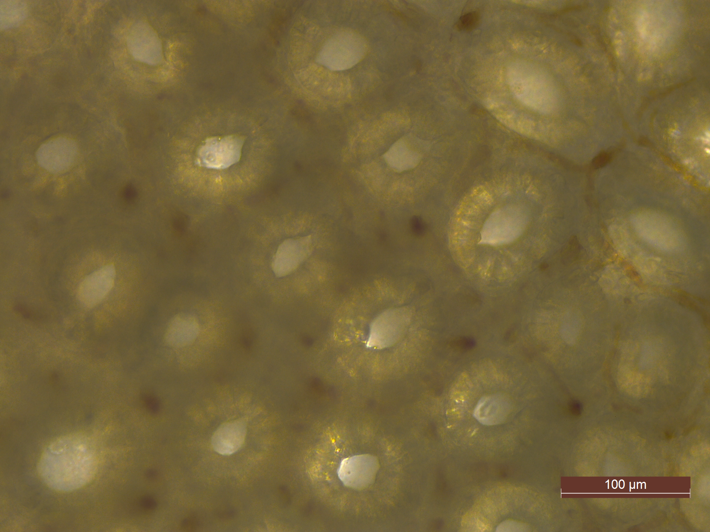
Crypt cell release from tissue
Additional file 3: Figure S1: Appearance of holes after EDTA incubation indicates release of crypts from intestinal tissue. Representative image of colon tissue after EDTA incubation, showing apparent holes and dense cellular spheroids by phase contrast microscope (20X magnification).

