Slide 1
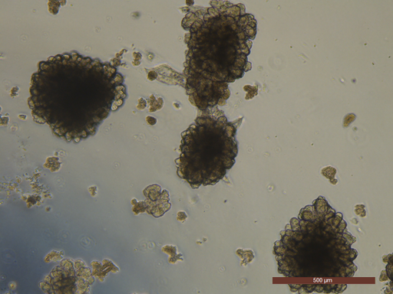
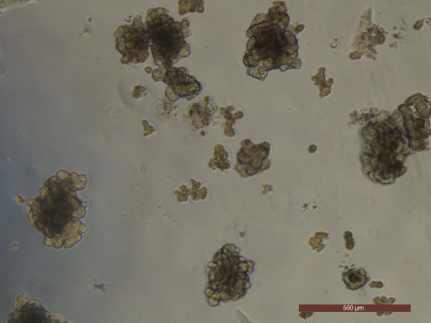
Recovery cell freezing media 90% FBS+10% DMSO media
Additional file 4: Figure S2. Comparison of medium for cryopreservation. Representative images of fully differentiated canine enteroids by phase contrast microscope (5X magnification). There was no discernable difference in quality or quantity of organoids recovered after freezing with either commercial cell freezing media (Invitrogen) or 90% FBS with 10% DMSO.

