Slide 1
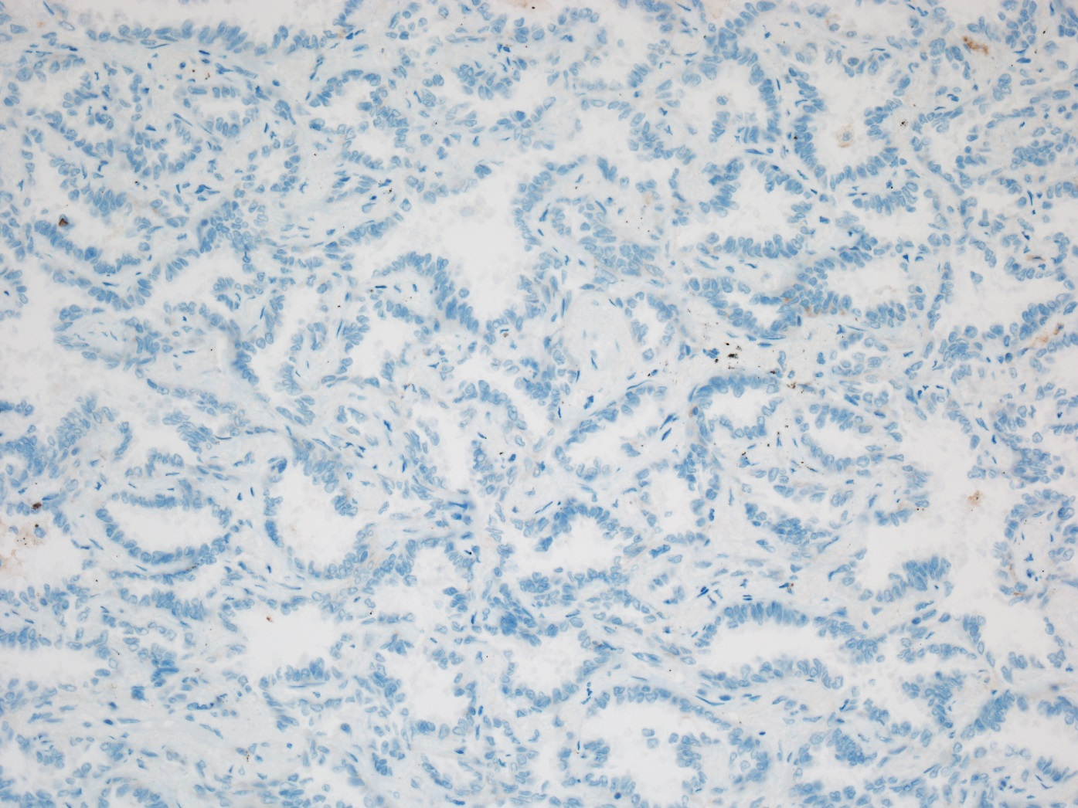
Negative expression for PD-L1

Slide 2
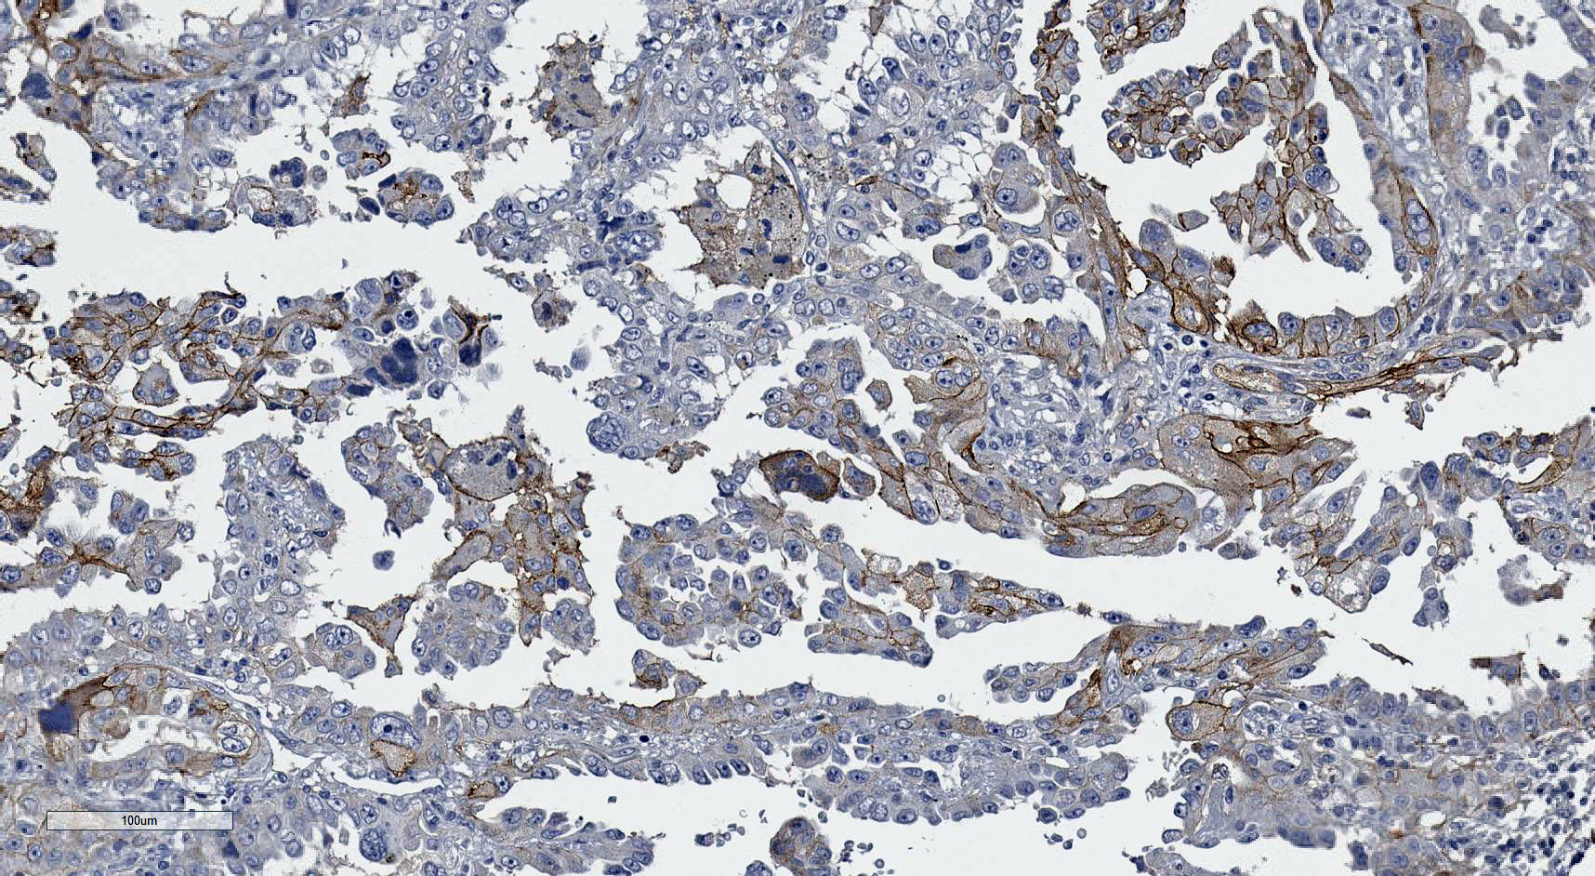
Positive expression for PD-L1 (adenocarcinoma)

Slide 3
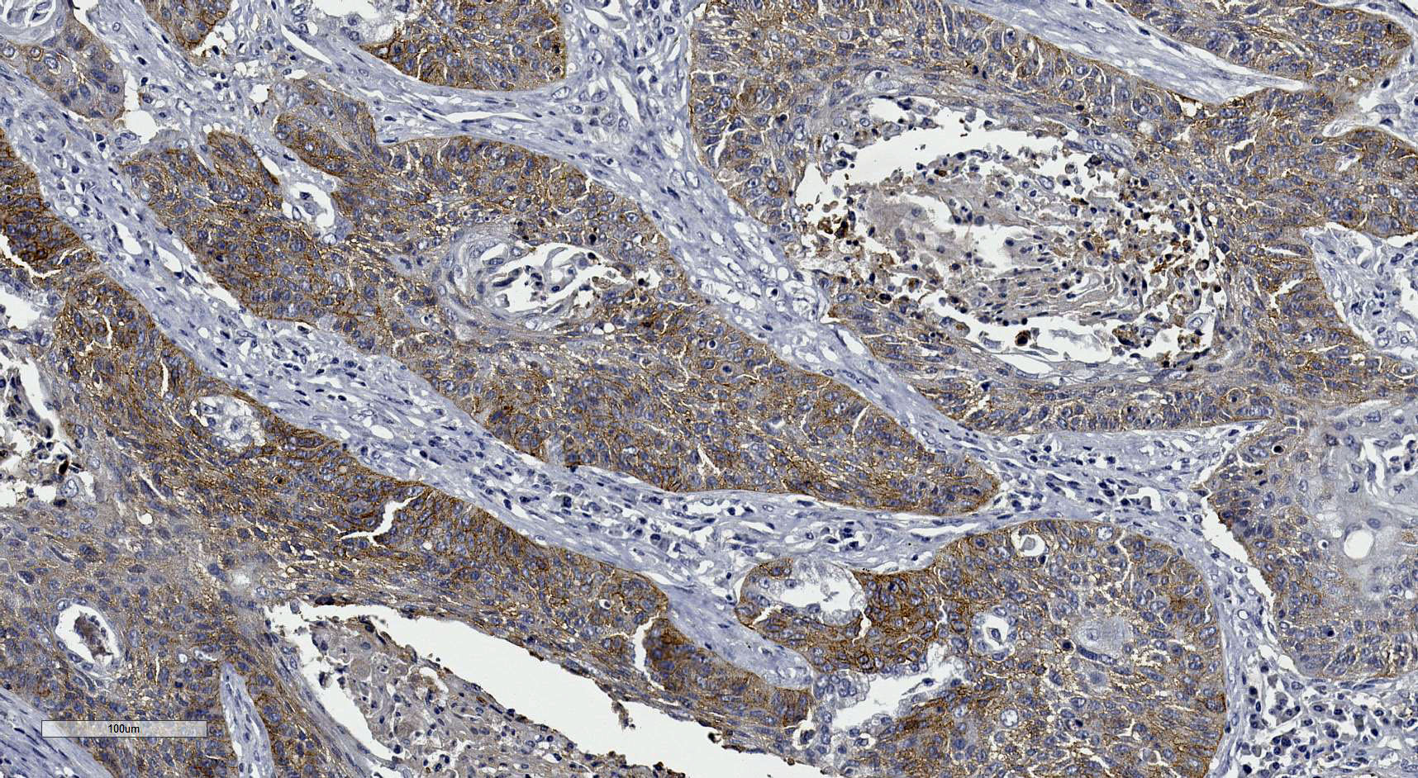
Positive expression for PD-L1 (squamous cell carcinoma)

