Slide 1
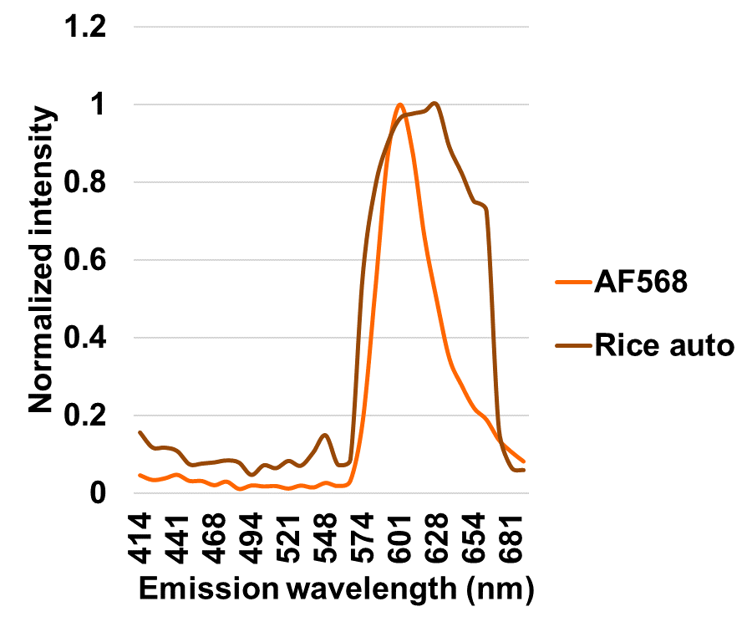
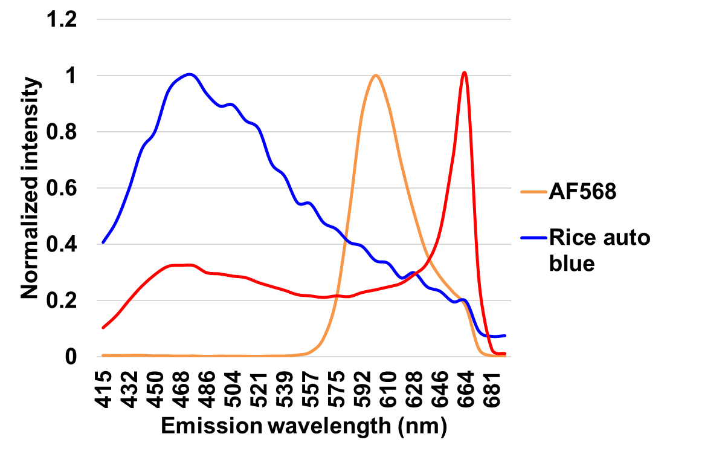
(a)
one-photon
multi-photon
osa-miR1874
Negative control
osa-miR1874
Negative control
signal
Spectral
image
background
autofluorescence
signal
autofluorescence
signal
CW
AF568
Spectra
unmixed
CW
CW
S
S
CW
S
S
signal
(b)
Supplementary Figure 1. Comparison of one-photon and multi-photon excitation on imaging resolution in rice endosperm amyloplast.
(a) Images show localization of osa-miR1874 in paraffin-embedded rice endosperm. Using one-photon excitation, it is hard to distinguish AF568 signal (orange color dots) from the background (also orange). Using multi-photon excitation, background is spectrally different from real signal (orange signal vs. blue background). Images were taken with laser-scanning confocal microscopy using multi-photon at wavelength 745 nm. After the image is taken, each image is spectrally unmixed using Zen software. After unmixing, the signal is represented in color green. And background is shown in purple. S: starch granule in rice amyloplast; CW: cell wall. Scale bar = 5 µm for all images. (b) Spectra profile of AF568 and rice endosperm autofluorescence using one-photon and multi-photon excitation.

