Slide 1
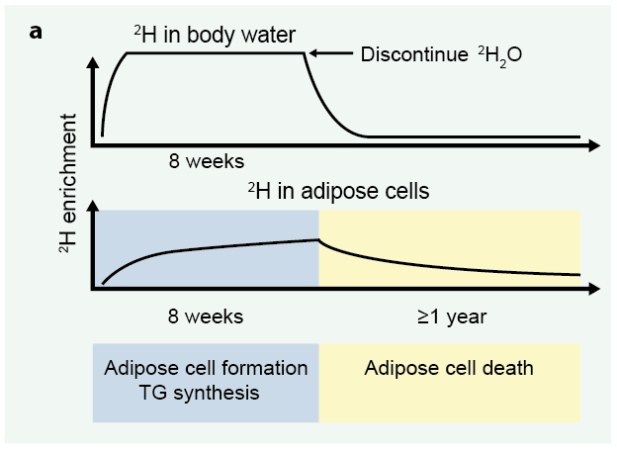
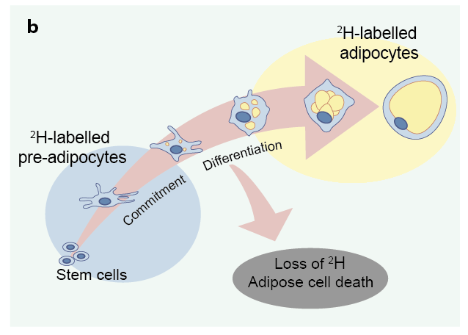
²H labelling protocol to assess in vivo adipose turnover
White and Ravussin (2018) Diabetologia DOI 10.1007/s00125-018-4732-x
© Springer-Verlag GmbH Germany, part of Springer Nature 2018

