Slide 1
Figure S1

Slide 2
Figure S2
A.
B.
DDO
UGGT1
MTMR1
IDO1
UGGT2

Slide 3
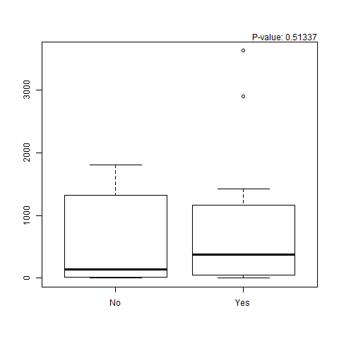
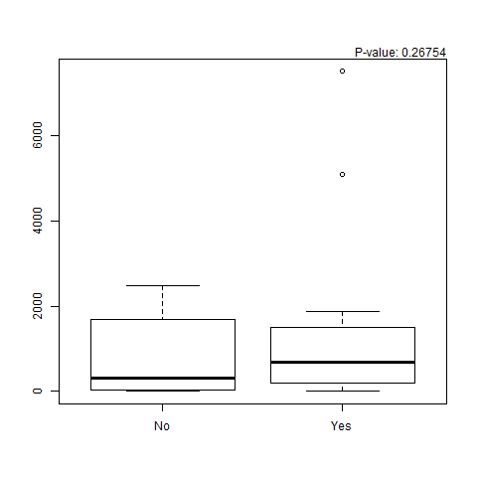
Figure S3
A
B
MFI
MFI
C
Anti-AdV antibodies vs T cell response
p=0.51 ns
p=0.26 ns
MFI
1-4 Baseline vs Vaccine Antigen Response
1-8 Baseline vs Vaccine Antigen Response

