Slide 1
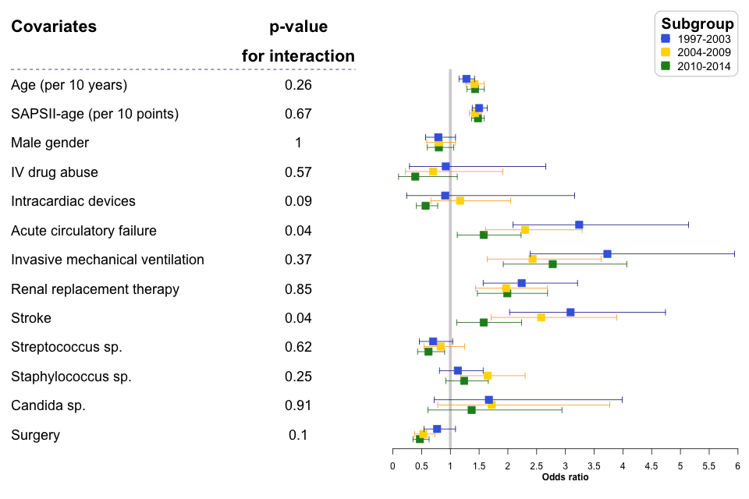
Additional Fig. 4

