Slide 1
Effects of declining sorafenib levels and dose on acquired reversible resistance and toxicity in hepatocellular carcinoma
Elizabeth A. Kuczynski, Christina R. Lee, Shan Man, Eric Chen, Robert S. Kerbel
SUPPLEMENTARY FIGURES S1-5

Slide 2
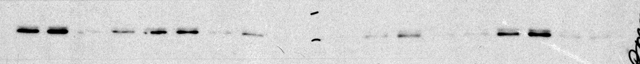
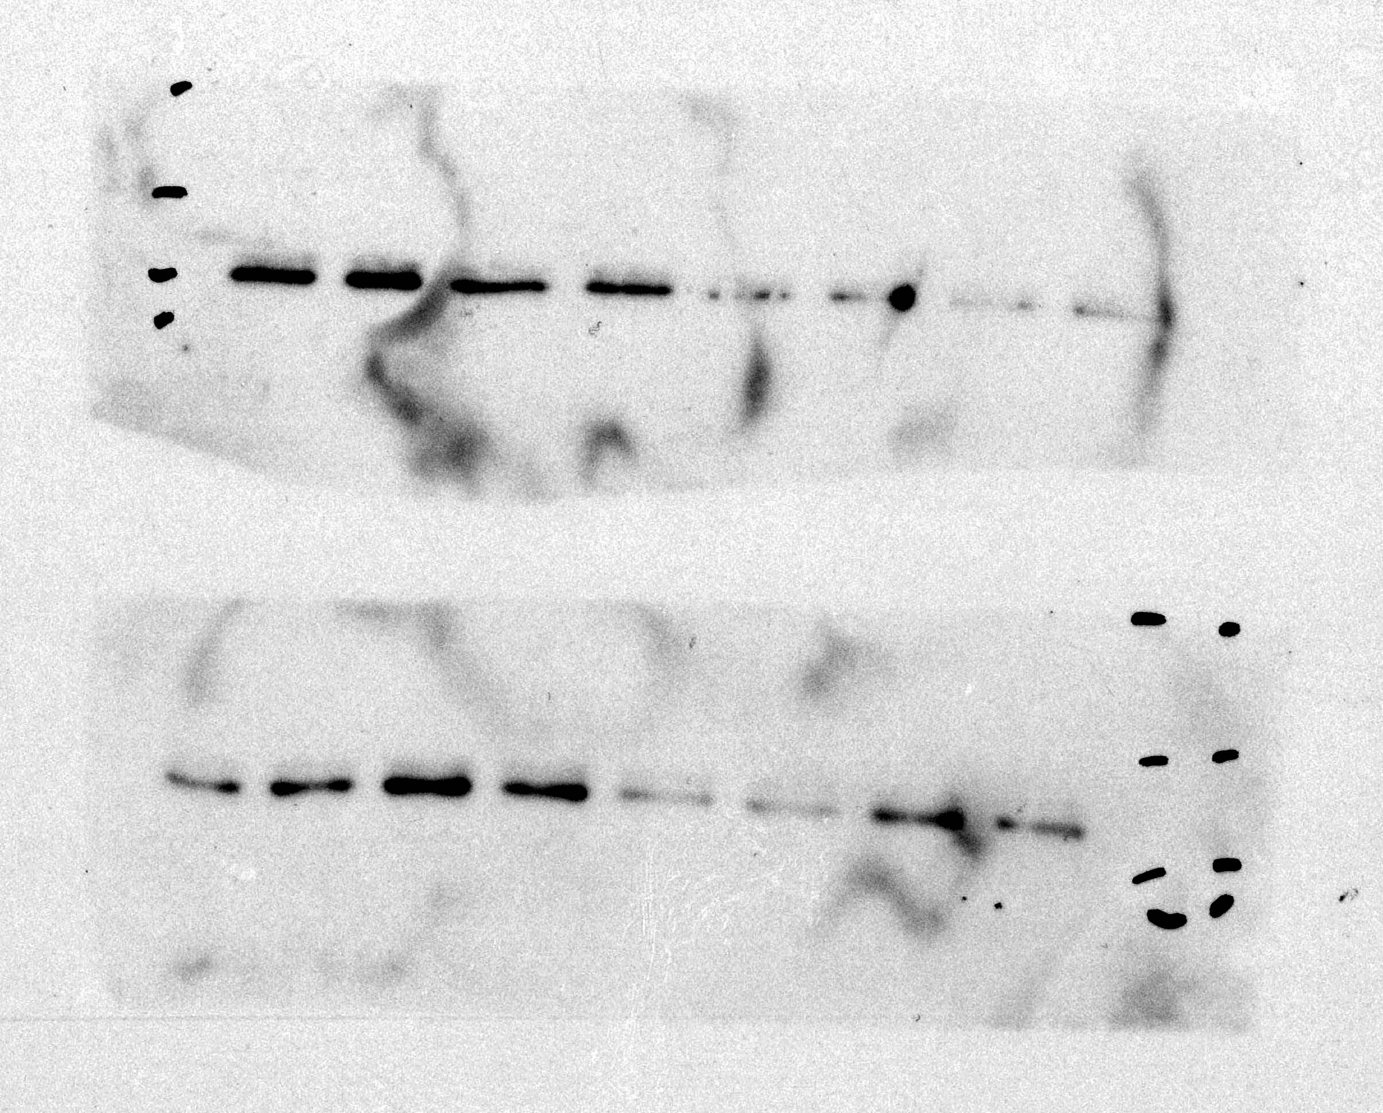
Supplementary Figure S1
A
Tumor growth (hCG)
B
Proliferation
IC50: 3.03µM (P),
2.92µM (R1),
2.36µM (R2)
C
Invasion
D
Clonogenic Survival
Hep3B-hCG parental
Hep3B-hCG-R1
Hep3B-hCG-R2
E
Parental
R1
EGF
Sorafenib
+ - + - + - +
- + + - - + +
P-ERK
ERK
F
hCG: Subcutaneous Transfer
G
hCG: Orthotopic Transfer

Slide 3
Supplementary Figure S2
A
hCG for Drug Level Assessment
B
Plasma
Tumor
*

Slide 4
Supplementary Figure S3
A
p=0.965
p=0.742
P=0.0659
B
hCG: Indicator Group of SCID HCC mice
C
hCG: 65 Day Sorafenib Pre-Conditioned Mice
+2d implant, +5d treat
+2d implant, +5d treat

Slide 5
Supplementary Figure S4
A
B
hCG: Dose Escalation Early vs. Late Progressors
p=0.00554
p=0.152
p=0.202
C
Sorafenib concentrations: day 14
p=0.285
p=0.165
*p=0.0145
D
E
Weight Loss: HCC vs. Tumor-Free
Tumor + Liver Weight
**
**
F
Survival: HCC vs. Tumor-Free
G
Survival: Dose escalation
p=0.266
p=0.600
(30 mg/kg)
(30 mg/kg)

Slide 6
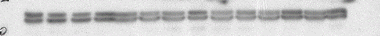
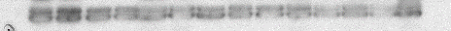
Supplementary Figure S5
A
Tumor Lysates
B
Control
Sensitive
Resistant
Escalated
P-PDGFRβ
PDGFRβ
P-ERK
ERK
C
Liver Lysates - Tumor-Free
Control*
Sensitive
Resistant
Escalated
P-STAT3
STAT3
Liver lysates - HCC
Control
Sensitive
Resistant
Escalated
P-STAT3
STAT3
D
Tumor Lysates
Control
Sensitive
Resistant
Escalated
CAIX
Actin

