Slide 1
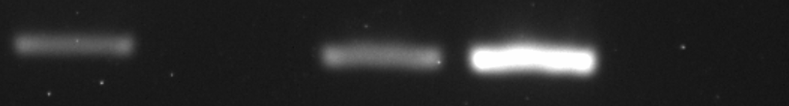
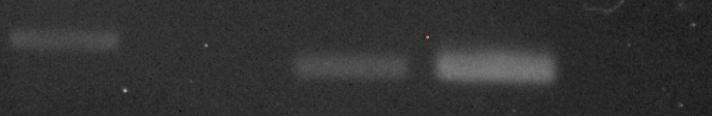
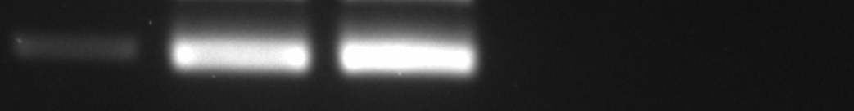
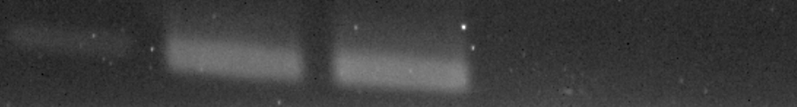


Supplementary Figure 1
A.
Plasmid_PJA2/BRAF
Plasmid_AGK/BRAF
PC9_PJA2/BRAF
PC9_AGK/BRAF
PC9
PC9
-RT
-RT
PJA2/BRAF
AGK/BRAF
GAPDH
GAPDH
H1975
-RT
Plasmid_PJA2/BRAF
H1975_PJA2/BRAF
PJA2/BRAF
GAPDH
B.
PC9
PC9
H1975

Slide 2
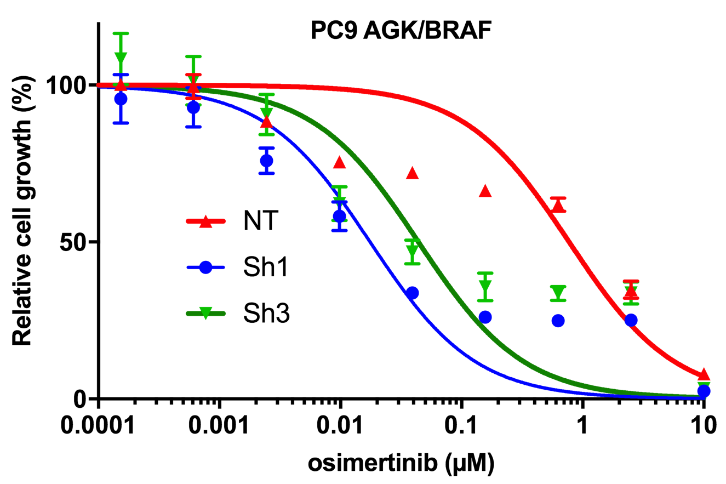
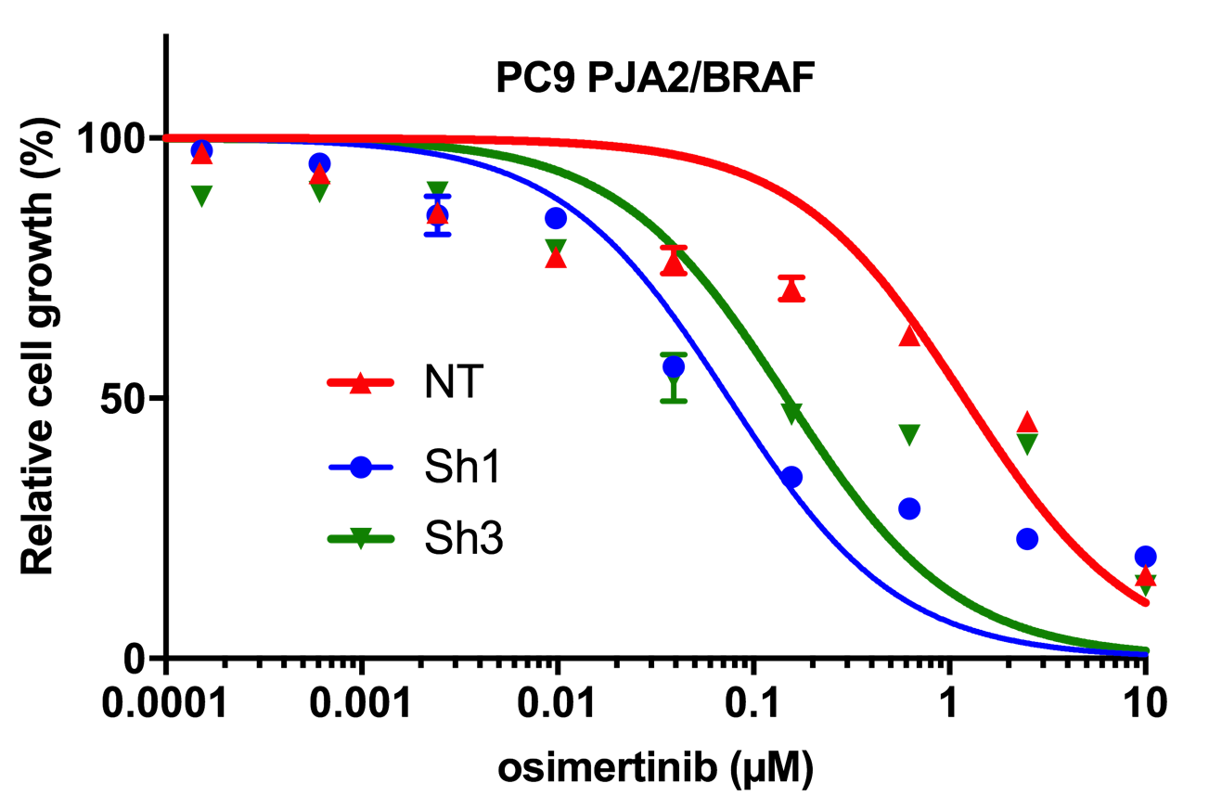
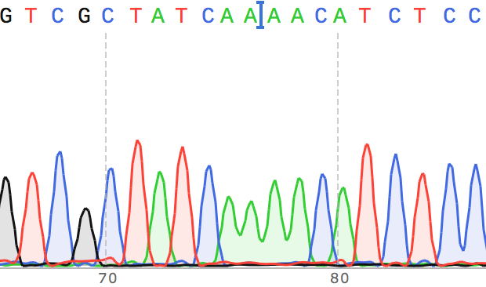
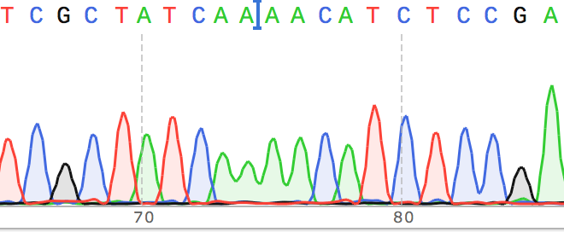
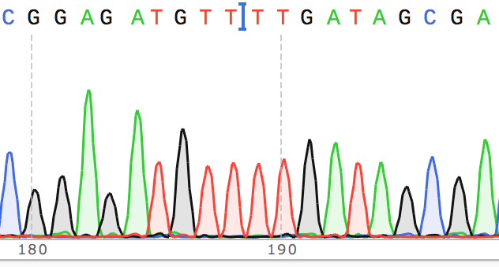
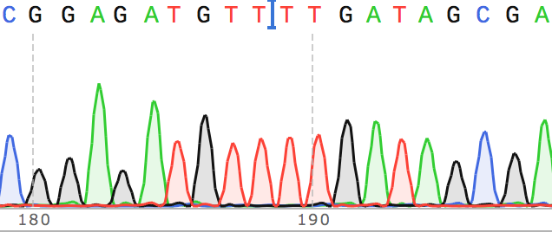
Supplementary Figure 1
C.
D.
Supplementary Figure 2
A.
MSK-LX138cl
B.
MSK-LX138cl PJA2/BRAF PDX
EGFR ex19_delE746 Fw
EGFR ex19_delE746 Fw
EGFR ex19_delE746 Rv
EGFR ex19_delE746 Rv

