Slide 1
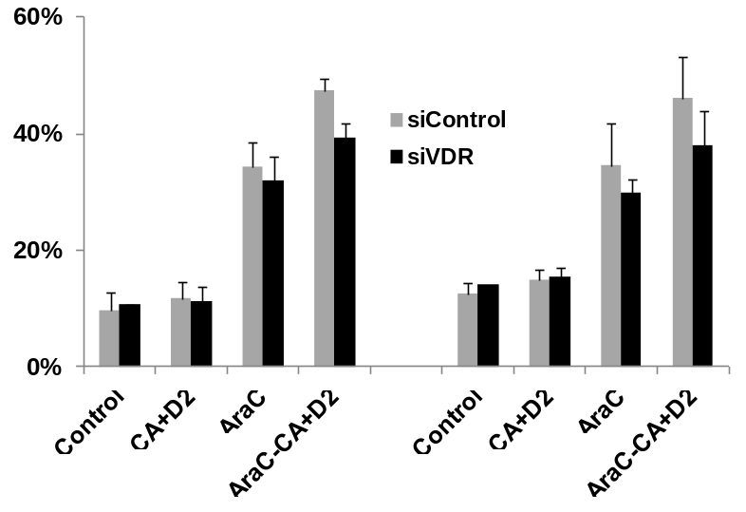

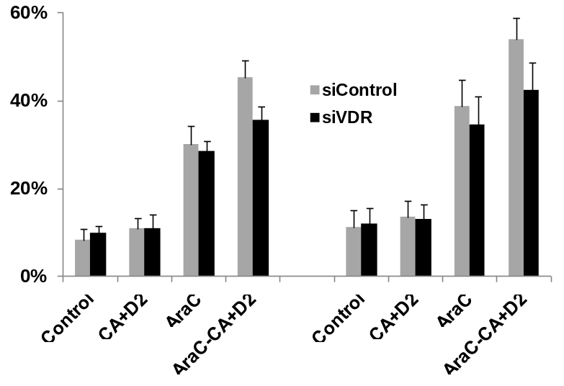
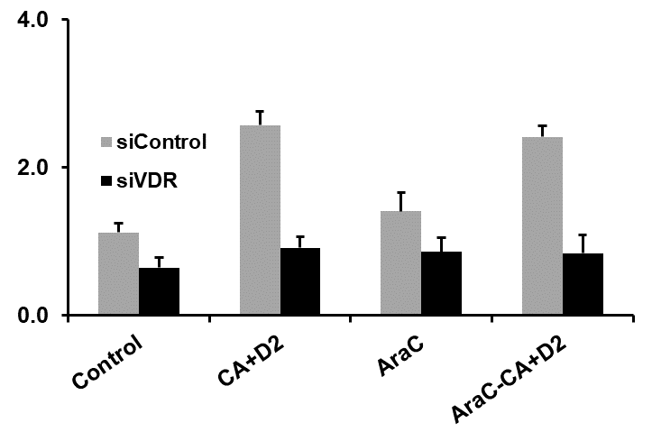
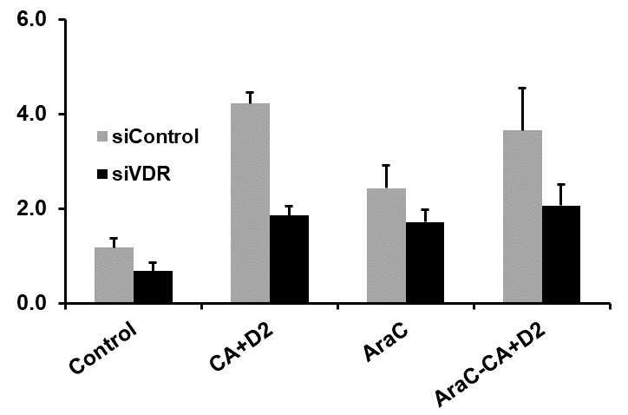
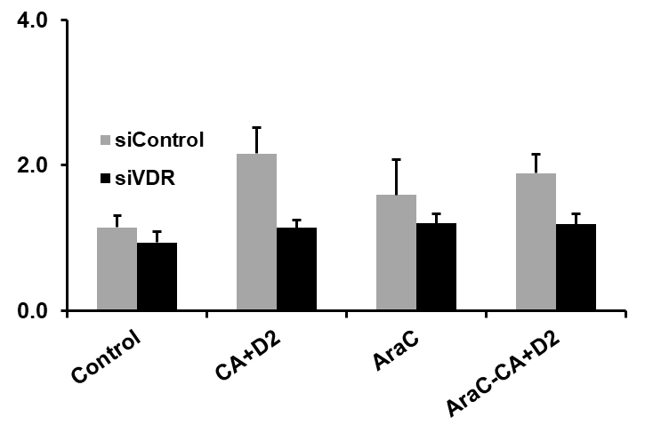
A.
HL60 cells
U937 cells
#
#
#
*
*
*
*
Percent of cell death
Percent of cell death
TB exclusion
Annexin V/PI positivity
TB exclusion
Annexin V/PI positivity
B.
VDR mRNA in U937 cells
CD14 mRNA in U937 cells
CYP24A1 mRNA in U937 cells
#
#
#
#
#
#
Relative values vs RPII
Suppl. Fig. 2

