Slide 1
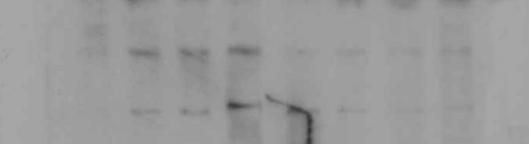
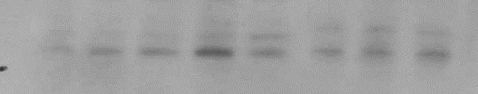
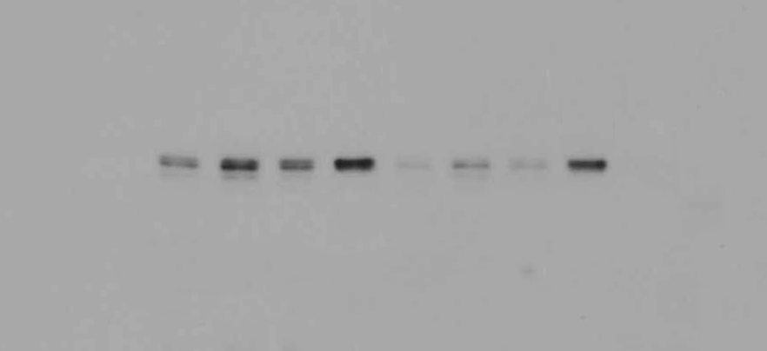
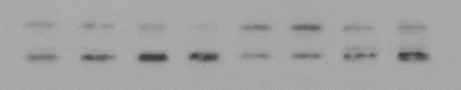
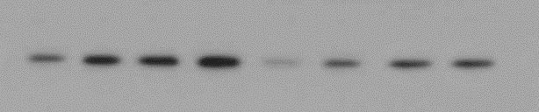

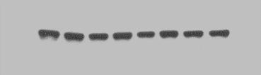
C.
siRNA CTL
siVDR
siRNA CTL
siVDR
AraC
- - + + - - + +
AraC
- - + + - - + +
D2/CA
- + - + - + - +
D2/CA
- + - + - + - +
VDR
P-MKK4
1.0 1.8 1.7 2.2 0.5 0.8 0.7 1.1
1.0 1.3 1.5 3.1 1.4 1.2 1.4 1.4
TXNIP
P-JNK2
P-JNK1
1.0 1.6 1.2 2.3 0.4 0.9 0.7 1.5
1.0 1.1 1.0 0.7 1.2 1.4 1.1 1.1 P-JNK2
1.0 1.2 1.6 1.6 0.7 0.9 1.2 1.5 P-JNK1
P-ASK1
BIM
1.0 1.6 1.5 2.2 0.4 0.9 1.2 1.3
1.0 0.9 1.4 2.5 1.0 0.9 1.2 1.2
CRK-L
1.0 1.1 1.0 1.1 0.9 1.0 0.9 1.0
Suppl. Fig. 2C

