Slide 1
Supplemental Figure I
A.
Tamox injection (100µg/g body weight)
7 consecutive days
B.
~5wks of age
30
n.s.
20
Weight (g)
Adult vascular studies/phenotyping
10
0
n=14
n=12
~10wks of age
Control
Akt1 iECKO
(A) Schematic depiction of the adult conditional Akt1 deletion strategy. (B) Adult, inducible deletion of endothelial-specific Akt1 expression does not affect overall weight
Notes:
B. In folder: From ANA
C. MYL_011917A

Slide 2
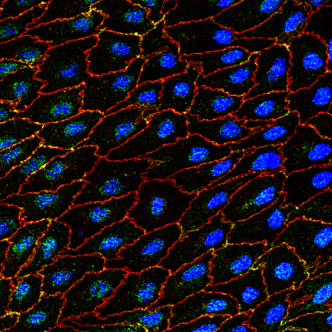
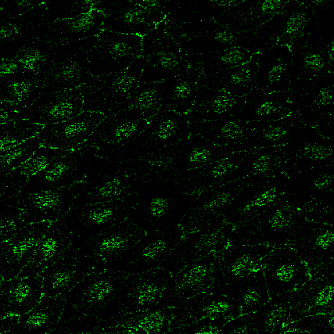
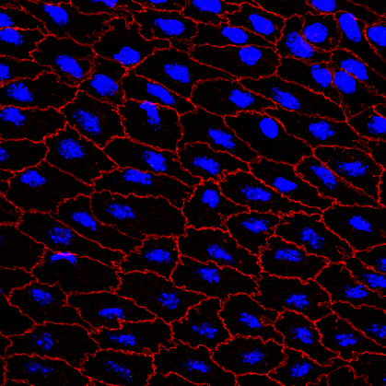

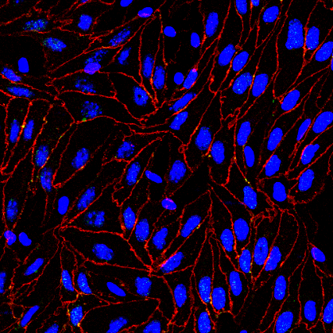
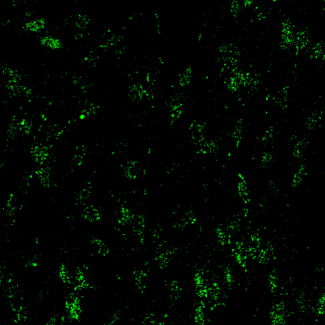
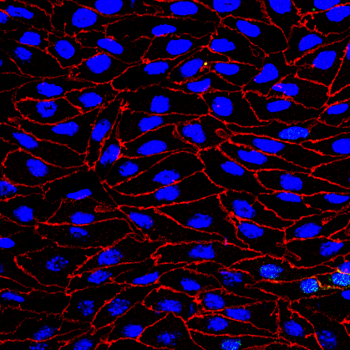
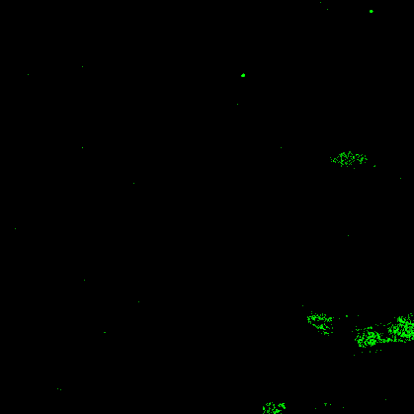
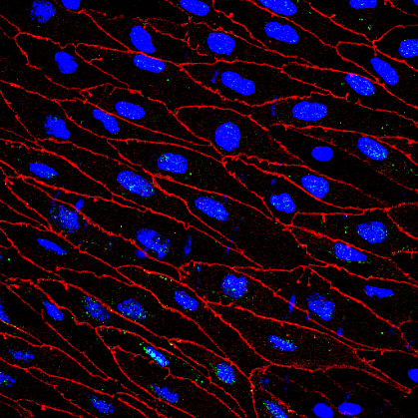
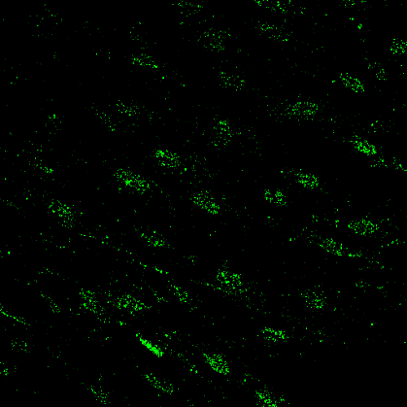
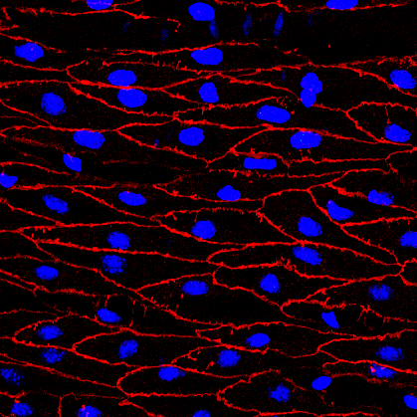

Supplemental Figure II
Control
Akt1iECKO
Thoracic Aorta
Mesenteric Artery
Femoral Artery
VECD | DAPI | panAkt
panAkt
En face immunofluorescent imaging of the endothelium in various arterial vessels post-tamoxifen treatment demonstrates decreased total Akt protein expression. (representative z-stack compressed confocal images). Performed in parallel with Supplemental Figure 3.
Notes:
MYL_080117A

Slide 3
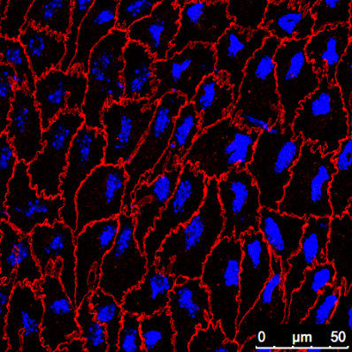

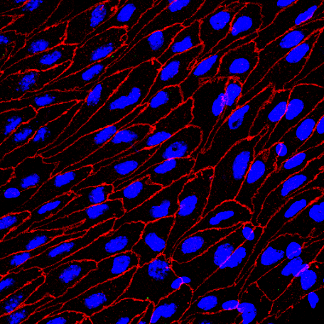

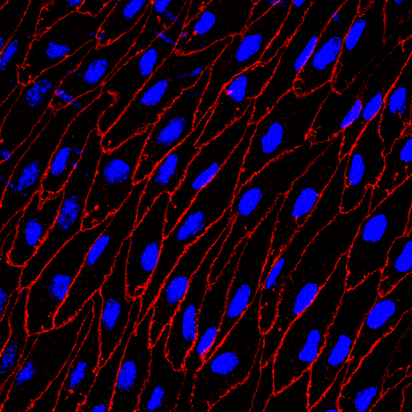

Supplemental Figure III
Akt1 global KO
Thoracic Aorta
Mesenteric Artery
Femoral Artery
VECD | DAPI | panAkt
panAkt
Minimal Akt signal is observed in the endothelium of Akt1 global KO mice, thus demonstrating antibody specificity. Performed in parallel with Supplemental Figure 2.

Slide 4
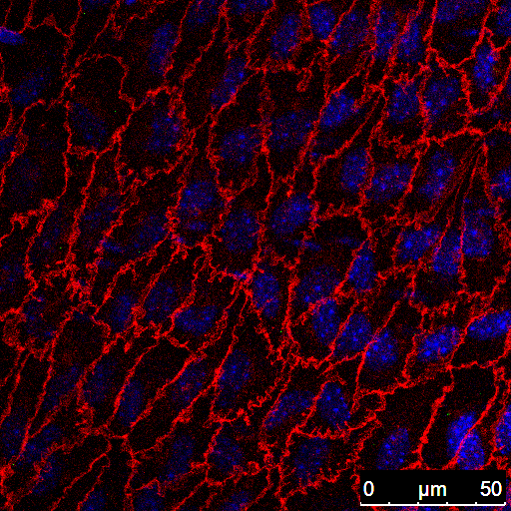

Supplemental Figure IV
Akt1^{-/-}; SA^{+/+}
Angiopoetin1 (500ng/mL, 10’ stimulation)
VECD | p-eNOS | DAPI
p-eNOS
Minimal immunofluorescence signal is seen in thoracic aortas of Akt1^{-/-}; SA+^{/+} mice (i.e. loss of function mutation in Akt phosphorylation site [eNOS S1176A]), demonstrating p-eNOS-S1176 antibody specificity. Performed in parallel with Supplemental Figure 5.
Notes:
A. MYL_081516A

Slide 5




Supplemental Figure V
A.
VEH
PDGF-BB (50ng/mL, 10’ stimulation)
Control
Akt1 iECKO
VECD p-eNOS DAPI GM130
p-eNOS
B.
Control
*
**
iECKO
p-eNOS signal intensity A.U.
(norm. to cell number)
VEH
PDGF-BB
(A) Endothelial loss of Akt1 results in decreased PDGF-BB-induced p-eNOS S1176 ex vivo, quantified in (B) n=3-4 mice per group, 2-5 images per mouse * p<0.05, **p<0.01. Performed in parallel with Supplemental Figure 4.
Notes:
MYL_030316C
Compiled data analysis (MYL_030316C)
C. MYL_120614B

Slide 6
Supplemental Figure VI
A.
B.
Control
Mean Arterial Pressure
Akt1iECKO
Pressure (mmHg)
Activity Index
Hour
Hour
Blood telemetry readings for (A) mean arterial pressure and (B) recorded activity levels. n=6 mice per group. Graphs illustrate a 3-day reading period where white and gray regions indicate light and dark cycles, respectively.

Slide 7
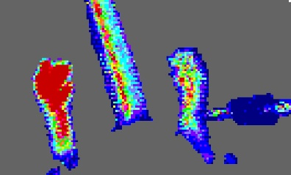
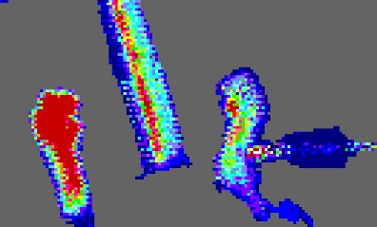
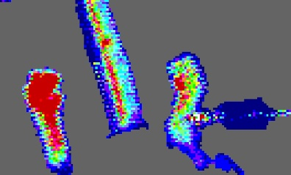
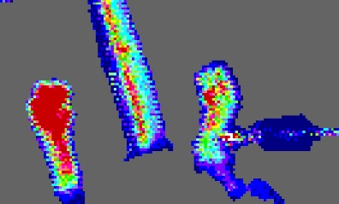
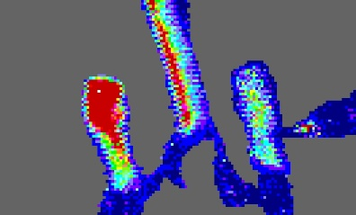
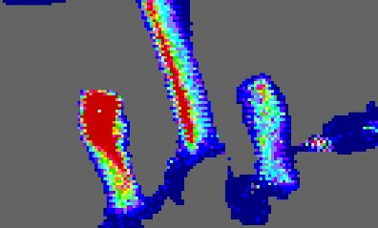
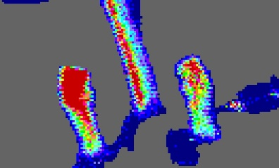
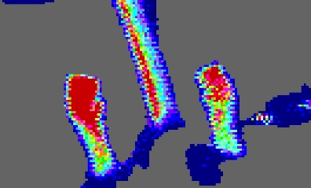

Supplemental Figure VII
SNAP: S-Nitroso-N-acetyl-DL-penicillamine
SNAP
A.
PRE
10’
20’
25’
C57
Akt1 KO
DAY10 post-HLI
B.
C57-UNINJ
C57-INJ
Akt1 KO-UNINJ
*
Akt1 KO-INJ
**
**
Blood Flow Fold Change
(norm. to pre-SNAP)
***
*
Pre-SNAP
10’
20’
25’
Time (minutes)
Global Akt1 KO mice display significantly impaired blood flow recovery by DAY10 post-injury, as previously described. (A) Local administration (via syringe, depicted by star) of SNAP, an NO donor, results in immediate flow recovery to the injured limb with markedly enhanced blood flow in the global Ak1 KO mice at the indicated time intervals when compared to control mice. Relative blood flow perfusion rates in the injured limb normalized to pre-SNAP delivery shown in (B). Delivery of saline only controls did not affect blood flow patterns (data not shown). n=4 mice per groups, * < p0.05, ** p < 0.01
Notes:
MYL_011316

