Slide 1
S6 Fig. Risk residues for Class II HLA genes. A. Accumulation of Class II risk residues in the peptide-binding groove; B. Accumulation of Class II risk residues in the peptide-binding groove (zoom); C Risk residues in the peptide-binding groove of HLA-DPA1/DPB1. Post-conditioning on DRB1-11/13, DRB1-37 and DQB1-37; D. Risk residues in the peptide-binding groove of HLA-DPA1/DPB1. Post-conditioning on DRB1-11/13, DRB1-37 and DQB1-37 (zoom). DPB1-55 emerges as a significantly associated residue in addition to DPB1-35; E. Risk residues in the peptide-binding groove of HLA-DPA1/DPB1. Post-conditioning on DRB1-11/13, DRB1-37, DQB1-37, A-70, DPB1-35, and B-9; F. Risk residues in the peptide-binding groove of HLA-DPA1/DPB1. Post-conditioning on DRB1-11/13, DRB1-37, DQB1-37, A-70, DPB1-35, and B-9 (zoom). DPA1-11 emerges as a significantly associated residue in addition to DPB1-35; G. Risk residues in the peptide-binding groove of HLA-DQA1/DQB1. Post-conditioning on DRB1-11/13 and DRB1-37; H. Risk residues in the peptide-binding groove of HLA-DQA1/DQB1. Post-conditioning on DRB1-11/13 and DRB1-37 (zoom). DQB1-70 emerges as a significantly associated residue in addition to DQB1-37; I. Risk residues in the peptide-binding groove of HLA-DQA1/DQB1. Post-conditioning on DRB1-11/13, DRB1-37, DQB1-37, A-70, DPB1-35, and B-9; J. Risk residues in the peptide-binding groove of HLA-DQA1/DQB1. Post-conditioning on DRB1-11/13, DRB1-37, DQB1-37, A-70, DPB1-35, and B-9 (zoom). DQB1-57 emerges as a significantly associated residue in addition to DQB1-37; K. Risk residues in the peptide-binding groove of HLA-DRA1/DRB1; L. Risk residues in the peptide-binding groove of HLA-DRA1/DRB1 (zoom); M. Risk residues in the peptide-binding groove of HLA-DRA1/DRB1. Post-conditioning on DRB1-11/13; N. Risk residues in the peptide-binding groove of HLA-DRA1/DRB1. Post-conditioning on DRB1-11/13, DRB1-37, DQB1-37, A-70, DPB1-35, and B-9. DRB1-67 emerges as a significantly associated residue; O. Correspondence of risk positions across multiple Class I (left) and Class II (right) subunits. Risk position 35 in DQB1 and DRB1 is equivalent to DPB1-35 due to a 2-amino acid deletion; similarly DQB1-57 is equivalent to DPB1-55. Position 152 in A and C is equivalent to DRB1-67. C-99 and A-97 are equivalent to DRB1-13 and DRB1-11, respectively. A-114 is equivalent to DRB1-26. Position 9 appears as a top risk position for both B and C.

Slide 2
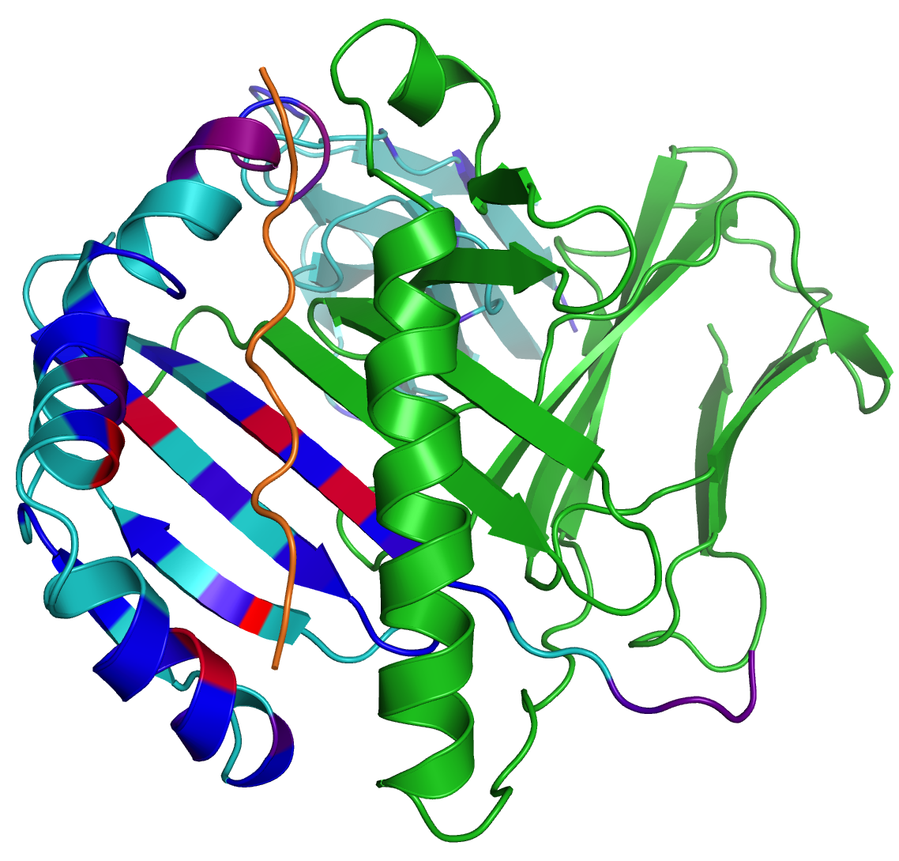
S6 Fig. Risk residues for Class II HLA genes. Accumulation of Class II risk residues in the peptide-binding groove is color-coded according to the strength of association (from pure blue, weakest association, to pure red, highest association – formula for producing color value is given in Methods). a) Class II risk; b) Zoomed version; c) Risk residues in the peptide-binding groove of HLA-DPA1/DPB1. Post-conditioning on DRB1-11/13, DRB1-37 and DQB1-37; d) Zoomed version; e) Post-conditioning on DRB1-11/13, DRB1-37, DQB1-37, A-70, DPB1-35, and B-9; f) Post-conditioning on DRB1-11/13, DRB1-37, DQB1-37, A-70, DPB1-35, and B-9 (zoom); g) Risk residues in the peptide-binding groove of HLA-DQA1/DQB1. Post-conditioning on DRB1-11/13 and DRB1-37; h) Zoomed version; i) Post-conditioning on DRB1-11/13, DRB1-37, DQB1-37, A-70, DPB1-35, and B-9; j) Zoomed version; k) Risk residues in the peptide-binding groove of HLA-DRA1/DRB1; l) Zoomed version; m) Post-conditioning on DRB1-11/13; n) Post-conditioning on DRB1-11/13, DRB1-37, DQB1-37, A-70, DPB1-35, and B-9. o) Comparison of Class I and Class II amino-acid residue risk. Protein Data Bank (PDB) files used for image generation are: HLA-DPA1 (3LQZ), HLA-DQA1 (1JK8), HLA-DRB1 (2SEB). For the Class II composite images, HLA-DRB1 is used as the structure upon which to represent the combined results.
Class II
S6a Fig. Accumulation of Class II risk residues in the peptide-binding groove.

Slide 3
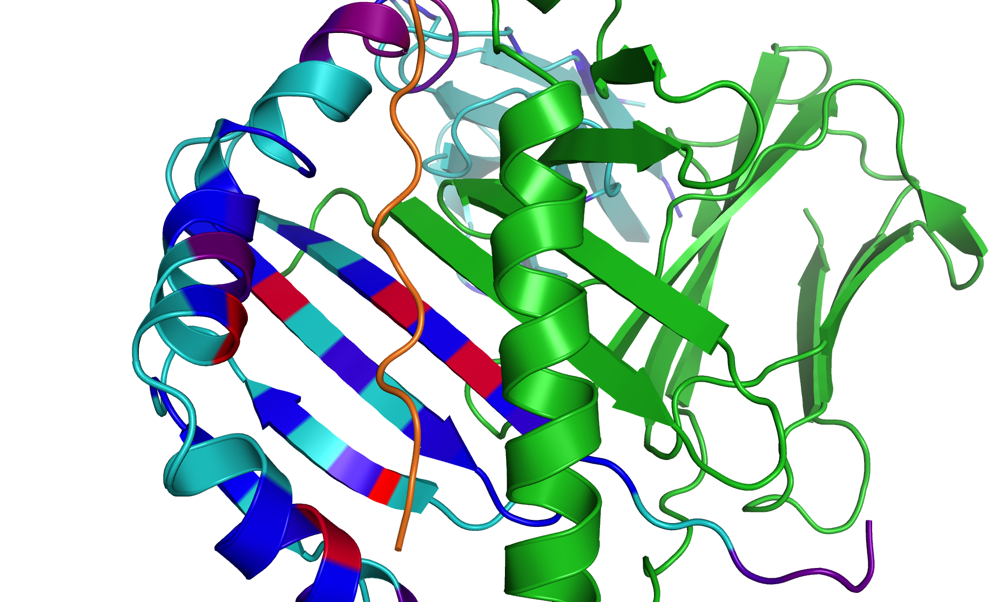
S6b Fig. Accumulation of Class II risk residues in the peptide-binding groove (zoom).
Class II
26
13
67
11
37
57

Slide 4
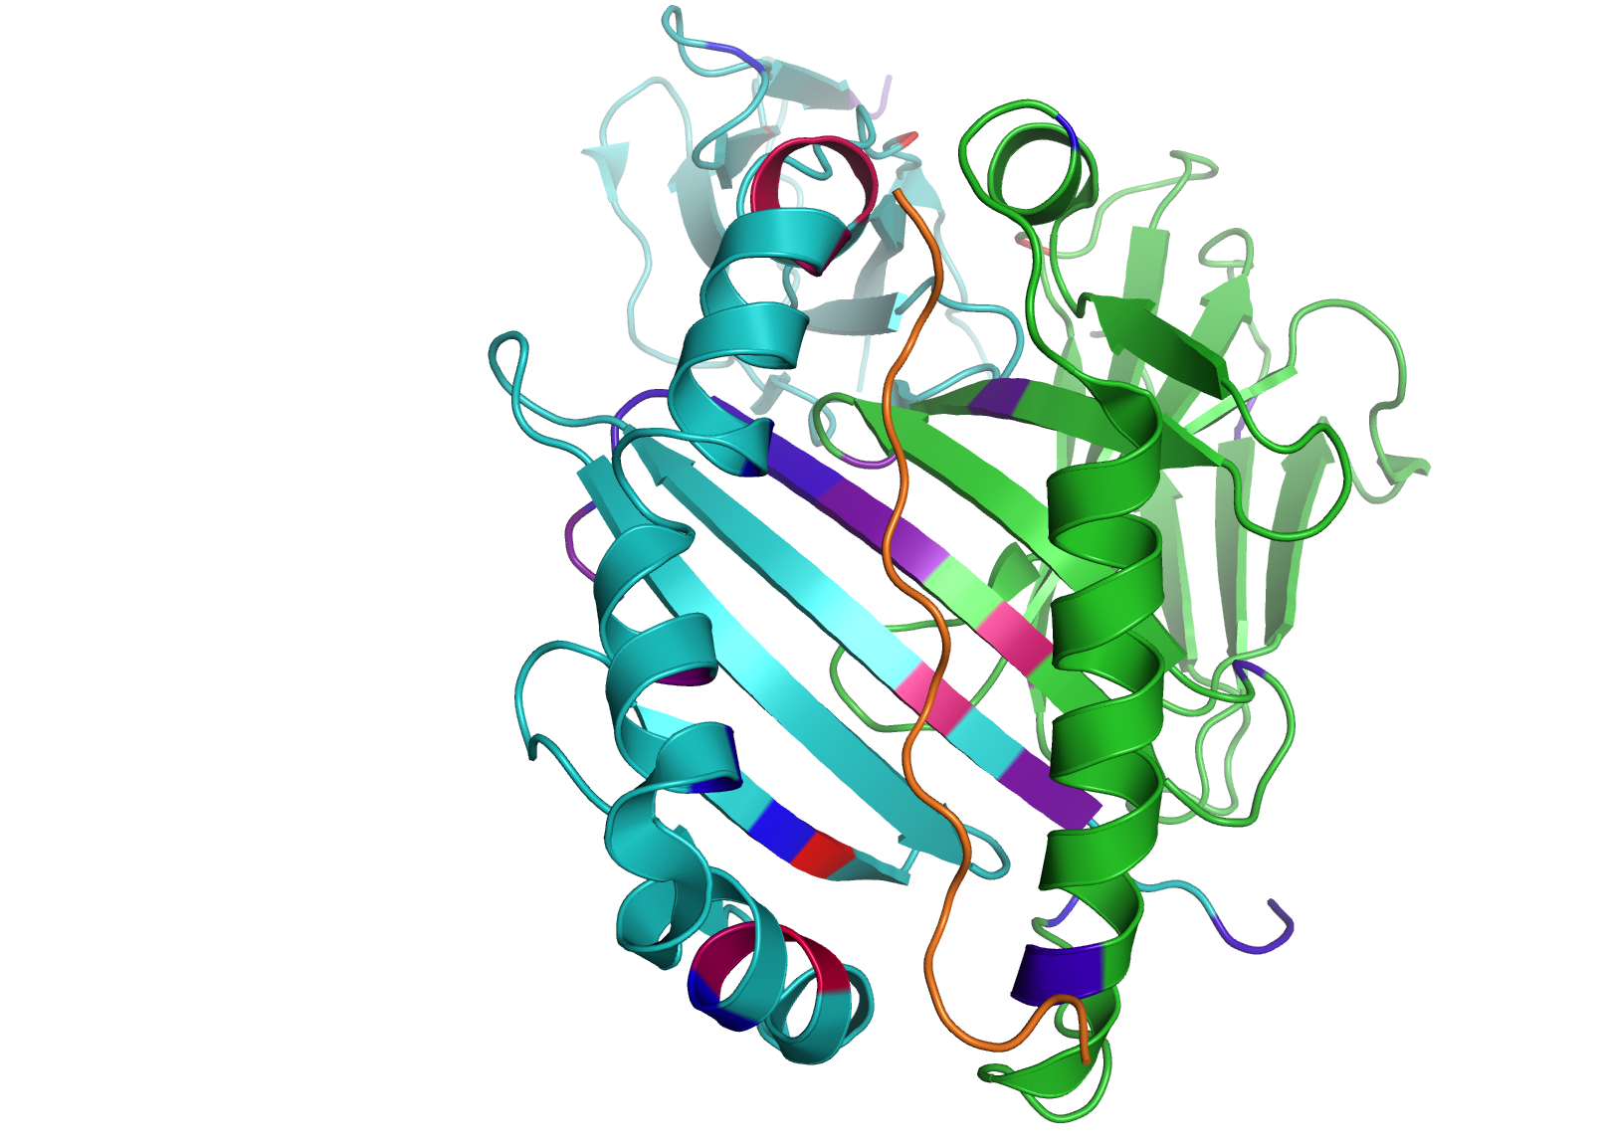
S6c Fig. Risk residues in the peptide-binding groove of HLA-DPA1/DPB1. Post-conditioning on DRB1-11/13, DRB1-37 and DQB1-37.
DPA1
DPB1
B35

Slide 5
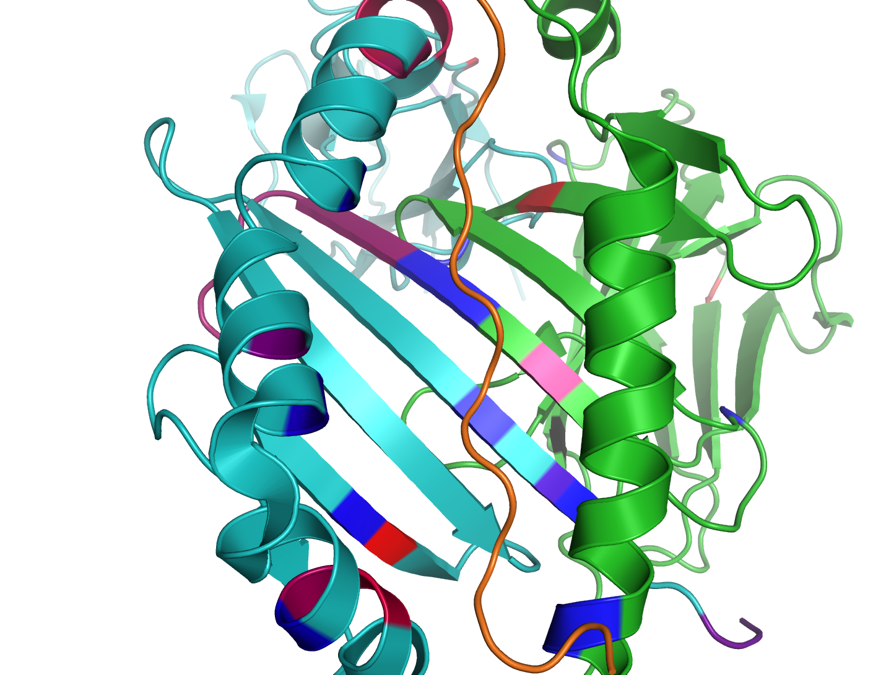
S6d Fig. Risk residues in the peptide-binding groove of HLA-DPA1/DPB1. Post-conditioning on DRB1-11/13, DRB1-37 and DQB1-37 (zoom). DPB1-55 emerges as a significantly associated residue in addition to DPB1-35.
DPA1
DPB1
B35
B55

Slide 6
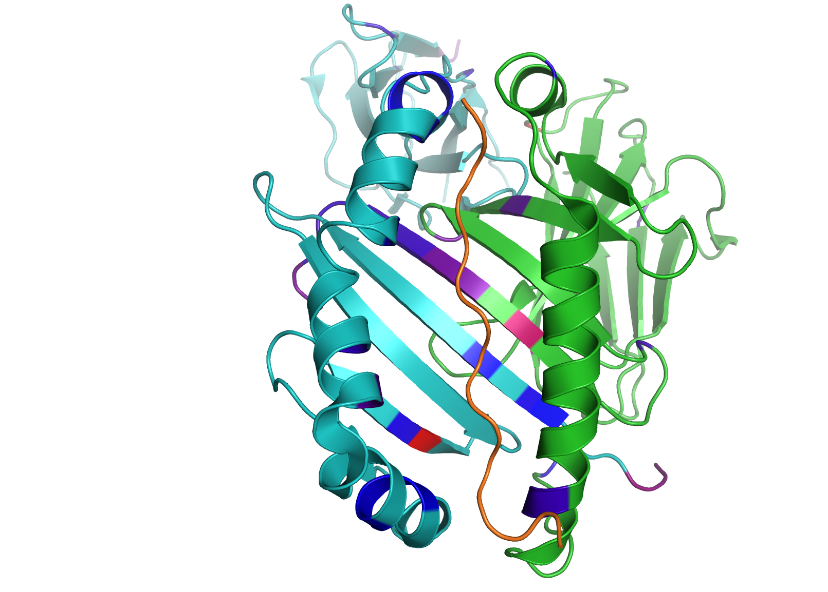
S6e Fig. Risk residues in the peptide-binding groove of HLA-DPA1/DPB1. Post-conditioning on DRB1-11/13, DRB1-37, DQB1-37, A-70, DPB1-35, and B-9.
DPA1
DPB1

Slide 7
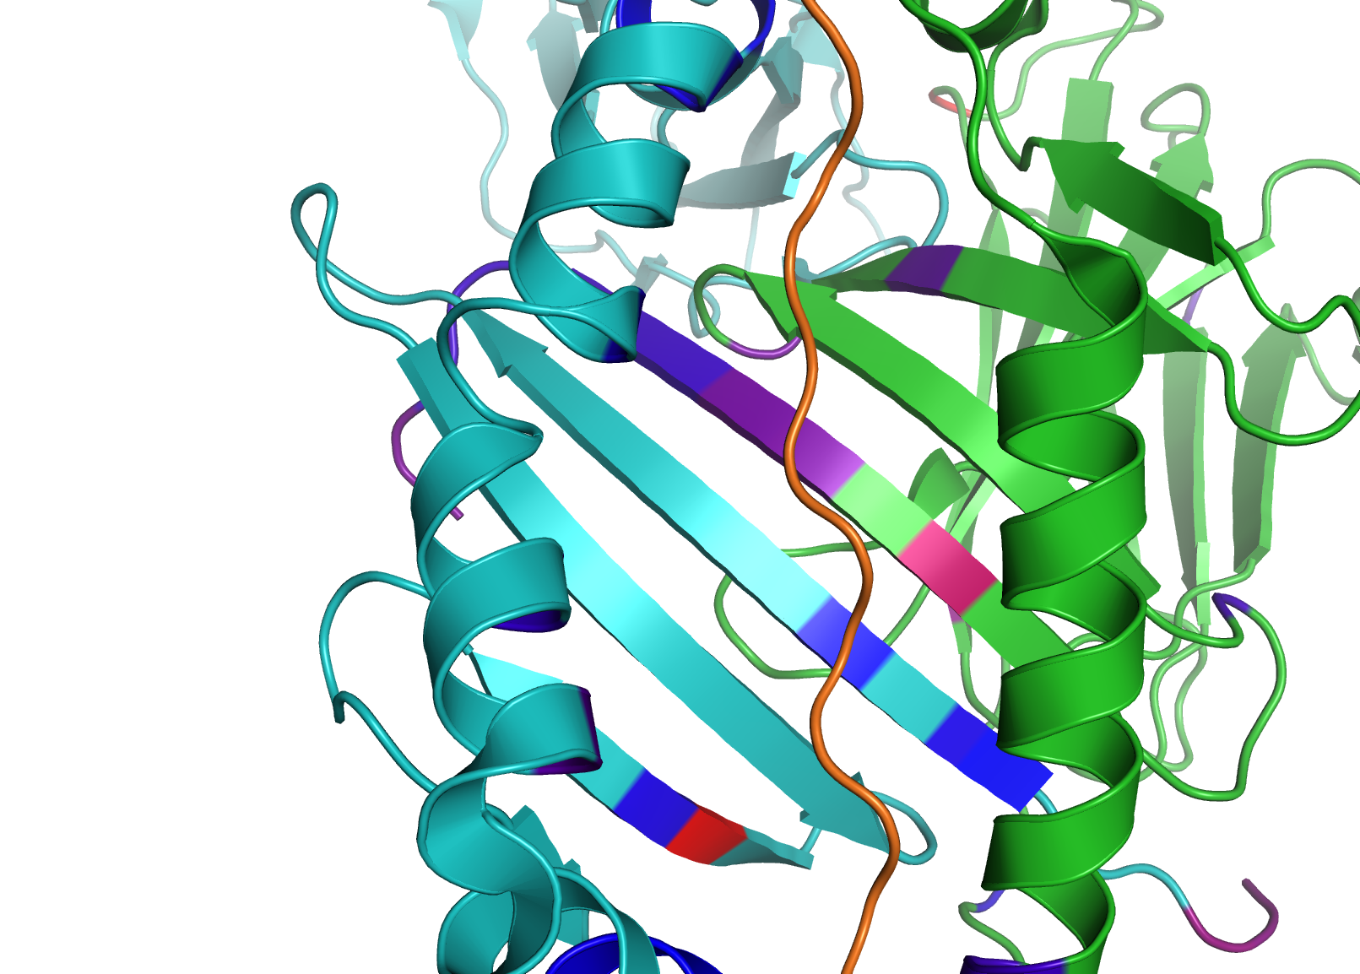
S6f Fig. Risk residues in the peptide-binding groove of HLA-DPA1/DPB1. Post-conditioning on DRB1-11/13, DRB1-37, DQB1-37, A-70, DPB1-35, and B-9 (zoom). DPA1-11 emerges as a significantly associated residue in addition to DPB1-35.
DPA1
DPB1
A11
B35

Slide 8
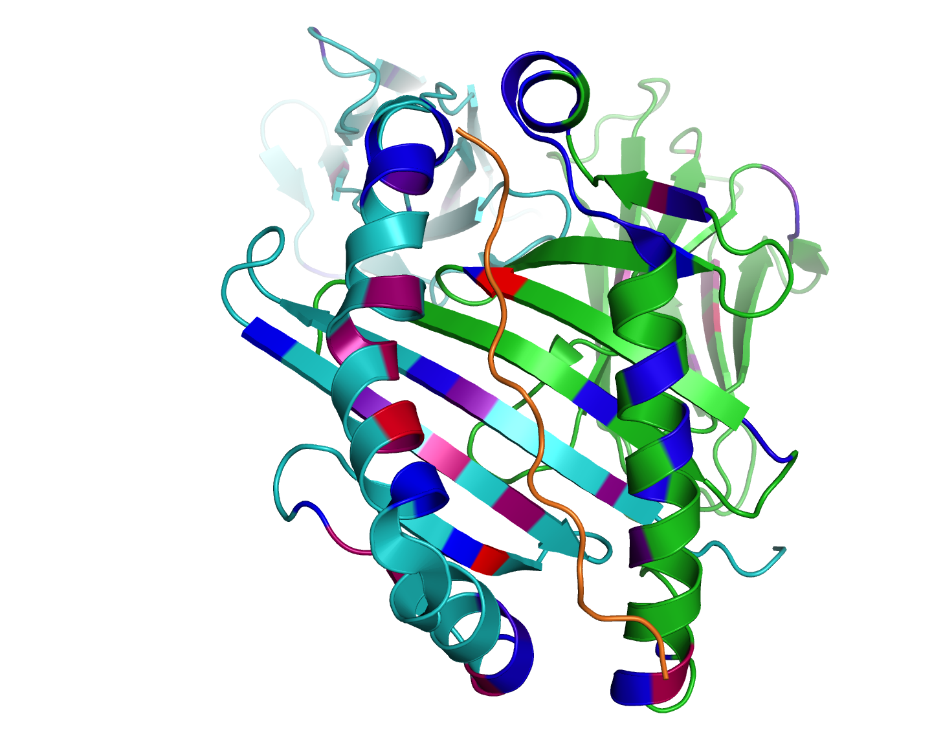
S6g Fig. Risk residues in the peptide-binding groove of HLA-DQA1/DQB1. Post-conditioning on DRB1-11/13 and DRB1-37.
DQA1
DQB1

Slide 9
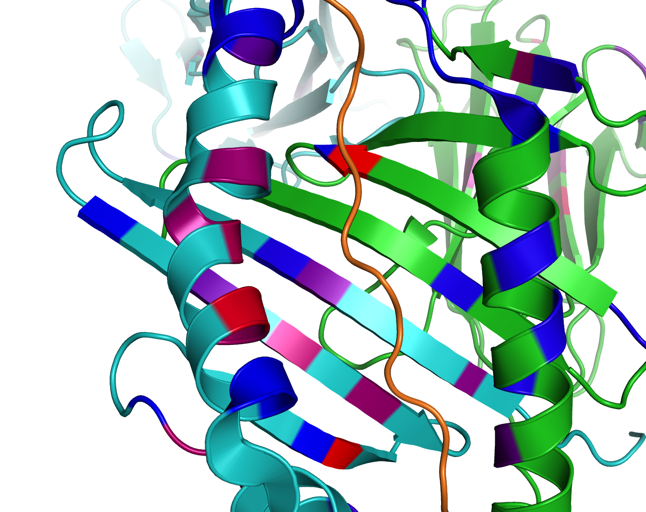
S6h Fig. Risk residues in the peptide-binding groove of HLA-DQA1/DQB1. Post-conditioning on DRB1-11/13 and DRB1-37 (zoom). DQB1-70 emerges as a significantly associated residue in addition to DQB1-37.
DQA1
DQB1
B70
B37

Slide 10
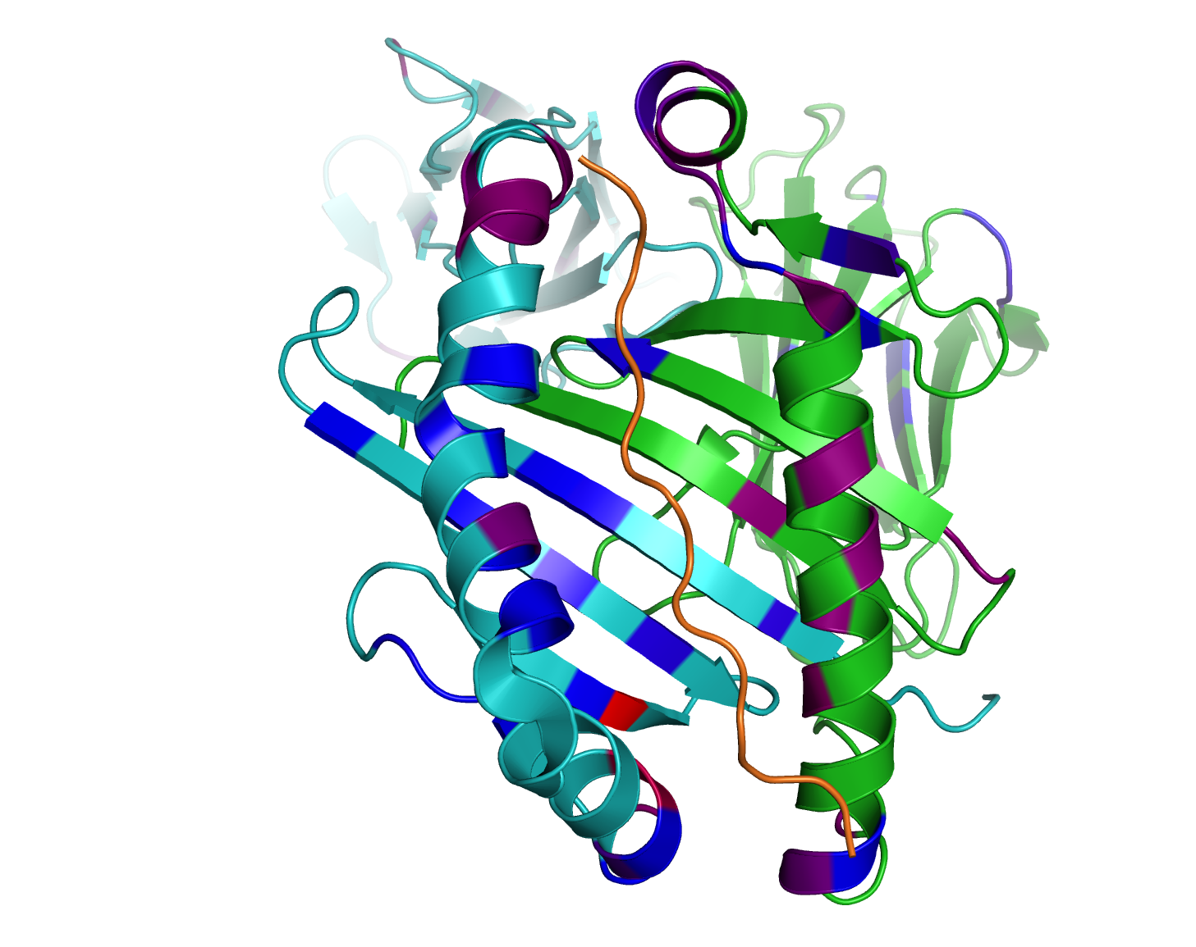
S6i Fig. Risk residues in the peptide-binding groove of HLA-DQA1/DQB1. Post-conditioning on DRB1-11/13, DRB1-37, DQB1-37, A-70, DPB1-35, and B-9.
DQA1
DQB1

Slide 11
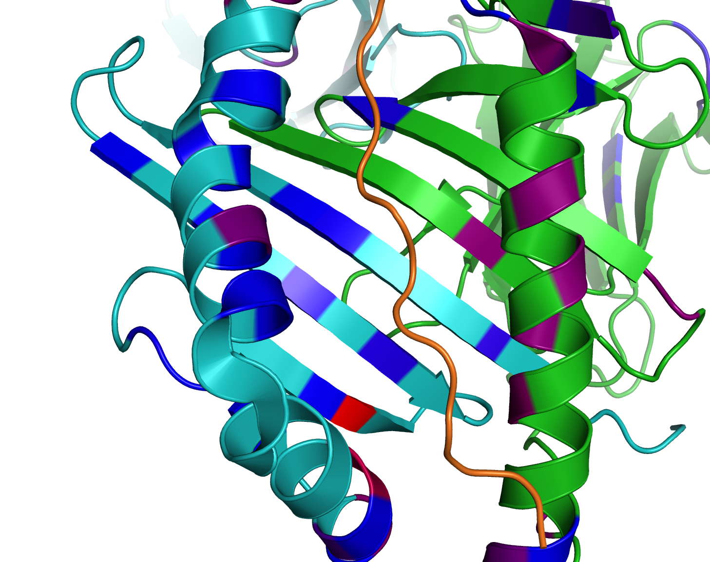
S6j Fig. Risk residues in the peptide-binding groove of HLA-DQA1/DQB1. Post-conditioning on DRB1-11/13, DRB1-37, DQB1-37, A-70, DPB1-35, and B-9 (zoom). DQB1-57 emerges as a significantly associated residue in addition to DQB1-37.
DQA1
DQB1
B37
B57

Slide 12
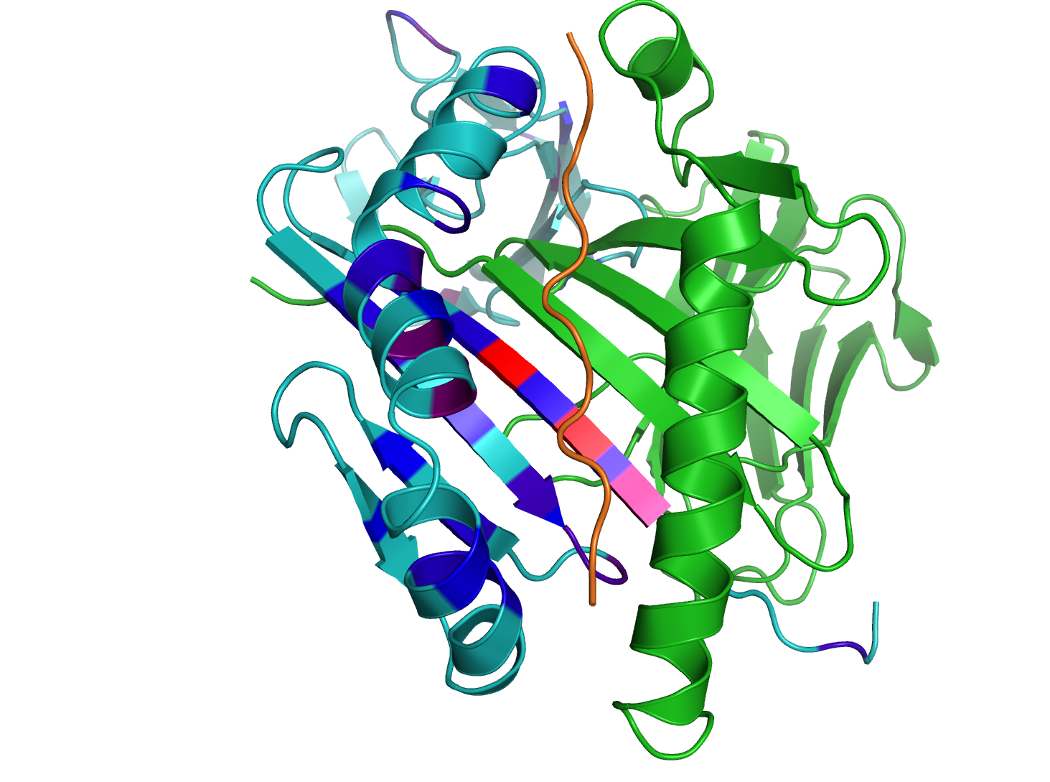
S6k Fig. Risk residues in the peptide-binding groove of HLA-DRA1/DRB1.
DRA1
DRB1

Slide 13
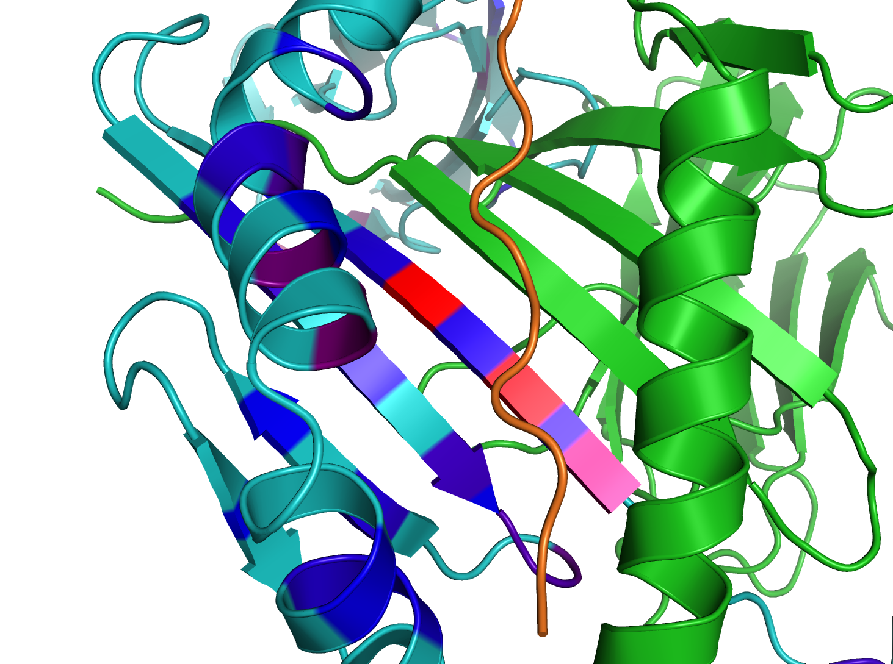
S6l Fig. Risk residues in the peptide-binding groove of HLA-DRA1/DRB1 (zoom).
DRA1
DRB1
13
11
9

Slide 14
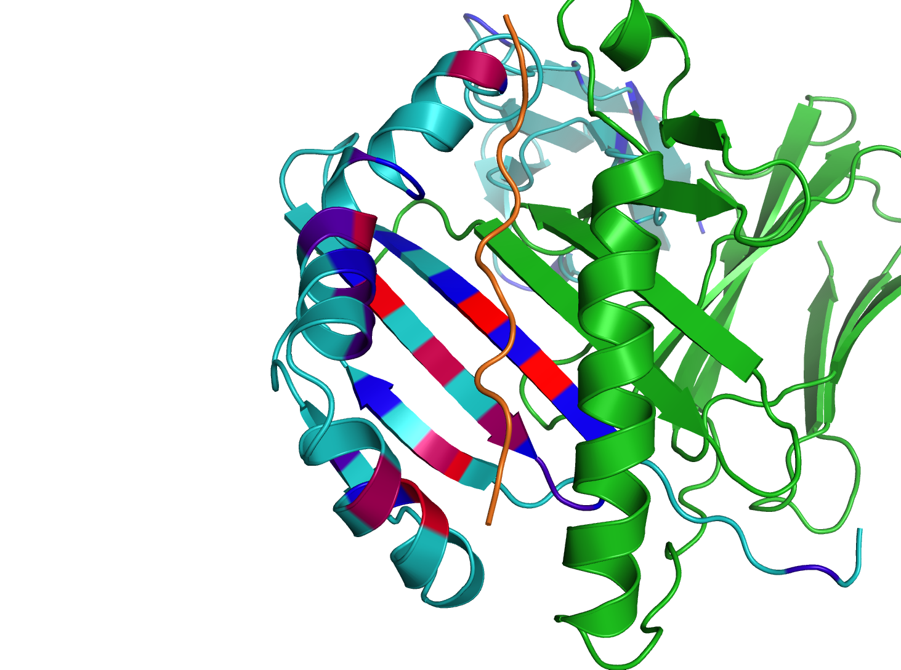
S6m Fig. Risk residues in the peptide-binding groove of HLA-DRA1/DRB1. Post-conditioning on DRB1-11/13.
DRA1
DRB1
26
13
11
37

Slide 15
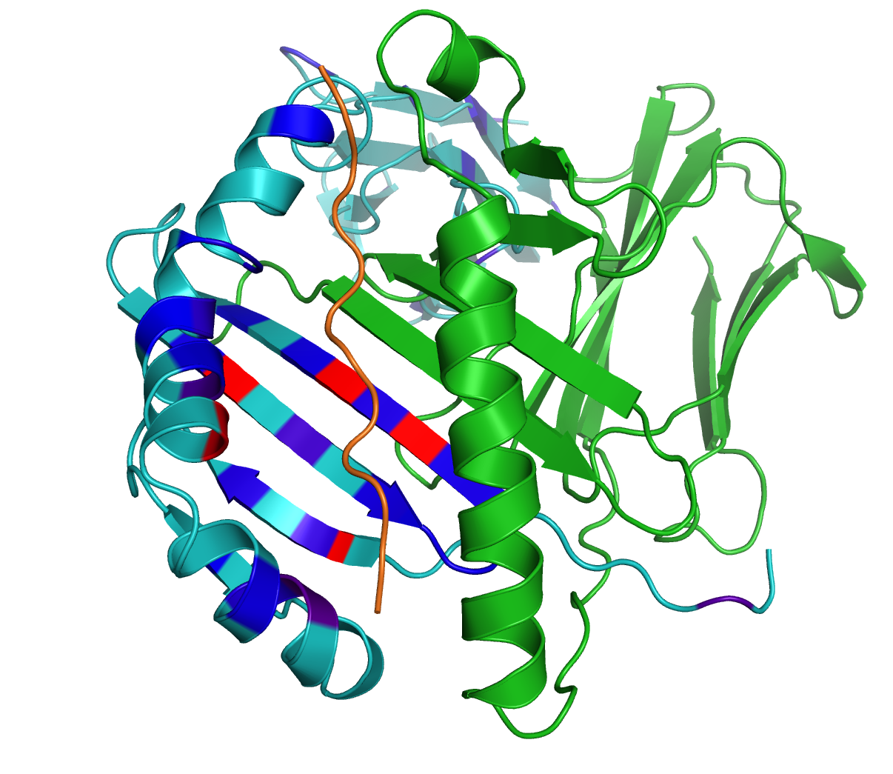
S6n Fig. Risk residues in the peptide-binding groove of HLA-DRA1/DRB1. Post-conditioning on DRB1-11/13, DRB1-37, DQB1-37, A-70, DPB1-35, and B-9. DRB1-67 emerges as a significantly associated residue.
DRA1
DRB1
26
13
67
11
37

Slide 16
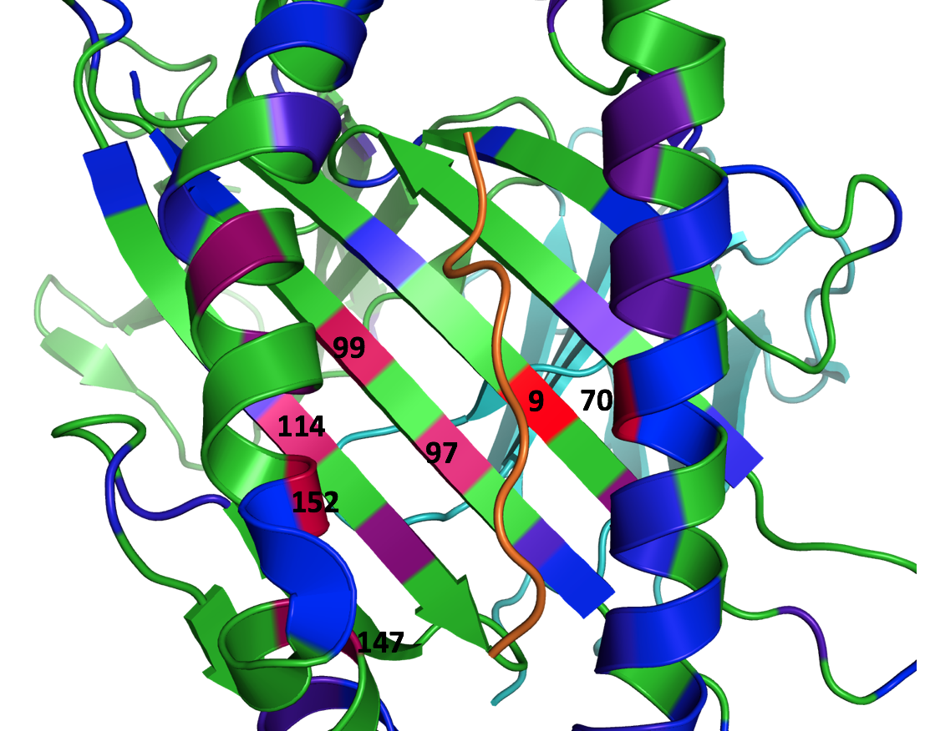
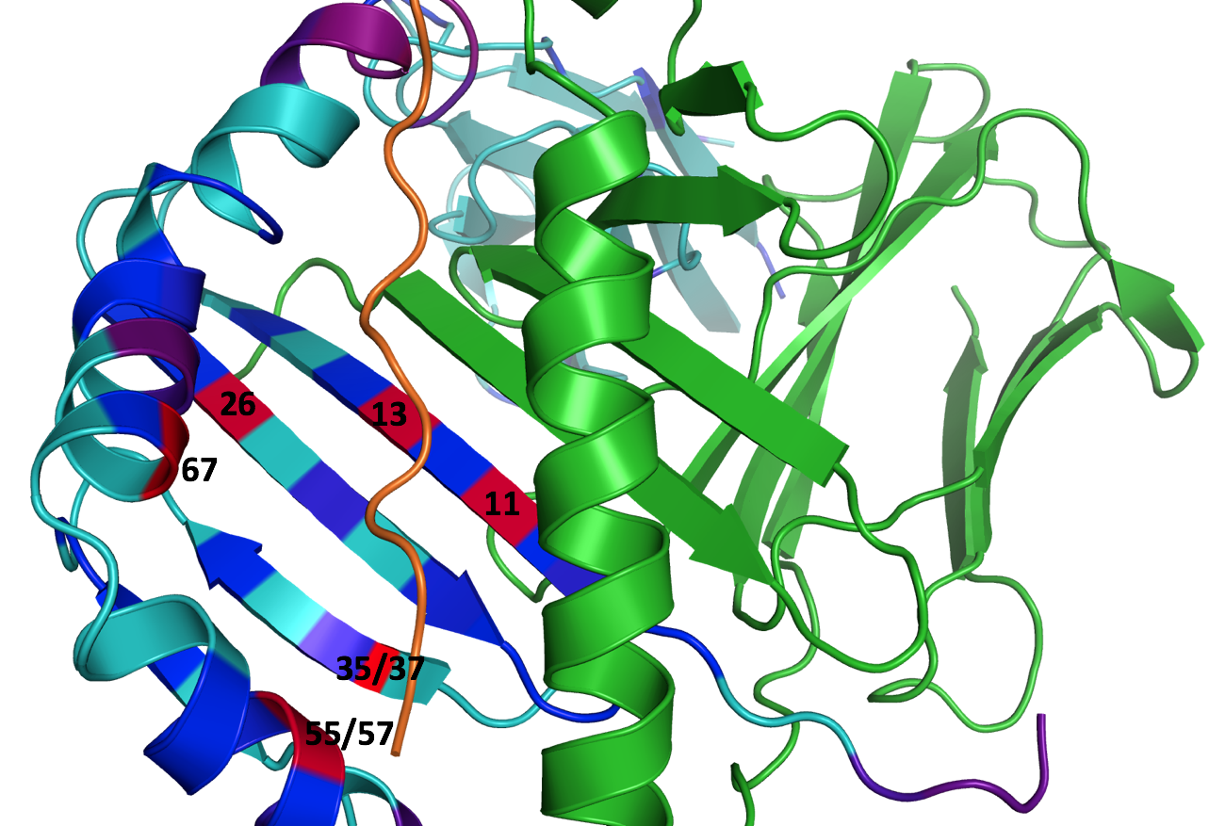
S6o Fig. Correspondence of risk positions across multiple Class I (left) and Class II (right) subunits. Risk position 35 in DQB1 and DRB1 is equivalent to DPB1-35 due to a 2-amino acid deletion; similarly DQB1-57 is equivalent to DPB1-55. Position 152 in A and C is equivalent to DRB1-67. C-99 and A-97 are equivalent to DRB1-13 and DRB1-11, respectively. A-114 is equivalent to DRB1-26. Position 9 appears as a top risk position for both B and C.

