Slide 1
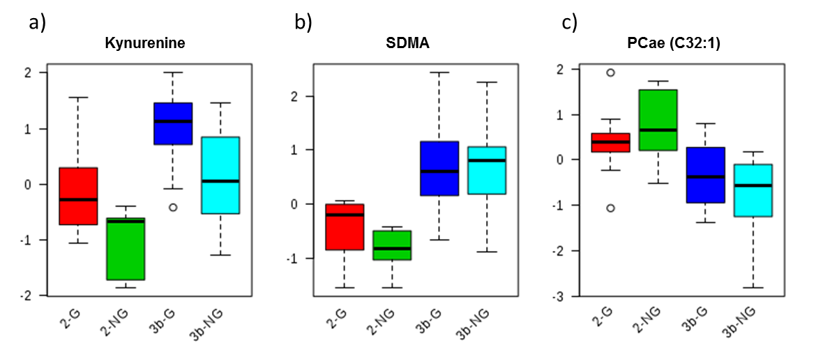
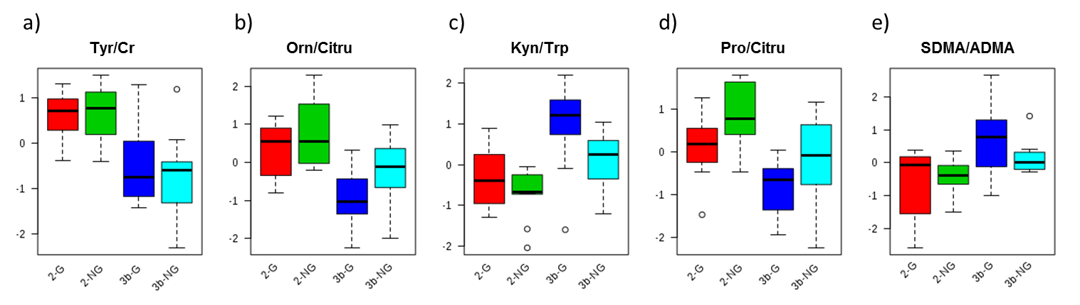
SUPPLEMENTARY FIGURE 3 (a-h)
(a) (b) (c)
Kynurenine SDMA PC ae (C32:1)
CKD Sub-Group 2-G 2-NG 3b-G 3b-NG 2-G 2-NG 3b-G 3b-NG 2-G 2-NG 3b-G 3b-NG
p Value 0.0023 0.00313 0.019
(d) (e) (f) (g) (h)
Tyr/Cr Orn/Cit Kyn/Trp Pro/Cit SDMA/ADMA
CKD Sub-Group 2-G 2-NG 3b-G 3b-NG 2-G 2-NG 3b-G 3b-NG 2-G 2-NG 3b-G 3b-NG 2-G 2-NG 3b-G 3b-NG 2-G 2-NG 3b-G 3b-NG
p Value 8.83E-05 1.19E-04 3.98E-04 5.08E-04 0.00424

