Slide 1
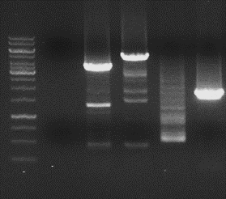
kb
M
H₂O
PstI
HindIII
BsrGI
AseI
10
6
4
3
2
1
0.5

