Slide 1
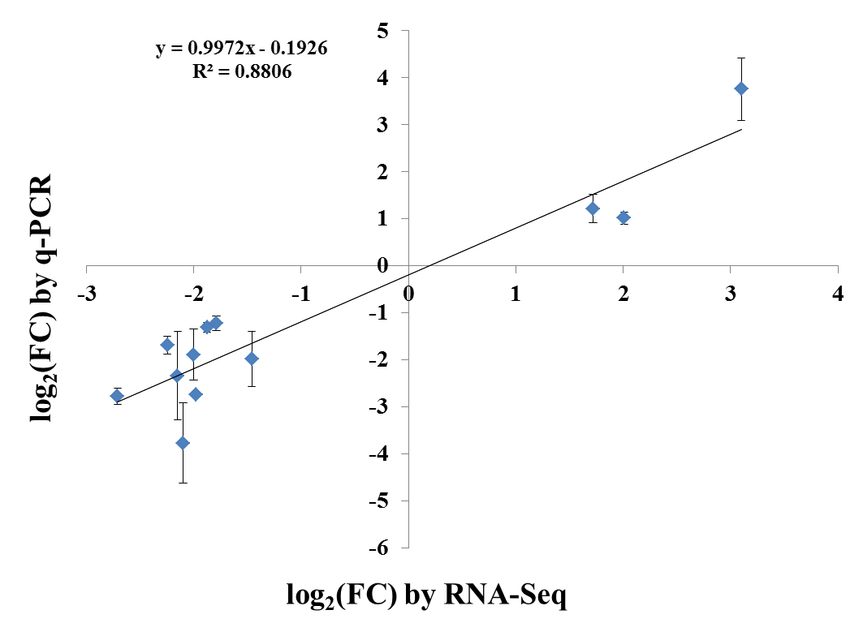
Figure. S5 Comparison of the log2 (FC) of 12 selected transcripts using RNA-Seq and q-PCR. Both the log2 transformed values of relative expression of qRT-PCR and fold changes of RNA-seq data were used for linear regression. The Pearson’s correlation coefficient was used to measure the linear correlation of qRT-PCR and RNA-seq analysis.

