Slide 1
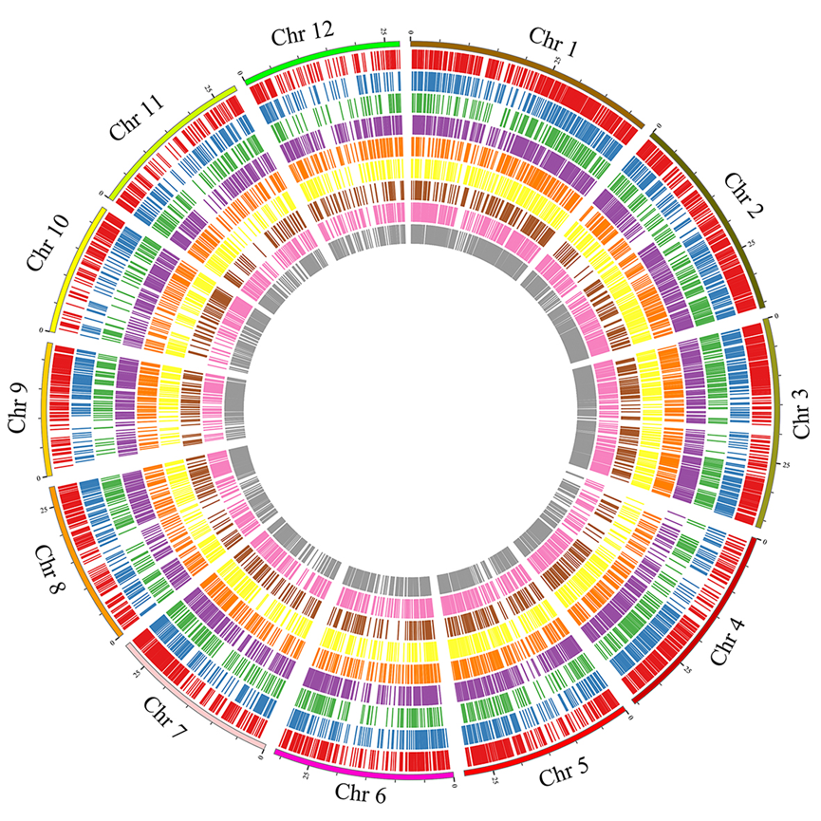
Figure. S7 Distribution of DEG_{FPU} mapped in yield- and yield-related QTLs. From the outside to the inside are L1, L2, L3, P1, P2, P3, E2, Z2 and Z3, respectively. L1 and P1 represent flag leaves and anthers at meiosis stage, respectively. L2, P2, E2 and Z2 represent flag leaves, anther, embryo sac and leaf sheath at pre-flowering stage, respectively. L3, P3 and Z3 represent flag leaves, grain and leaf sheath at three days after flowering, respectively.

