Slide 1
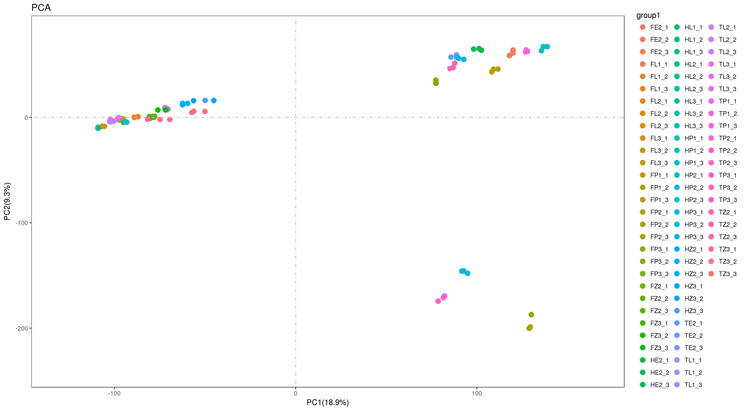
Figure. S3 The principal component analysis (PCA) in the hybrid and its parents. T, H and F represent T449, H1 and F₁, respectively. L1 and P1 represent flag leaves and anthers at meiosis stage, respectively. L2, P2, E2 and Z2 represent flag leaves, anther, embryo sac and leaf sheath at pre-flowering stage, respectively. L3, P3 and Z3 represent flag leaves, grain and leaf sheath at three days after flowering, respectively.

