Slide 1
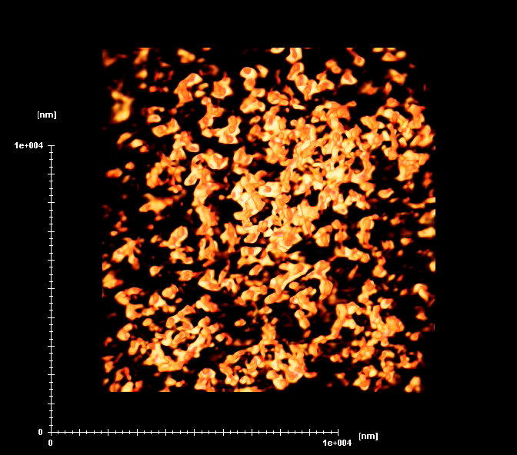
Supplementary Movie 1

Slide 2
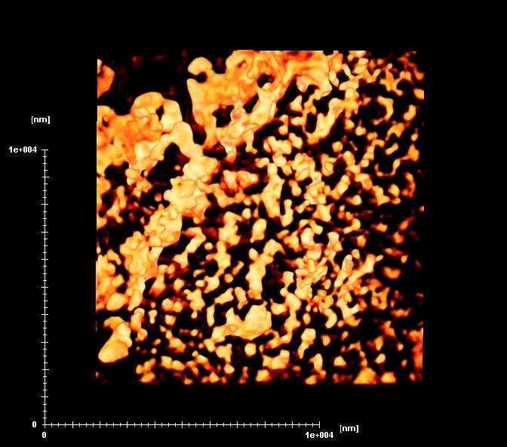
Supplementary Movie 2

Slide 3
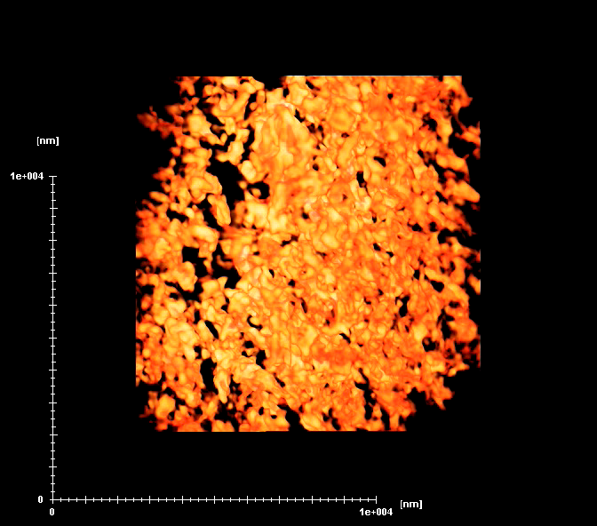
Supplementary Movie 3

