Slide 1
OPTIMIZE-HF (n=48,612)
Linked to Medicare fee-for-service data (n=26,376)
Discharged alive (n=25,345)
Left ventricular ejection fraction ≤35% (n=9050)
No prior spironolactone use (n=8206)
Cr ≤2.5 (male), ≤2.0 (female)
eGFR ≥30
Pre-Match Creatinine Cohort
(n=6986)
Pre-Match eGFR Cohort
(n=6466)
No spironolactone (n=6121)
Spironolactone (n=865)
No spironolactone (n=5646)
Spironolactone
(n=820)
Patients matched 1:1 by propensity scores for spironolactone use
No spironolactone
(n=862)
Spironolactone
(n=862)
No spironolactone
(n=819)
Spironolactone
(n=819)
Matched Creatinine Cohort
(n=1724)
Matched eGFR Cohort
(n=1638)
Figure 1. Flow chart displaying assembly of propensity score-matched Creatinine Cohort (serum creatinine ≤2.5mg/dL for men and ≤2.0mg/dL for women) and eGFR Cohort (estimated glomerular filtration rate ≥30 mL/min/1.73 m²) of patients with heart failure, left ventricular ejection fraction ≤35%, with no prior spironolactone therapy

Slide 2
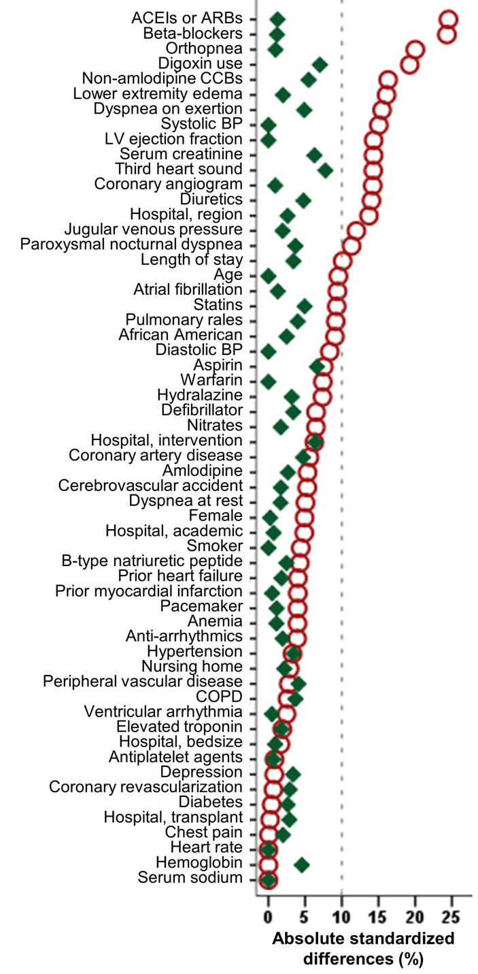

Figure 2. Love plot displaying absolute standardized differences for 58 baseline characteristics between patients receiving and not receiving a discharge prescription for spironolactone, before and after propensity score matching. Data based on patients with heart failure, left ventricular ejection fraction ≤35%, no prior spironolactone therapy, and serum creatinine ≤2.5mg/dL for men and ≤2.0mg/dL for women. A standardized difference of 0% indicates no residual bias and values <10% indicate inconsequential bias (ACE=angiotensin-converting enzyme; ARB=angiotensin receptor blockers; BP=blood pressure; CCB= calcium channel blocker; COPD=chronic obstructive pulmonary disease)
Pre-match
Post-match

Slide 3
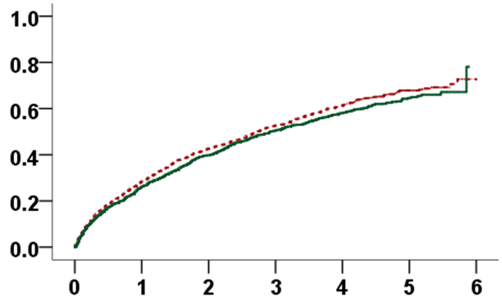
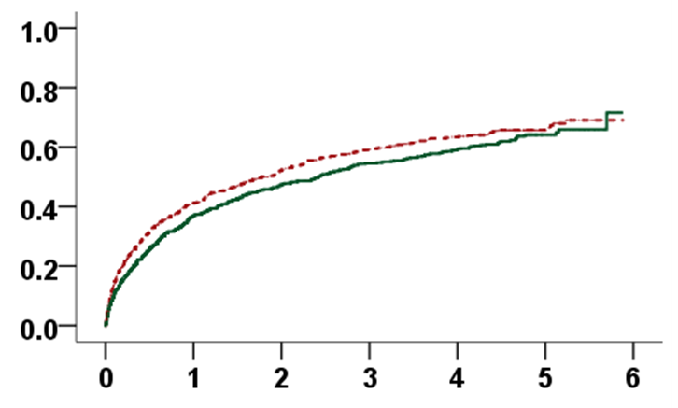
Hazard ratio (95% CI):
0.92 (0.81–1.03); p=0.135
Hazard ratio (95% CI):
0.87 (0.77–0.99); p=0.041
No spironolactone
No spironolactone
All-cause mortality
HF readmission
Spironolactone
Spironolactone
Follow-up (years)
Follow-up (years)
Number at risk
No spironolactone | 862 | 617 | 494 | 408 | 334 | 107
Spironolactone | 862 | 636 | 519 | 427 | 362 | 96
Number at risk
No spironolactone | 862 | 399 | 276 | 210 | 161 | 48
Spironolactone | 862 | 444 | 322 | 248 | 201 | 48
Figure 3. Kaplan Meier plots for outcomes by discharge prescription for spironolactone in patients with heart failure, left ventricular ejection fraction ≤35%, no prior spironolactone therapy, and serum creatinine ≤2.5mg/dL for men and ≤2.0mg/dL for women (CI= confidence interval)

Slide 4
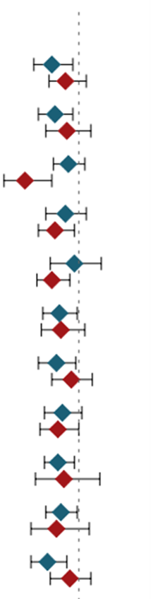
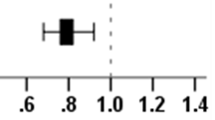
Spironolactone better
Spironolactone worse
HF readmission or all-cause mortality, events/at risk (%)
HR (95% CI)
Figure 4. Subgroup analyses for the combined endpoint by discharge prescription for spironolactone in 1724 propensity score-matched patients with heart failure, left ventricular ejection fraction ≤35%, no prior spironolactone therapy, and serum creatinine ≤2.5mg/dL for men and ≤2.0mg/dL for women

Slide 5
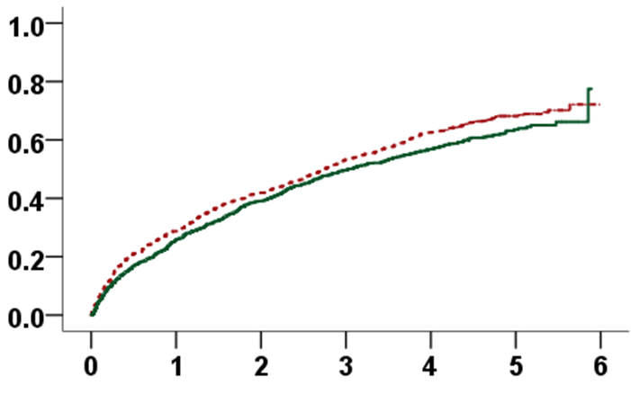
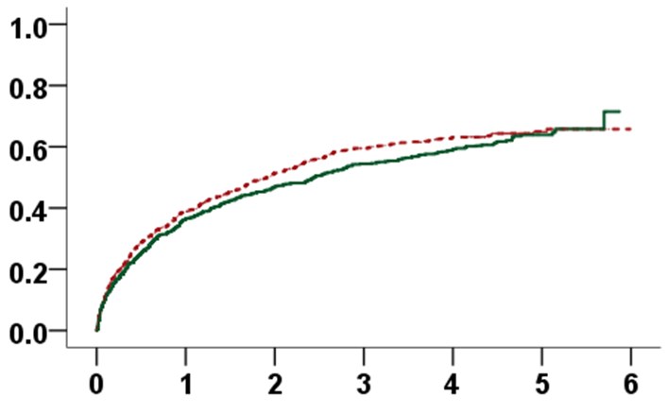
Hazard ratio (95%CI):
0.87 (0.77 – 0.98); p =0.025
Hazard ratio (95% CI):
0.92 (0.80 – 1.05); p =0.213
No spironolactone
No spironolactone
All-cause mortality
Heart failure readmission
Spironolactone
Spironolactone
Follow-up (years)
Follow-up (years)
Number at risk
No spironolactone | 819 | 584 | 476 | 383 | 307 | 98
Spironolactone | 819 | 607 | 499 | 412 | 354 | 94
Number at risk
No spironolactone | 819 | 392 | 277 | 199 | 160 | 49
Spironolactone | 819 | 425 | 308 | 237 | 194 | 46
Figure 5. Kaplan Meier plots for outcomes by discharge prescription for spironolactone in patients with heart failure, left ventricular ejection fraction ≤35%, no prior spironolactone therapy, and estimated glomerular filtration rate ≥30 mL/min/1.73 m² (CI= confidence interval)

