Slide 1
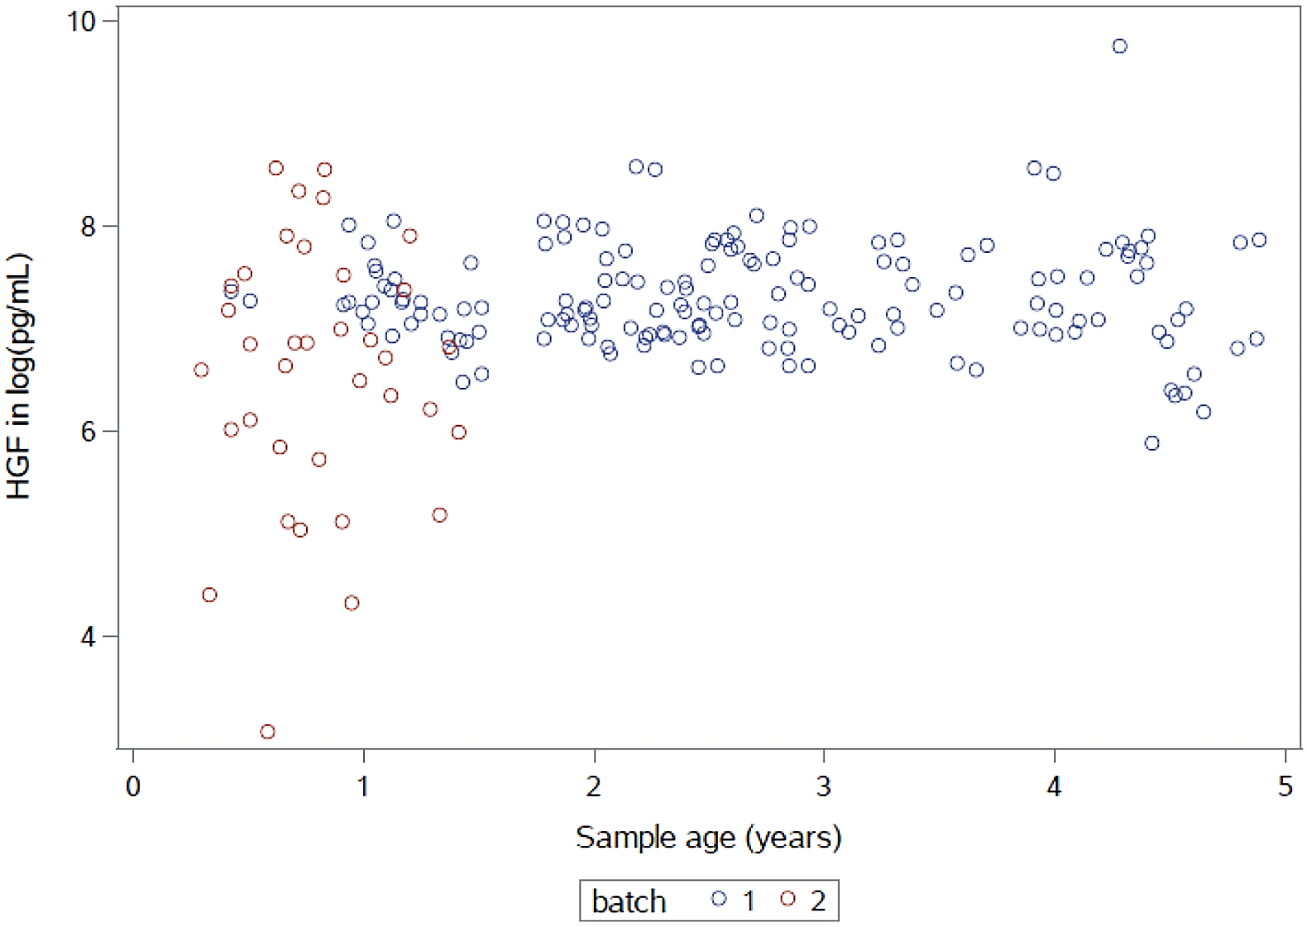
Supplemental Figure 1

Slide 2
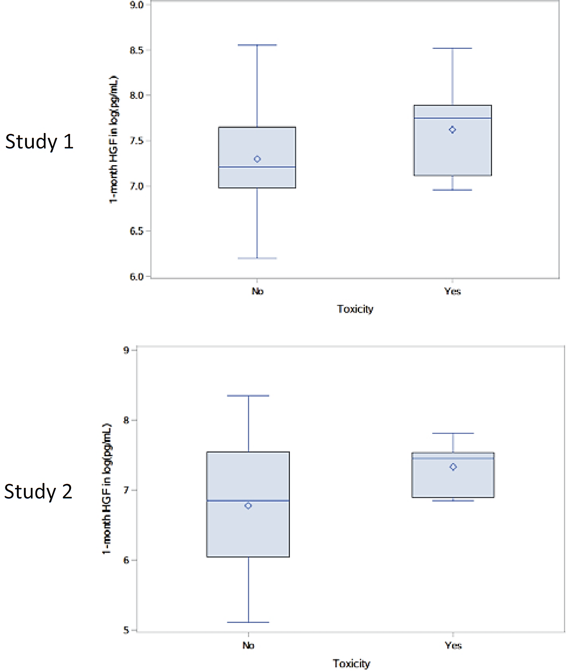
Supplemental Figure 2

Slide 3
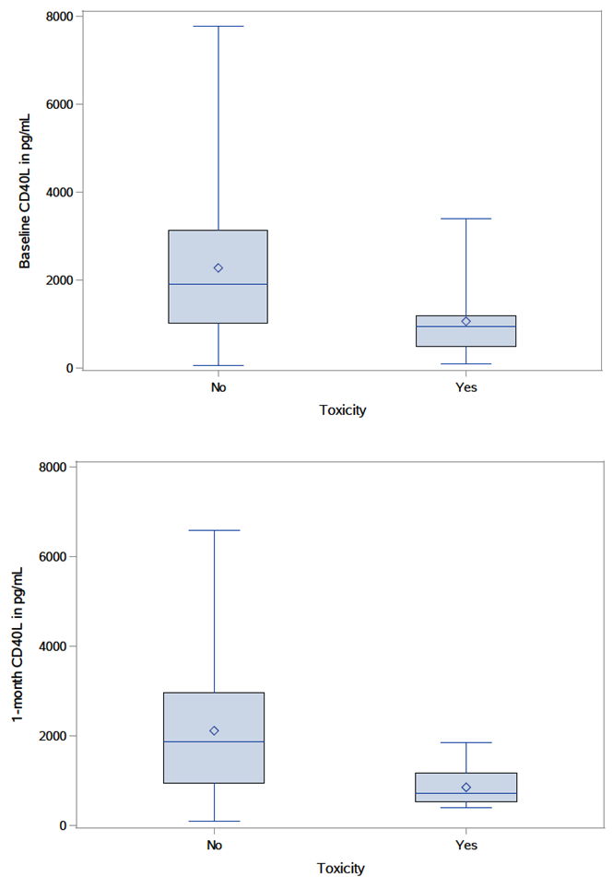
Supplemental Figure 3

