Slide 1
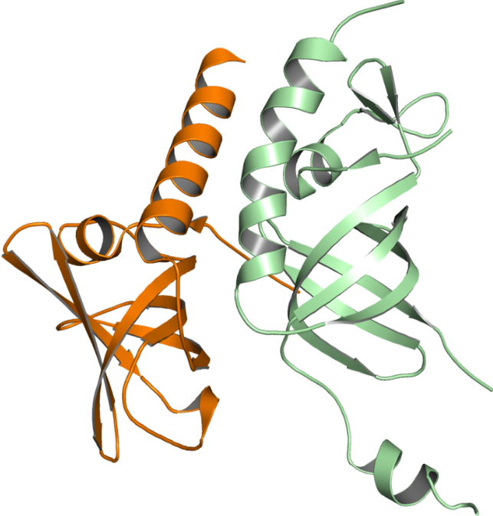
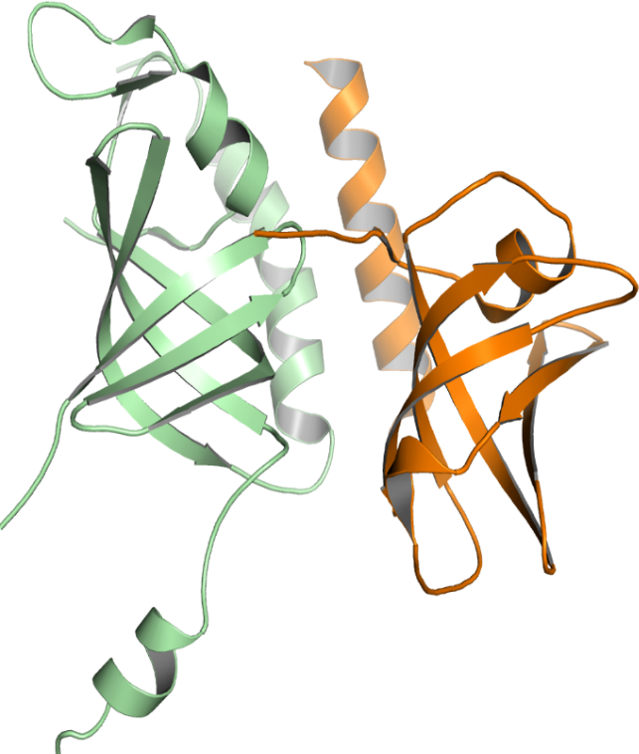

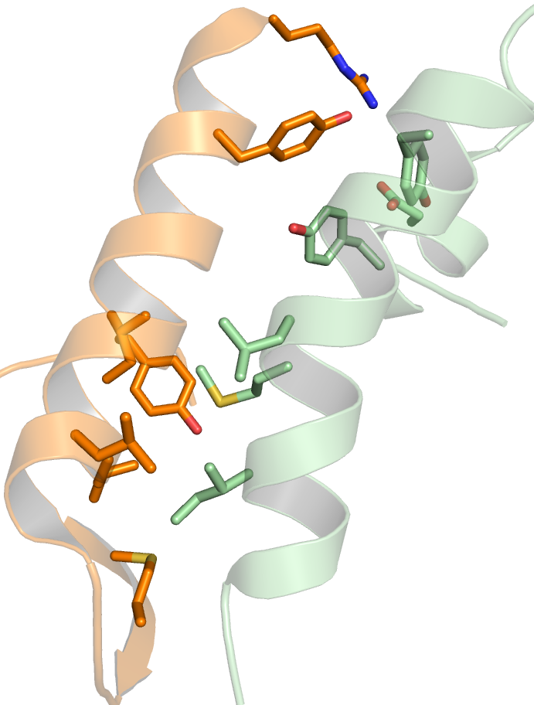
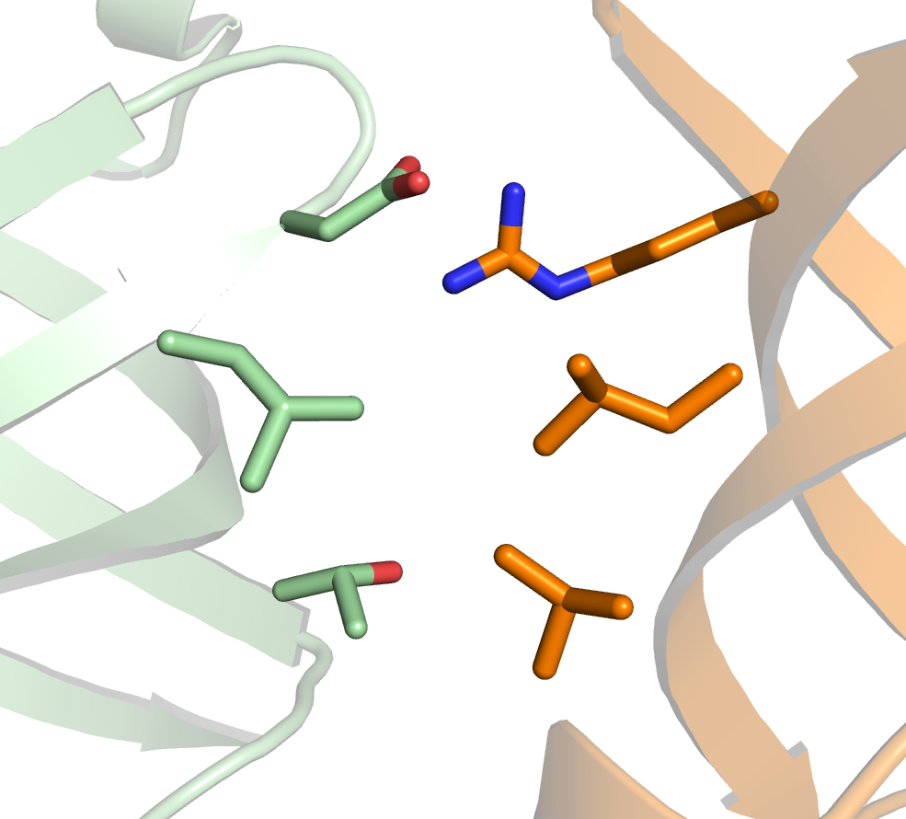
A
α2
α3
B
TEN1
STN1
180º
C
Arg119
D
Tyr115
Tyr174
β3
β3
Asp78
Arg27
Asp33
Ile109
Tyr30
β4
Tyr9
Leu168
β2
Ile64
Leu76
Met167
Leu104
Ile164
β1
Thr62
Val93
β5
Leu105
α2
α3
TEN1
Met100
STN1
Fig. S2. Structure of STN1-TEN1 complex. (A) Cartoon representation of STN1-TEN1 dimer, showing interface of two subunits. (B) View of the STN1-TEN1 complex after 180° rotation. (C) Interactions between N-terminal STN1 and TEN1 C-terminal helices α3 and α2, respectively. (D) Interaction between the β-barrels of STN1 and TEN1 complex.

