Slide 1
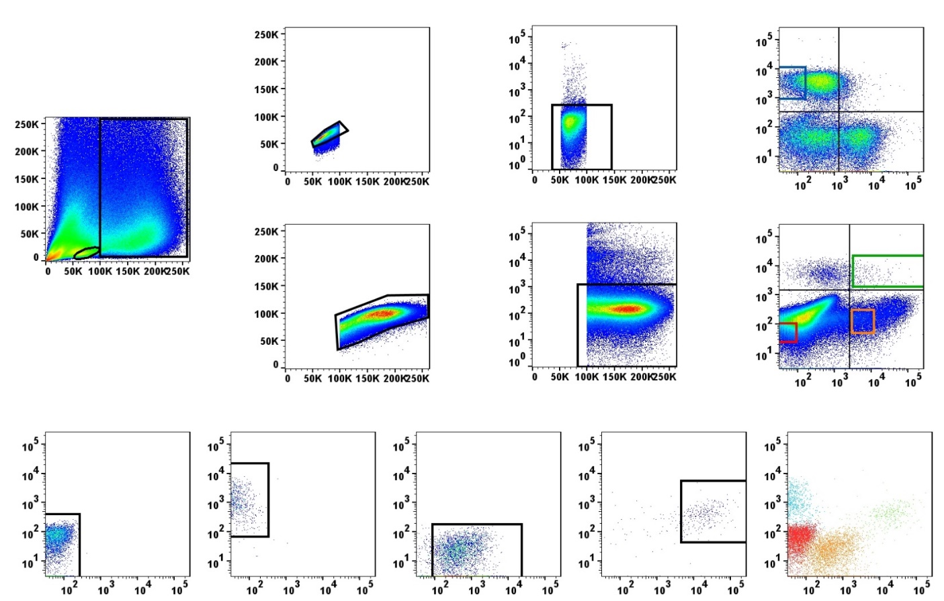

Fig. Sup 1
A
FSC-H
L
CD8
YO-PRO-1
7.9
SSC
M
L
M
0.062
FSC
16.5
1.57
FSC-A
FSC
MHC-II
B
CD8
100%
99%
94.2%
79.1%
MHC-II
Figure S1. FACS gating strategy for intestinal CD8⁺ DCs. (A) Rainbow trout intestinal leukocytes were stained with YOPRO-1, anti-MHC-II and anti-CD8 mAbs. For each sample, FSC/SSC profiles were used to define lymphoid (L) and myeloid (M) gates. Single cells were identified by plotting FSC-H/FSC-A profiles. YOPRO-1 negative cells within the singlet gate were gated in order to select live cells. CD8 an MHC-II staining within the live gate is also shown (right panel) highlighting the sorted populations. Sorted populations included CD8⁺ T cells (lymphoid CD8⁺ MHC II⁻ cells; blue gate), CD8⁺ DCs (myeloid CD8⁺ MHC II⁺ cells; green gate), other antigen presenting myeloid cells (orange gate) and double negative myeloid cells (red gate). (B) Dot plot showing the different populations after their isolation by FACS. Double negative cells and other antigen presenting myeloid cells were isolated as purity controls. The left dot plot displays an overlay of all sorted populations.

