Slide 1
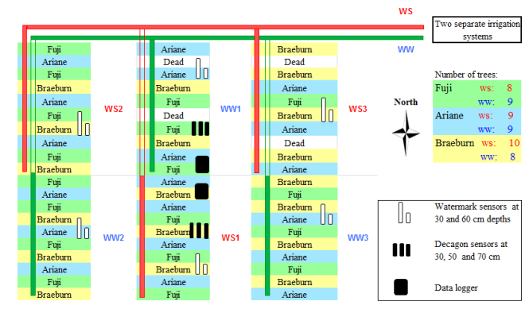
Figure S1. Field layout of the experiment.

Slide 2
Figure S2. Changes in daily rainfall, temperature and vapor pressure deﬁcit (VPD) during the experimental period in 2016 (A) and 2017 (B).

Slide 3
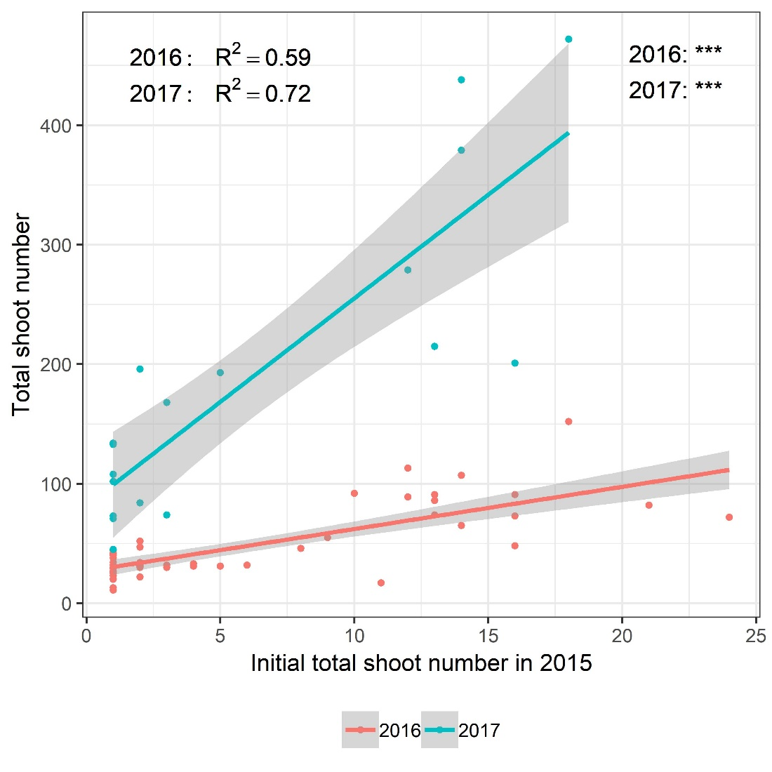
Figure S3. Relationships between initial total shoot number in 2015 and the total shoot number per tree of three apple cultivars, Ariane, Braeburn and Fuji, under well-watered (WW) and water stressed (WS) conditions in 2016 and 2017. Lines represent the correlation line in each year. Determination coefficients (R²) and their associated significances are represented for each year. Arrows represent the date at which irrigation was completely stopped for WS trees in both year. Before this date, half of the quantity of water provided to control trees was added to WS trees.

Slide 4
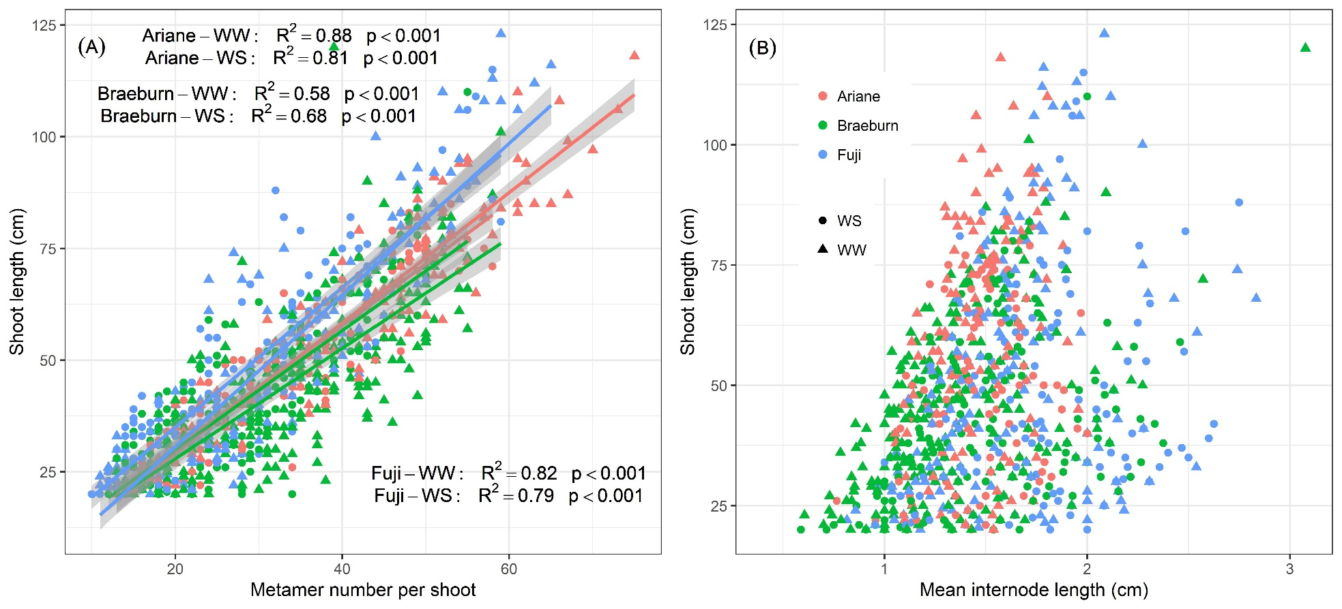
Figure S4. Relationships between shoot length and (A) metamer number per shoot and (B) mean metamer length for three apple cultivars Ariane, Braeburn, and Fuji under well-watered (WW) and water stressed (WS) conditions in 2016 and 2017. Data in both years were plotted together. The number of points was 222, 390 and 310 for Ariane, Braeburn and Fuji respectively. Determination coefficients (R²) and their associated significances are represented for each year.

