Slide 1
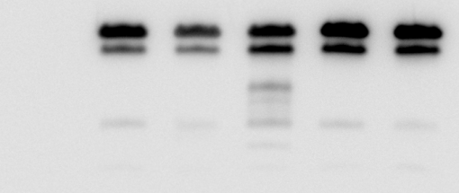



Supplementary figure 2: Cleavage of CD99 by meprin heterodimer.
CD99
Mepα
CD99
Mepβ
CD99
βE153A
CD99
βE153A
Mepα
kDa
Vektor
CD99
35
CD99-Myc
25
100
Mepα
130
Mepβ
100
50
Actin
Supplementary figure 2: Cleavage of CD99 by meprin heterodimer.
HeLa cells were transfected with CD99-Myc, meprin wt constructs and inactive meprin β E153A variant. Cell lysates were analyzed via immunoblotting and revealed no cleavage of CD99 by membrane bound meprin α or the inactive meprin β variant.

