Slide 1

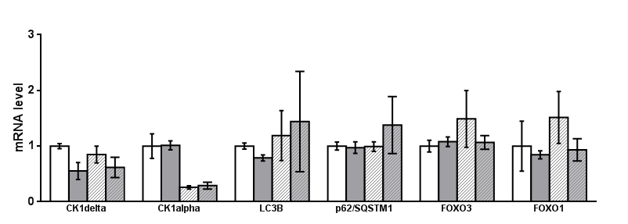
Figure S9
A
H929 shRNA 6044
B
H929 shRNA 6044
siRNA SCR
+
-
+
-
siRNA CSNK1D
-
+
-
+
ns
-
-
ns
IPTG
+
+
ns
50kDa
CK1δ
36kDa
CK1α
98kDa
p-FOXO3a S318/321
-
-
98kDa
siRNA SCR
+
+
FOXO3a
siRNA CSNK1D
-
+
-
+
36kDa
GAPDH
IPTG
-
-
+
+
C
H929 shRNA 6044
**
***
ns
ns
ns
ns
ns
***
ns
ns
ns
ns
***
ns
***
ns
ns
ns
siRNA SCR
siRNA CSNK1D
IPTG 1mM
+
-
-
-
+
-
+
-
+
-
+
+
+
-
-
-
+
-
+
-
+
-
+
+
+
-
-
-
+
-
+
-
+
-
+
+
+
-
-
-
+
-
+
-
+
-
+
+
+
-
-
-
+
-
+
-
+
-
+
+
+
-
-
-
+
-
+
-
+
-
+
+

