Slide 1
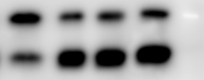

Figure S5
H929
D4476 48h
-
+
-
+
CQ 4h
-
-
+
+
17kDa
LC3B-I
LC3B-II
GAPDH
36kDa

