Slide 1
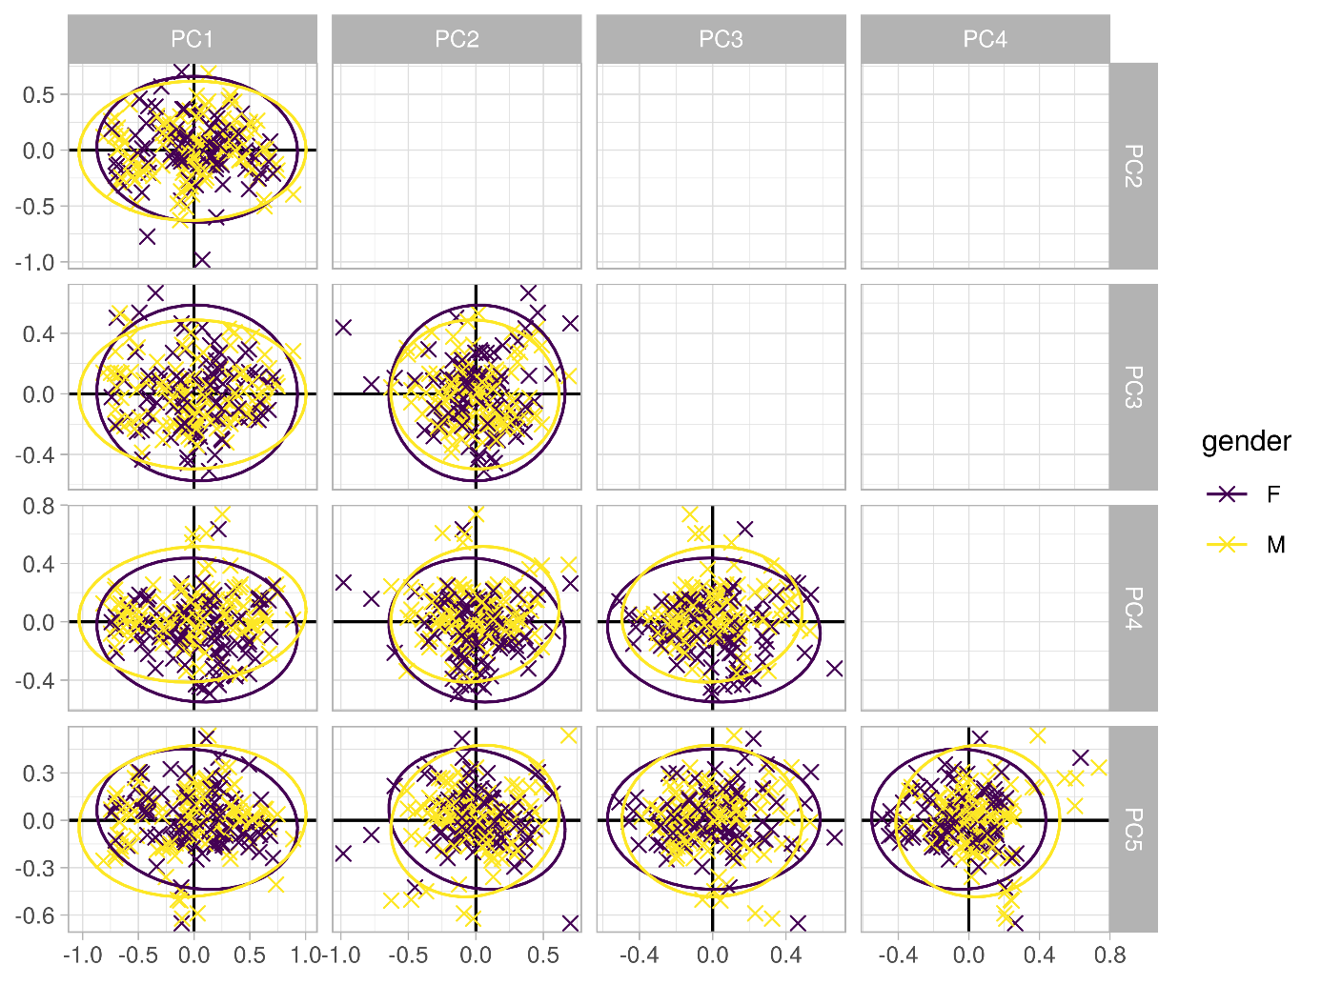
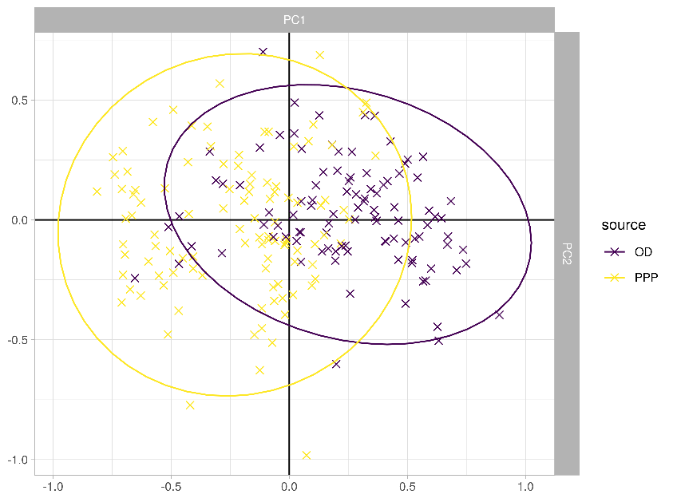
a.
b.
Supplementary Figure 1: PCA for transcriptomics. (a) PPP and OD samples clustered separately (b) but no difference in clustering in other factors, such as gender.

Slide 2
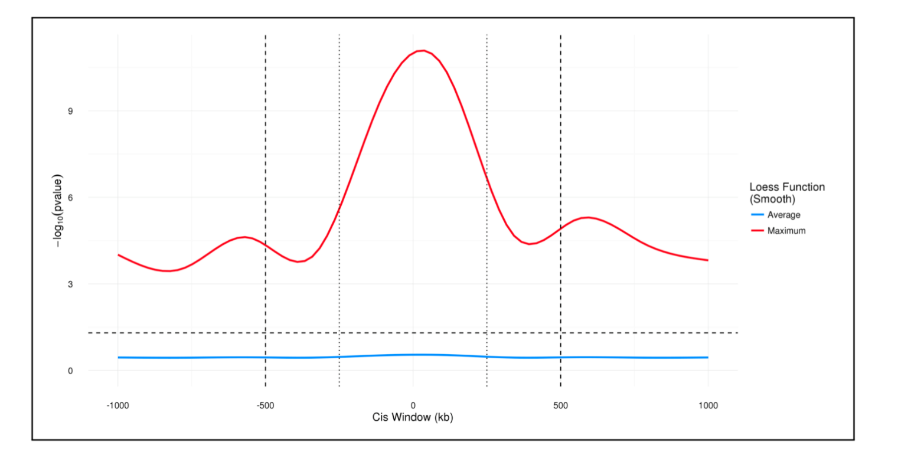
Supplementary Figure 2: Defining cis-window for eQTL. At first cis-window was defined as 1 Mb between SNPs and expression probes and then reduced to 500 Kb based on the observed p-values distribution

Slide 3
Supplementary Figure 3
Cell Junction - CC
ARFGEF2
BCR
DDX58
F11R
RAPGEF2
CADM1
RGS14
SYNM
CAMP1
Shared 519 genes between datasets
Gene ontology:
Biological process (BP)
Molecular function (MF)
Cellular component (CC)
Positive regulation of GTPase activity - BP
AKAP9
ARFGEF2
BCR
F11R
RAPGEF2
DOCK9
FNBP1
RGS14
RABEP1
SPTBN5
SPATA13
G-protein coupled receptor activity - MF
CASR
OR7D2
SCTR
Glutathione metabolic process BP
CLIC6
CTNS
GSTM3
GSTT1
GSTT2
SNARE Complex - CC
GOSR2
SNAP29
STX8
VAMP1
Supplementary Figure 3: Gene ontology annotations for of eQTL genes. An overview of the most significant gene ontologies using the DAVID software tool. Gene ontologies refer “Biological Proces”, “Molecular Function” and “Cellular Localisation”.

Slide 4
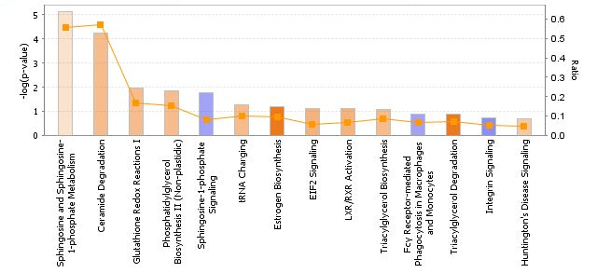
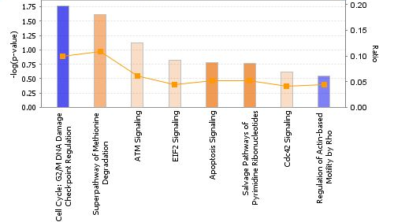
a.
b.
Supplementary Figure 4: Pathways analysis by IPA in OD and PPP islets. A bar chart illustrating the pathways identified using IPA for (a) OD and (b) PPP islets. Pathways shown in orange represents a significantly up-regulated pathway and blue indicates a significantly down-regulated pathway. The orange dotted line represents the ratio of proteins identified in the dataset to the total number of proteins in the pathway.

