Slide 1
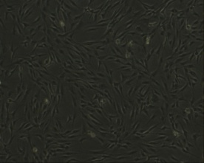
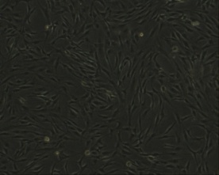
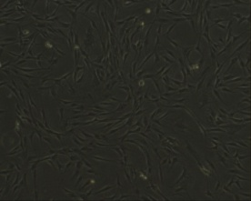
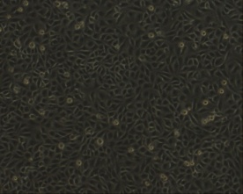
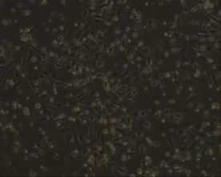
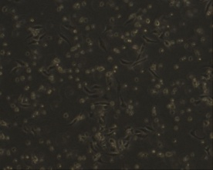

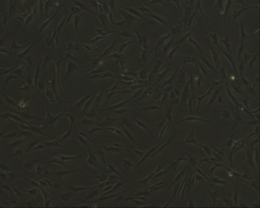
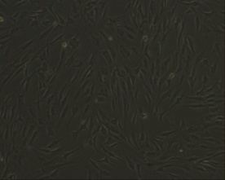
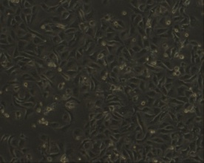
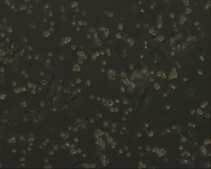
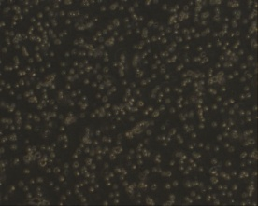
Supplementary Fig. 3. c-Met inhibitor and TRAIL treatment induces apoptosis in DDLPS cell lines.
a
ADMSC
SW872
b
TRAIL
TRAIL
0 ng/ml
2 ng/ml
5 ng/ml
0 ng/ml
2 ng/ml
5 ng/ml
0 µM
0 µM
5 µM
5 µM
c-Met inhibitor (PF)
c-Met inhibitor (PF)
1.4
1.8
1.2
0.8
0.8
1.6
4.0
4.2
2.7
36.9
1.7
56.6
0 µM
0 µM
96.4
95.6
97.5
90.6
41.2
17.3
0.3
0.2
0.2
1.2
19.3
24.5
6.3
10.9
1.5
1.9
1.0
2.0
6.3
10.9
1.86
66.8
1.2
78.0
5 µM
5 µM
76.9
96.1
96.3
76.9
9.9
3.0
7-AAD
5.9
0.5
0.7
7-AAD
5.9
21.4
17.8
Annexin V
Annexin V

