Slide 1
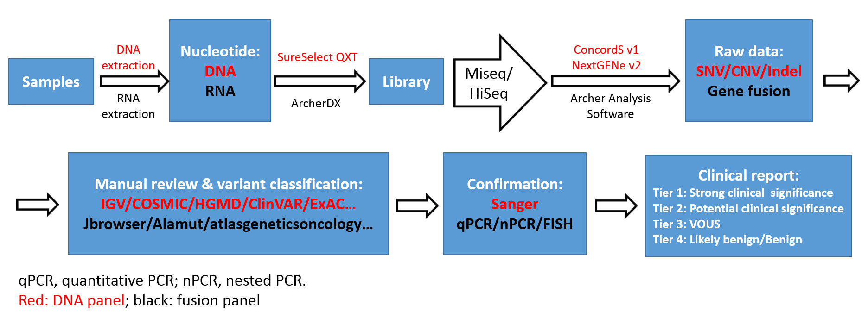
Fig. S1: Next generation sequencing workflow
Notes:
Fig. S1. Next generation sequencing workflow

Slide 2
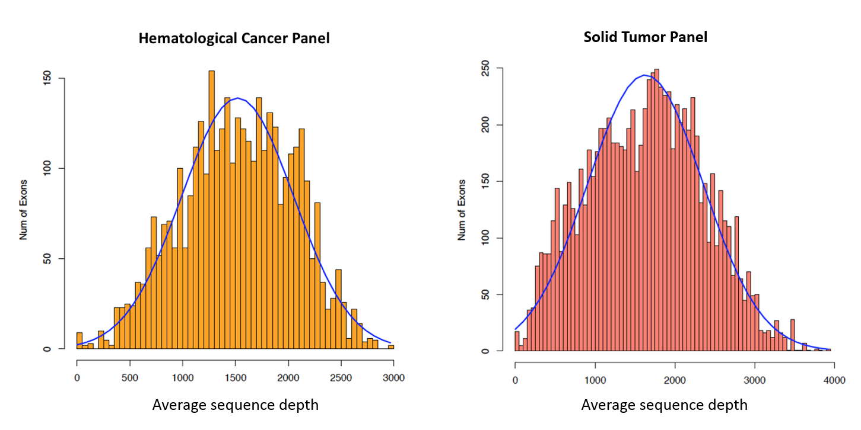
Fig. S2: Average sequence depth of exons for genes in the Hematologic and Solid Tumor Panels
Notes:
Figure S2. The histograms illustrate the average coverage of the exons of genes in the two cancer panels. The y-axis represents the number of exons and x-axis represents the average read depth as indicated in the figure. The total number of exons are partitioned into bins (bars). The height of the bars are the number of exons and where the bars locate on x-axis is the average coverage of these exons.

Slide 3
Fig. S3: Dilution studies for copy number variant detection limit
Notes:
Fig. S3. Dilution studies for copy number variant detection limit. Each chromosome is represented across the top of each panel. Dilution studies were performed from 100% tumor sample (upper left) creating samples with 50% tumor (upper right), 30% tumor (lower left), and 20% tumor (lower right). Copy number variants evident in the top two panels are discernable at 30% tumor (especially when considered the B-allele frequency) but are largely lost when examining 20% tumor. Abbreviations: BAF = B-allele frequency

Slide 4
Fig. S4: Frequency of Tier 1 or 2 variants detected in 101 genes across all tumor types
Notes:
Fig. S4. Frequency of Tier 1 or 2 variants detected in 101 genes across all tumor types. Genes are represented across the X axis and frequency (number of variants detected per gene across all cases) is represented on the Y axis.

