Slide 1
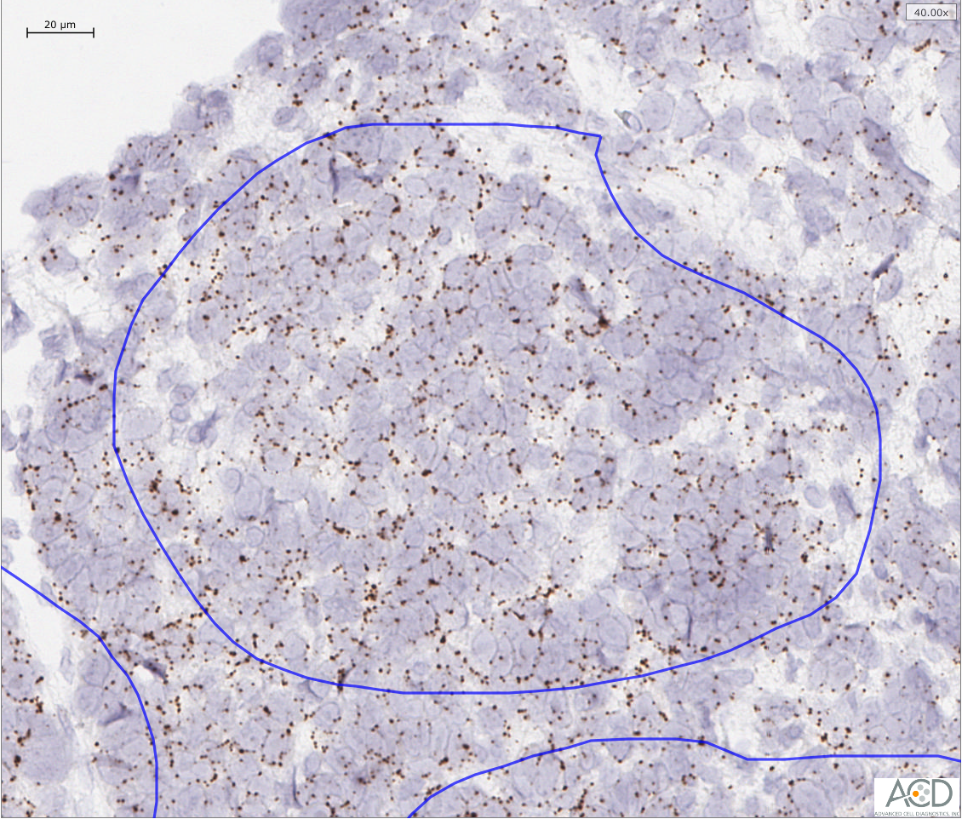
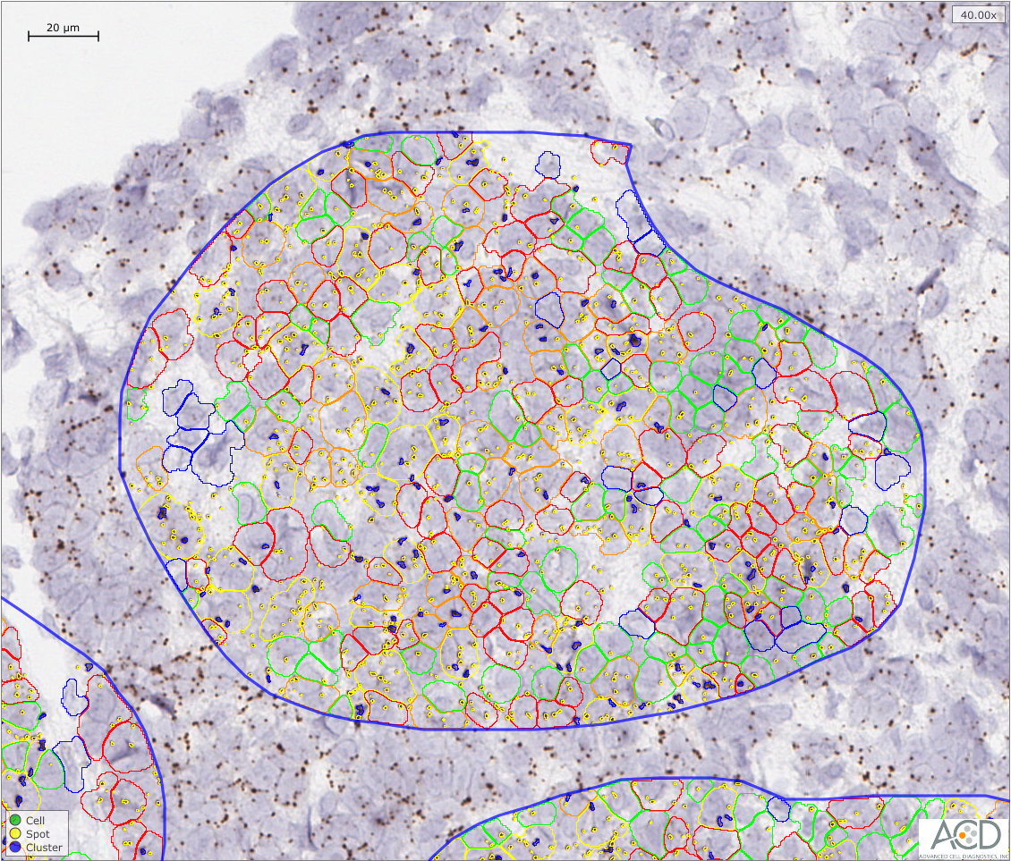
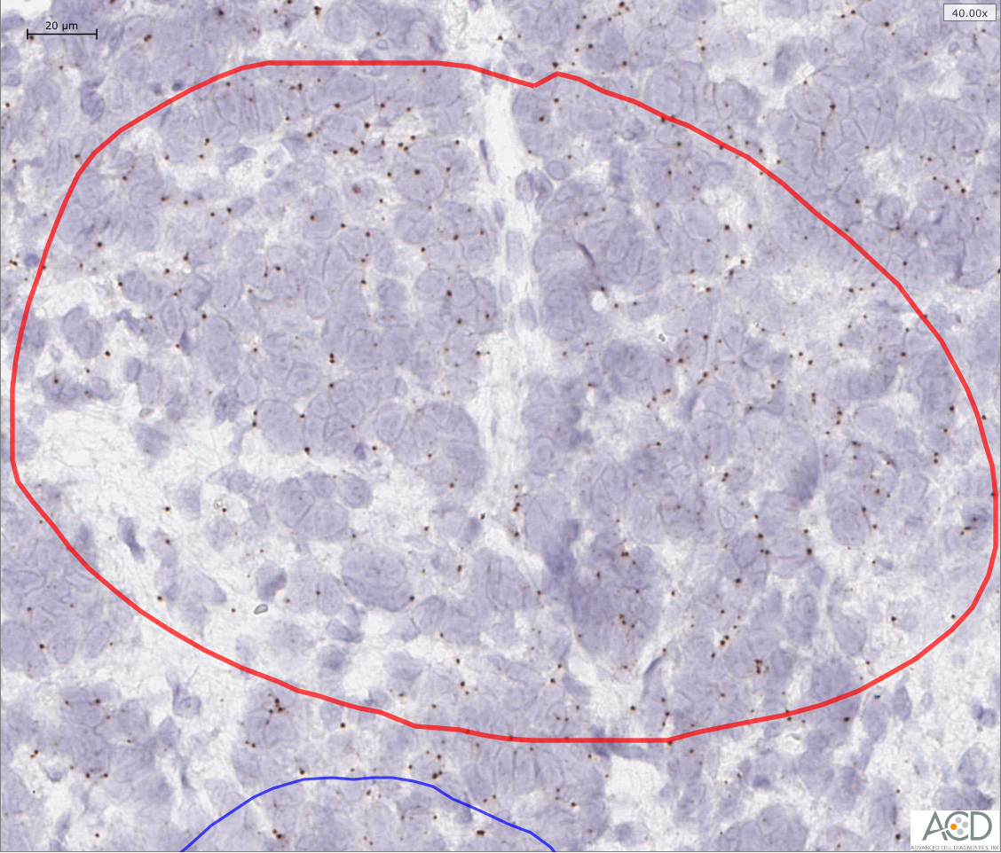
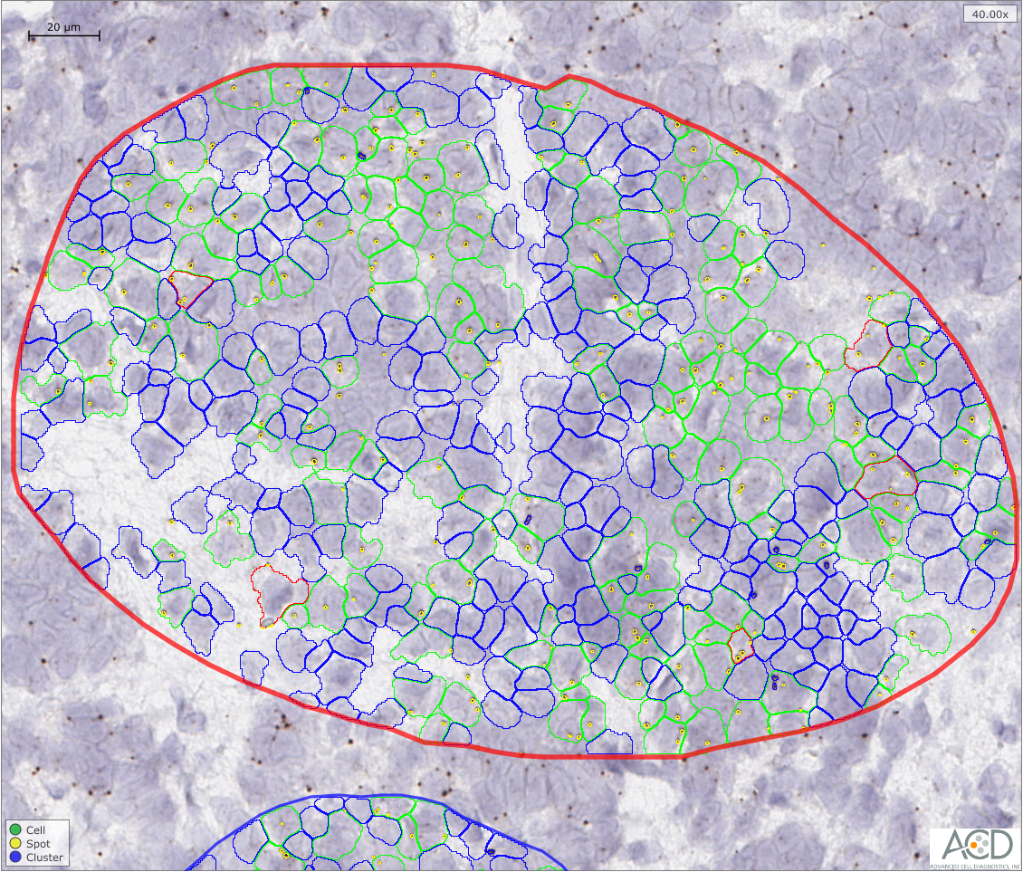
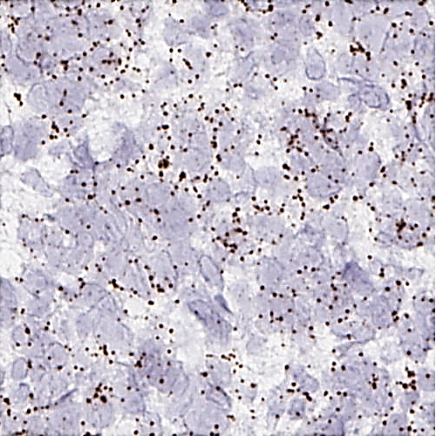
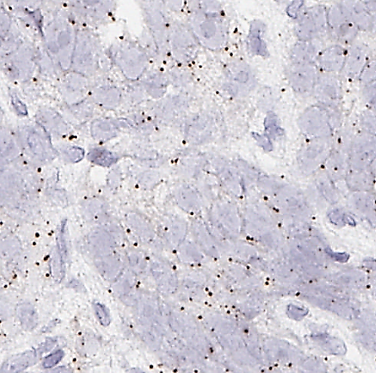
Figure S1
A
Quantified AR-FL and AR-V7 (SpotStudio)
B
BaseScope
1 ZZ AR-E7/E8
BaseScope
1 ZZ AR-E3/CE3
C
1 ZZ AR-E7/E8
1 ZZ AR-E3/CE3
3.28
0.63

Slide 2
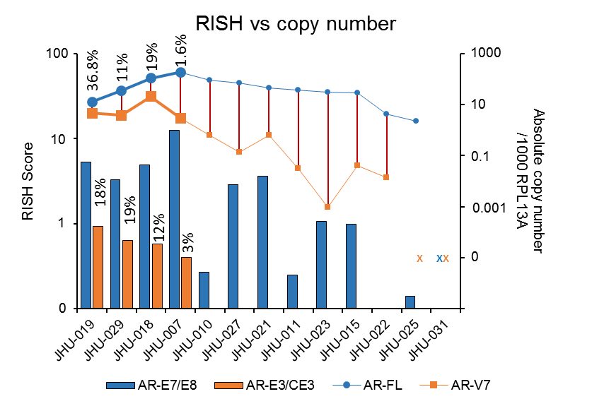
Figure S2
A
B

Slide 3
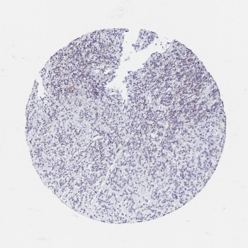
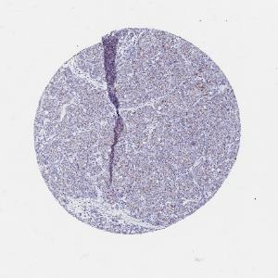
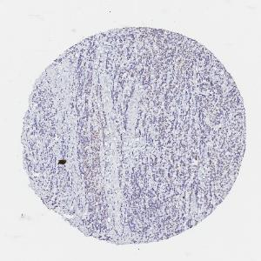
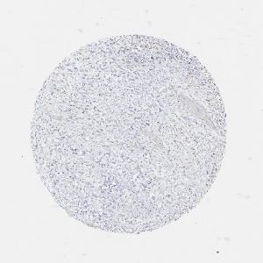
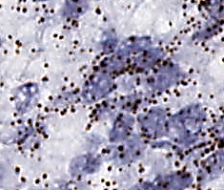
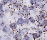
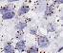
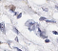
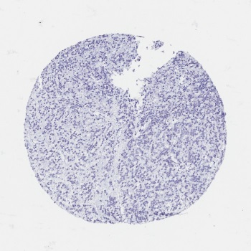
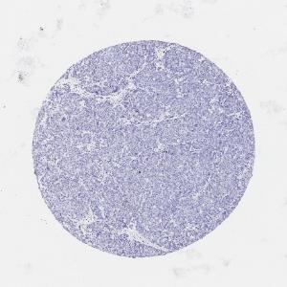
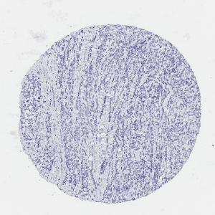
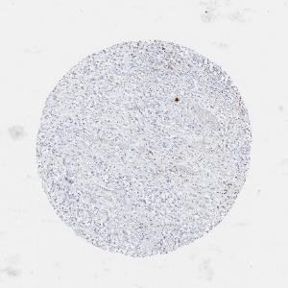
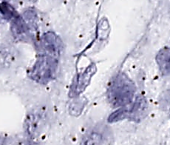
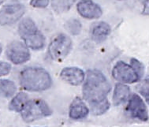
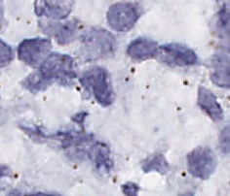
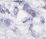
Figure S3
A
13-104M5_Kidney
14-053K1_LN
13-104K7_LN
13-117H8_LIVER
1 ZZ AR-E7/E8
10.73
6.54
4.14
0.00
1 ZZ AR-E3/CE3
1.08
0.28
0.54
0.00
B
C
 | AR-FL |  | AR-V7
ID | exon 7-8 | AR-E7/E8 RISH | exon3−CE3 | AR-E3/CE3 RISH
13-104K7_LN | 33 | 4.14 | 25 | 0.54
13-117H8_LIVER | 3 | 0 | 0 | 0
14-053K1_LN | 76 | 6.54 | 7 | 0.28
14-031L2_PLEURAL | 12 | 13.1 | 0 | 0.56
14-039K4_LIVER | 1 | 0 | 0 | 0
14-043H6_LIVER | 203 | 23.64 | 0 | 0.2
14-053H3_LIVER | 220 | 9.3 | 7 | 0.13
Pearson r correlation P-value | R²=0.6748 P>0.05 |  | R²=0.5536 P>0.05

Slide 4
Figure S4

Slide 5
Figure S5
A
B

