Slide 1
Primer pairs used for prophage detection
Each of the 14 Multiplex PCR designed to detect prophages A to F used :
1 primer’ pair specific of a prophages group
1 primer’ pair amplifying dltR, a GBS house keeping gene.

Slide 2
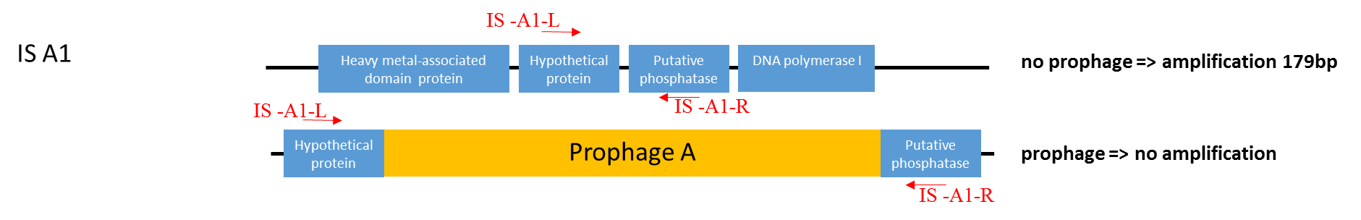
insertion site IS A1
ISA1
The Multiplex PCR designed to detect the insertion site IS A1 used
1 primer’ pair specific of IS A1
1 primer’ pair amplifying dltR, a GBS house keeping gene.

Slide 3
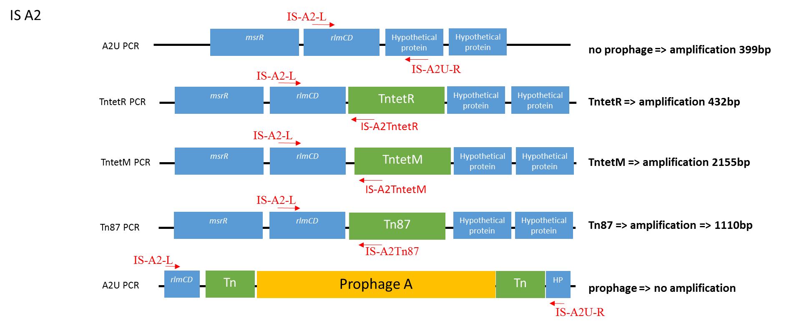
insertion site IS A2
ISA2
Each of the five Multiplex PCR designed to detect the insertion site IS A2 used
1 primer’ pair specific of the insertion site
1 primer’ pair amplifying dltR, a GBS house keeping gene.

Slide 4
IS A2 (S 89M)
araK
msrR
rlmCD
Tn
Prophage A
Tn
HP
HP
HP
ampH
1- rlmCD
2- Hypothetical protein
3- mepA
4- RNA polymerase
5- pknB
6- Hypothetical protein
7-Cna protein B-type domain protein
8-Hypothetical protein
1
2
3
4
5
6
7
8
388bp
311bp
249bp
213bp
Each of the five Multiplex PCR designed to detect the insertion site IS A2 used
1 primer’ pair specific of the insertion site
1 primer’ pair amplifying dltR, a GBS house keeping gene.
distance between stop codon of first ORF and start codon of second ORF

Slide 5
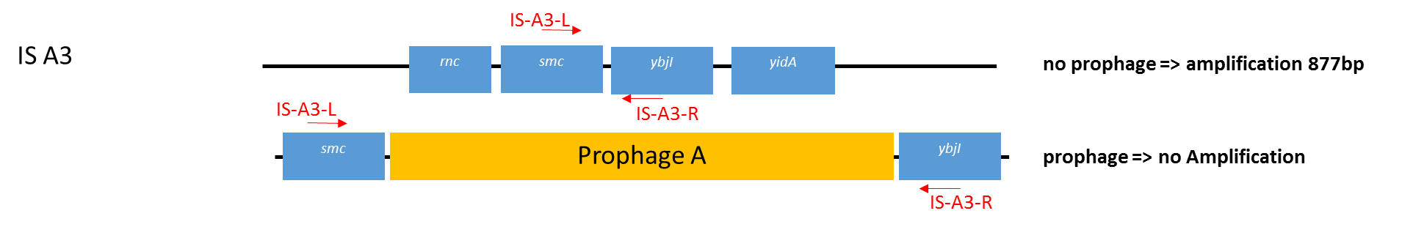
insertion site IS A3
The Multiplex PCR designed to detect the insertion site IS A3 used
1 primer’ pair specific of IS A3
1 primer’ pair amplifying dltR, a GBS house keeping gene.

Slide 6
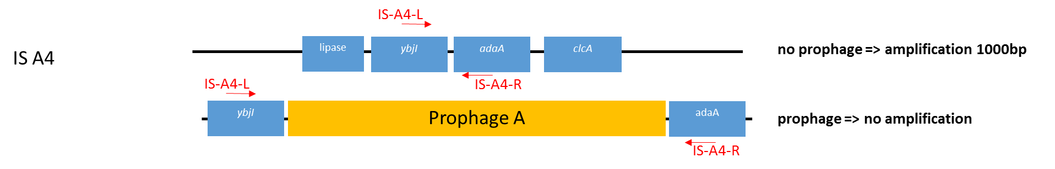
insertion site IS A4
ISA4
The Multiplex PCR designed to detect the insertion site IS A4 used
1 primer’ pair specific of IS A4
1 primer’ pair amplifying dltR, a GBS house keeping gene.

