Slide 1
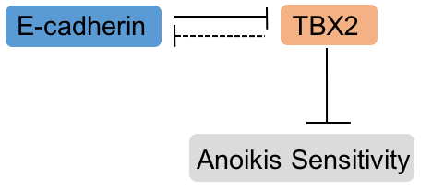
A
B
Treatment | FC (Anoikis)
E-cad OE | 1.33 +/- 0.01
TBX2 KD | 1.45 +/- 0.08
Both | 1.61 +/- 0.03

