Slide 1
Supplemental Figure 1: Sample trajectory plots showing good convergence of the three MCMC chains for select parameters.

Slide 2
Supplemental Figure 2: Cross-reactivity assessment: Dose-response curves of each individual biomarker in the singleplex and multiplex format superimpose each other over the entire dynamic range, indicating negligible cross-reactivity.

Slide 3
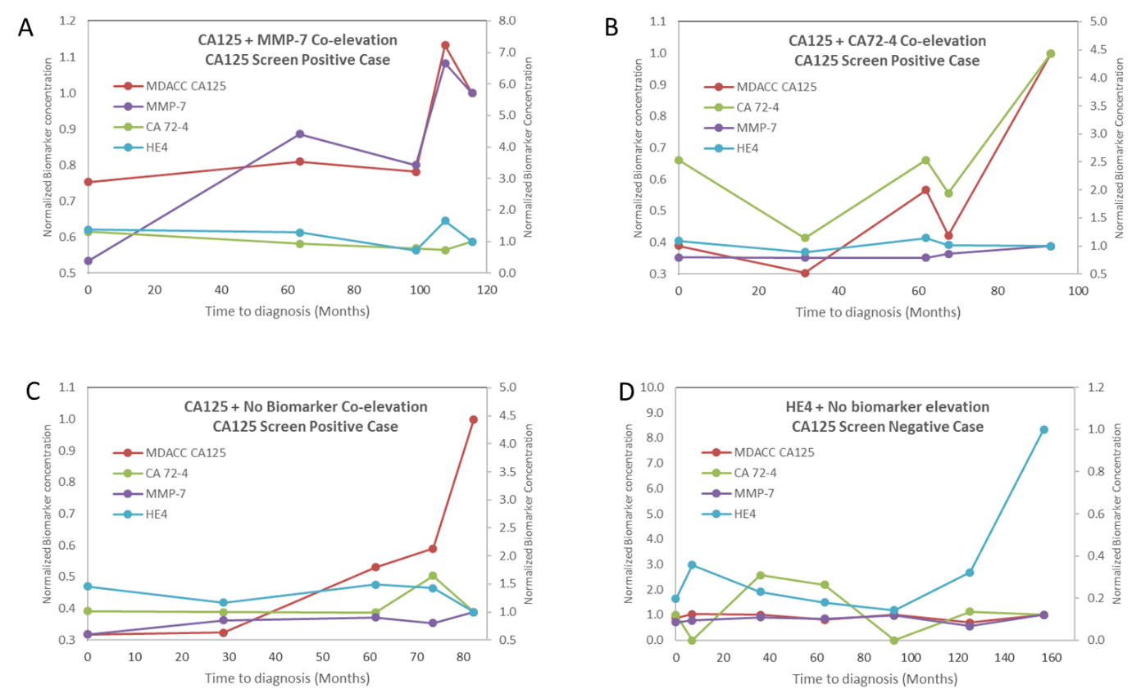
Supplemental Figure 3: Additional multi-marker longitudinal profiles representative of various biomarker patterns encountered in the study.

